Slide 1
Where do we stand?
Current status of nuclear weapons in our world, and the recent developments that present new challenges
Fact sheet presented as slide show to meeting of
No More Bombs
Anacortes WA, April 5, 2019

Slide 2
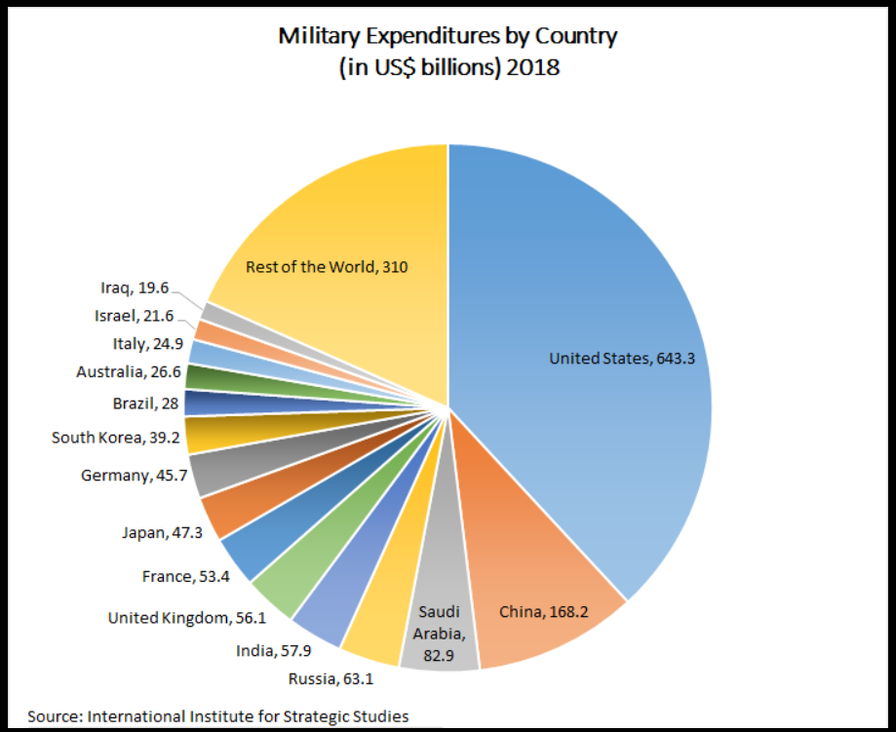
US Military Budget 2019
$686 Billion

Slide 3
9% of the US Military Budget is Nuclear Weapons
Defense Department: nuclear weapons deployment
$50 Billion
Submarines, ICBMs, Bombers
And all the warheads they carry
Department of Energy: nuclear weapons research and development
$12 Billion
Upgrade existing weapons and create new ones, including “low yield tactical weapons”
And waste disposal

Slide 4
US Nuclear Weapons Arsenal
There are now 450 ICBM silos, in which 400 ICBMs and as many warheads are deployed.
The 50 empty silos are “kept warm” so missiles can be reloaded if necessary.
The 400 ICBMs carry one warhead each – either a 300-kiloton W87/Mk21 or a 335-kiloton W78/Mk12A.
They can be upgraded to carry three independently targetable warheads each.
for a total of 800 warheads available for the ICBM force
The US Navy has now 212 deployed submarine-launched ballistic missiles (SLBMs),
Combined, the submarines carried 945 warheads – an average of four to five warheads per missile,
or nearly 90 warheads on each boat. 100-kiloton enhanced W76-1, and the 455-kiloton W88.
8 of the 14 submarines are stationed at Bangor.
60 (16 B-2s and 44 B-52Hs) nuclear capable bombers, carrying
980 nuclear weapons, including 528 air-launched cruise missiles,
about 300 weapons are thought to be deployed at bomber bases.
Approximately 500 tactical B61 bombs of about 50 Kt yield remain in the stockpile.
150 are deployed at six bases in Italy, Germany, Turkey, Belgium, Netherlands.
Total, including stored but available, retired and waiting to be dismantled,
about 6500 warheads
Source: United States nuclear forces, 2018, by Hans M. Kristensen & Robert S. Norris

Slide 5
Treaties
Some successes, and one big failure

Slide 6
Nuclear Weapons Treaties
NPT 1970
Non-proliferation Treaty, multilateral, nuclear weapons states will disarm, while sharing non-military nuclear technology,
Non-nuclear states will not arm
ABM 1972
Anti Ballistic Missile Treaty, bilateral limit on “star wars” systems,
INF 1988
Intermediate and Short Range Missile Treaty, bilateral, prohibits “tactical” weapons, removes them from Europe
START 1991
Strategic Arms Reduction Treaty, multilateral, reduced US and Russia nuclear arsenal, and eliminated nuclear weapons
In Ukraine, Belarus, and Kazakhstan. Expired 2009
CTPT 1996
Comprehensive test ban Treaty, multilateral, prohibits testing nuclear weapons testing, generally observed but not ratified
New START 2010
Extended START, US and Russia further reduced nuclear arsenals to current 7000 warheads each. Expires 2021

Slide 7
Treaties at risk
INF
Both US and Russia claim the other has already violated, both are now building new short range tactical “low yield” warheads and delivery systems
US building 1600 W76-1 warheads, could be deployed in Europe by the end of 2019
New START
Will expire in 2021, unless US and Russia agree to extend it. No negotiations yet.

Slide 8
Congressional action
Hold the Low-Yield Nuclear Explosive Act, or Hold the LYNE Act, introduced by Rep. Ted Lieu (D-CA-33) and Sen. Ed Markey (D-MA), which would prohibit President Trump's new proposed warheads from being produced or deployed. The bill numbers are H.R. 1086 for the House and S. 401 for the Senate. Both are in the Armed Services Committees
No First Use Act
S. 272 and H.R.921
To establish the policy of the United States regarding the no-first-use of
nuclear weapons. Latest version of similar bills introduced in previous sessions.
S. 272 , Senate Foreign Relations Committee. No Washington Senators cosponsoring.
H.R. 921, House Subcommittee on Asia, Pacific, and Nonproliferation.
Washington Representatives Rick Larsen, Denny Heck, and Pramila Jayapal, have cosponsored.

Slide 9
Washington Congressional contact info:
Senator Maria Cantwell
511 Hart Senate Office Building
Washington , DC 20510
(202) 224-3441
Local office:
2930 Wetmore Ave. Suite 9B
Everett, WA 98201
(425) 303-0114
Senator Patty Murray
154 Russell Senate Office Building
Washington, DC 20510
(202) 224-2621
Local office:
2930 Wetmore Ave. Suite 9D
Everett, WA 98201
(425) 259-6515
Representative Rick Larsen (District 2)
2113 Rayburn House Office Building
Washington, DC 20515
(202) 225-2605
Local Offices:
2930 Wetmore Ave. Suite 9F Everett, WA 98201
(425) 252-3188
119 N Commercial St #225
Bellingham, WA 98225
(360) 733-4500
Representative Susan DelBene (District 1)
2442 Rayburn House Office Building
Washington, DC 20515
Local Office:
204 W. Montgomery St.
Mount Vernon, WA 98273
(360) 416-7879

Slide 10
Washington Legislature: bills introduced
Senator Bob Hasegawa introduced SJM 8006 in January. Representative Gael Tarleton introduced HJM 4008 in February.
They would put the State of Washington on record as recognizing its status as a nuclear armed state, aware of its vulnerability to devastation in the event of any nuclear war, and recommending that Congress and the president take steps to
Back Away From the Brink.
Both were read into record, but no further actions were taken, and they will probably be reintroduced next session. Here are our WA Legislators contact info:
District 40
Representative Debra Lekanoff: phone (360) 786-7800, email Debra.Lekanoff@leg.wa.gov
Representative Jeff Morris: phone (360) 786-7970, email Jeff.Morris@leg.wa.gov
Senator Liz Lovelett: phone (360) 786-7678, email Liz.Lovelett@leg.wa.gov
District 10
Representative Dave Paul: phone 360-786-7914, email Dave.Paul@leg.wa.gov
Representative Norma Smith: phone (360) 786-7884, email norma.smith@leg.wa.gov
Senator Barbara Bailey: phone 360.786.7618, email Barbara.Bailey@leg.wa.gov

Slide 11
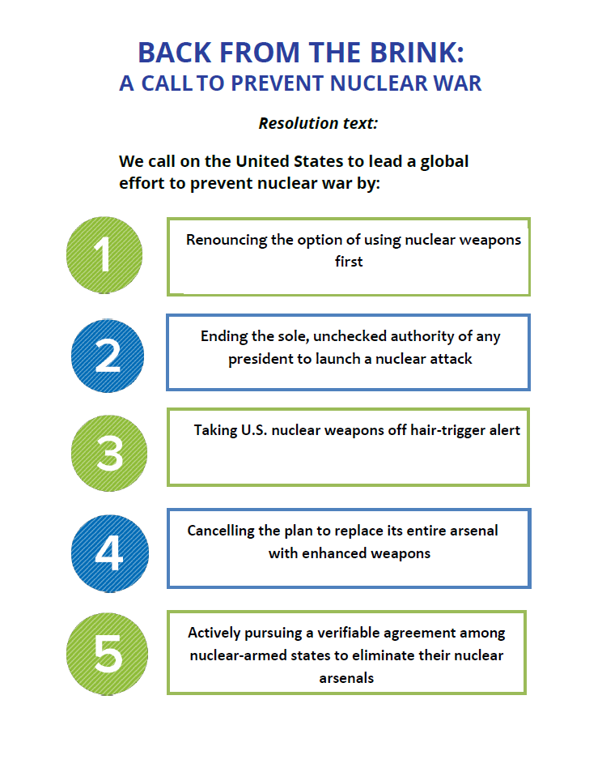

Slide 12
International Flashpoints
India - Pakistan
India’s Nuclear Arsenal about 200 warheads, many stationed near Pakistan, on high alert. Recently testing missile defense system.
Pakistan has equivalent numbers, also on high alert, and launch authorization held be several officers.
Recent Kahmir skirmishes have resulted in casualties on both sides, and tensions are high.
North Korea
Exact numbers unverified, could be 10 or more warheads, plus ICBMs. Negotiations with US have not produced anything. Reactors have been upgraded, and new reactors under construction. Potential output unknown.

Slide 13
Israel
Although Israel officially has never acknowledged its arsenal, it has 200 or more nuclear weapons, including bombs and missiles of varying destructive powers.
Iran
The head of the International Atomic Energy Agency (IAEA), which is monitoring Iran’s compliance with the 2015 nuclear deal said Iran is meeting its obligations under the JCPOA accord, despite US sanctions and withdrawal from the agreement.
Saudi Arabia
Saudi Arabia is nearing completion of its first nuclear reactor, and has not agreed to IAEA inspections, nor any restrictions on its operation. US technology and fissile material may have been already transferred to Saudi Arabia.

Slide 14
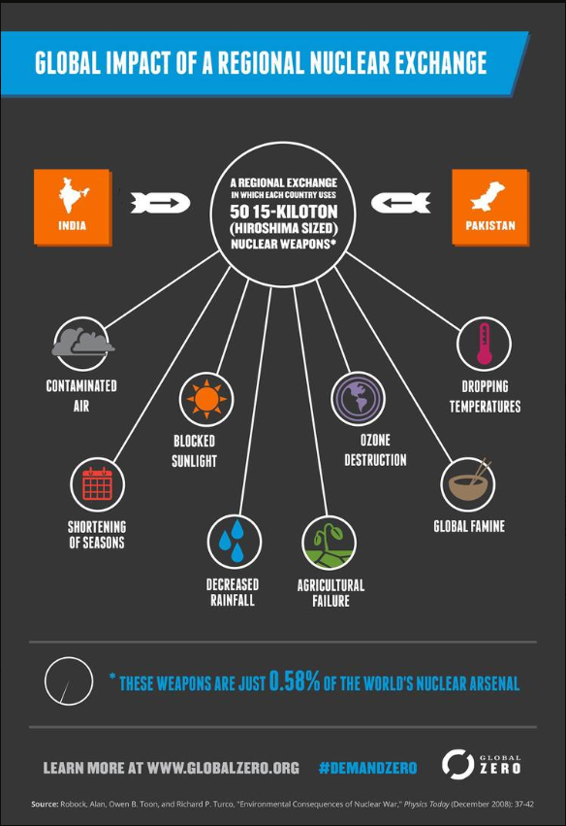

Slide 15
Local initiatives
Preliminary discussions with AHS, but nothing has come of it.
Requests for conversations with two local churches, no response.
Latest activities of WCANW:
Establish executive committee to direct their work, focusing on Education, Faith Communities, and Veterans,
With more concentrated outreach to these and other sectors. Also disinvestment advice, and legislative actions.
They seem to be having similar problems as we are.
Our movement is fragmented because there are so many equally important issues that we all are involved in, and we have not engaged the younger generations who will inherit all these problems.

Slide 16
So, What Do We Do?
We keep trying, as best we can.
www.nomorebombs.org

