Slide 1
NUCLEAR WEAPONS AND SOCIAL JUSTICE

Slide 2
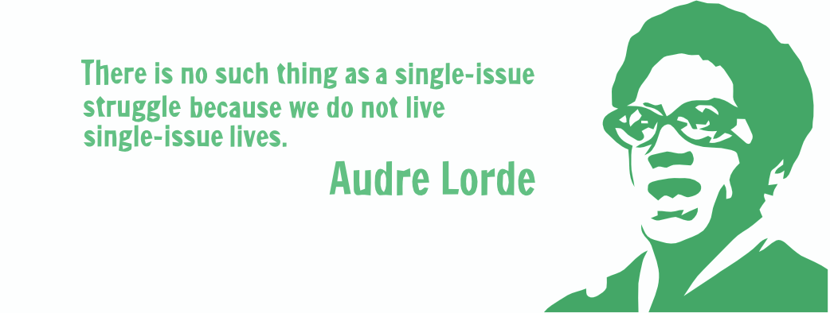
WHY FIND INTERSECTIONALITY?
Notes:
We get used to talking about issues in one particular way. We often think about what resonates with us, but not others.
another way to approach nuclear weapons as social justice issue is through intersectionality
This quote applies to nuclear weapons - women are influenced differently by nuclear weapons than men; indigenous people are influenced differently by nuclear weapons than white people. Nuclear weapons are a national security issue, a women’s issue, and a racial justice issue.
But studies have shown that this is not an issue that people relate to today – seems like an issue from another era
People today have many concerns, and want to take action, but those concerns are not generally nuclear weapons
Question for the group – what are your biggest concerns?

Slide 3
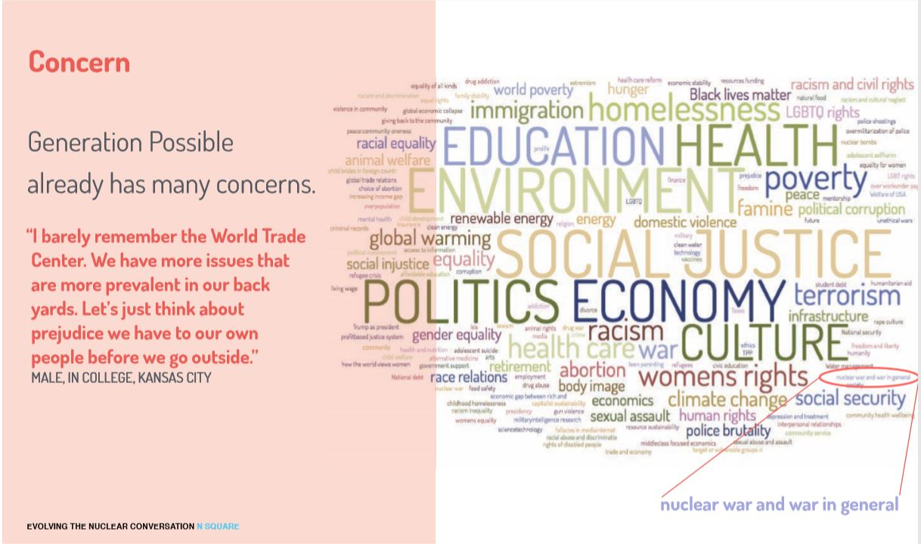
MONOLITHIC
Notes:
This is from N-square and some research they did on what issues Millennials are concerned about
The size of the word corresponds to how much people talk about this issue or care about it
Not just nuclear war, but war in general barely registers
Talking from experience, nuclear weapons was never an issue I thought I needed to be concerned about, never something I thought I would work on. It is not something that my friends worry about or think about on a day-to-day basis.
So, it’s crucial to be able to connect nuclear weapons to other issues that people care about today
But beyond just being able to connect with people, it’s the right thing to do. The stories of people most hurt by nuclear weapons deserve to be told and must not be sidelined
Here is a link to the report that this image comes from.

Slide 4
THE MONEY
$1.7 trillion over 30 years, with inflation
$4.6 million every hour, for the next 30 years
WHAT COULD WE SPEND THAT MONEY ON INSTEAD?
Notes:
We are set to spend a massive amount of money on nuclear weapons: $1.7 trillion over 30 years, $4.6 million every hour
What does $4.6 million/hour mean to people who are struggling financially? What kind of social programs could this fund?
Children’s health care, early education, raising minimum wage, affordable housing, etc
Paraphrasing from Director at El Centro de la Raza – This Admin. is cutting “bread and butter” programs – food stamps, money for schools, affordable housing, but can find the money for nuclear weapons. This is infuriating.

Slide 5
10 YEARS OF NUCLEAR WEAPONS FUNDING
School lunches for one million students, for 10 years
4 years of community college for 9 million students
Early childhood education for every 3-4 year old in the US
$400 billion for nukes
$5 billion
$120 billion
$260 billion
Notes:
It’s still hard to visualize this money. Over 10 years, not including inflation – $400 billion
Ex: Thinking about what I’d like to see money go towards, I also think about education
Math isn’t perfect, but roughly:
School lunches for 1 million students, for 10 years, would cost about 5 billion
Obama made a plan to pay for community college for 9 million high school students – would have cost roughly $120 billion over a decade to provide 4 yrs of school
then keep going - $260 billion would provide early childhood education for every 3-4 yr old in the US
Then we’d still have $15 billion left over
So, we could provide free college across the country and early childhood education for every child in the US…or make the deadliest weapons ever created even deadlier, only hoping that they will never be used

Slide 6
NUCLEAR COLONIALISM
“Nuclear colonialism is a system of domination through which governments and corporations disproportionately target and devastate indigenous peoples and their lands to maintain the nuclear production process.” - Danielle Endres, Assistant Professor of Communication at the University of Utah
People of color, indigenous people, and colonized peoples are most often the victims of nuclear weapons production and use, and are inadequately compensated by the governments and corporations that perpetrated this violence.

Slide 7
CRADLE TO GRAVE
Notes:
Spending on nuclear weapons is only one piece of the puzzle
The entire process of creating our nuclear weapons, to their testing and use, to the legacy they leave behind, is done at the expense of the people involved, often communities of color and low income populations
I’m going to take some time to look at some examples of the injustices associated with these stages
Cradle to grave – life cycle of a product

Slide 8
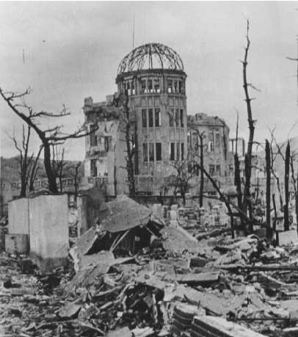
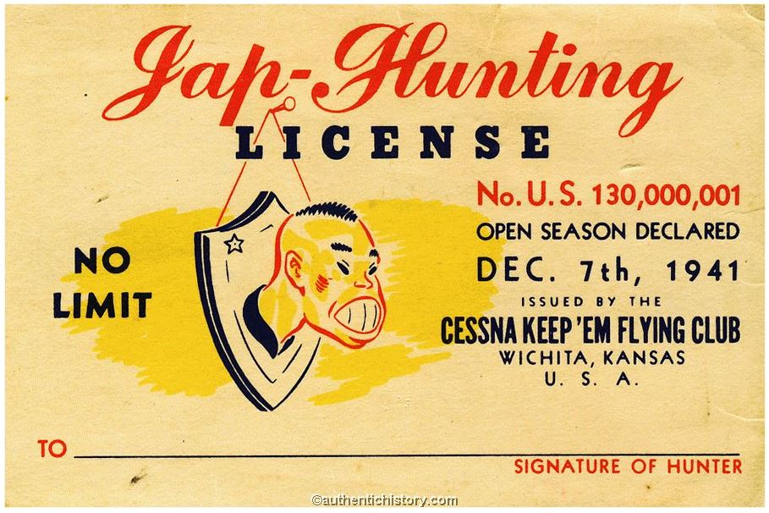
USE IN JAPAN
Notes:
Nuclear weapons have only ever been used in conflict by the United States
Used on Hiroshima and Nagasaki in 1945, in an effort to end WWII. It resulted in over 200,000 deaths
Indiscriminate – killing combatants and non-combatants, although the purpose of nuclear weapons are not to be used on the battlefield, but to destroy cities and infrastructure. Many have argued that their use was racially motivated – propaganda and anti-Japanese sentiment was extreme at that time. (For example, why were they not used on European enemies during WWII?)
WPSR would argue that because of the nature of their destruction – wiping out entire populations – that they threaten genocide, especially when considering that our current weapons are up to 75 times more destructive than those used in Hiroshima and Nagasaki
Lots of debate over their use in 1945, but there is lots of evidence suggesting that they were not necessary to end the war

Slide 9
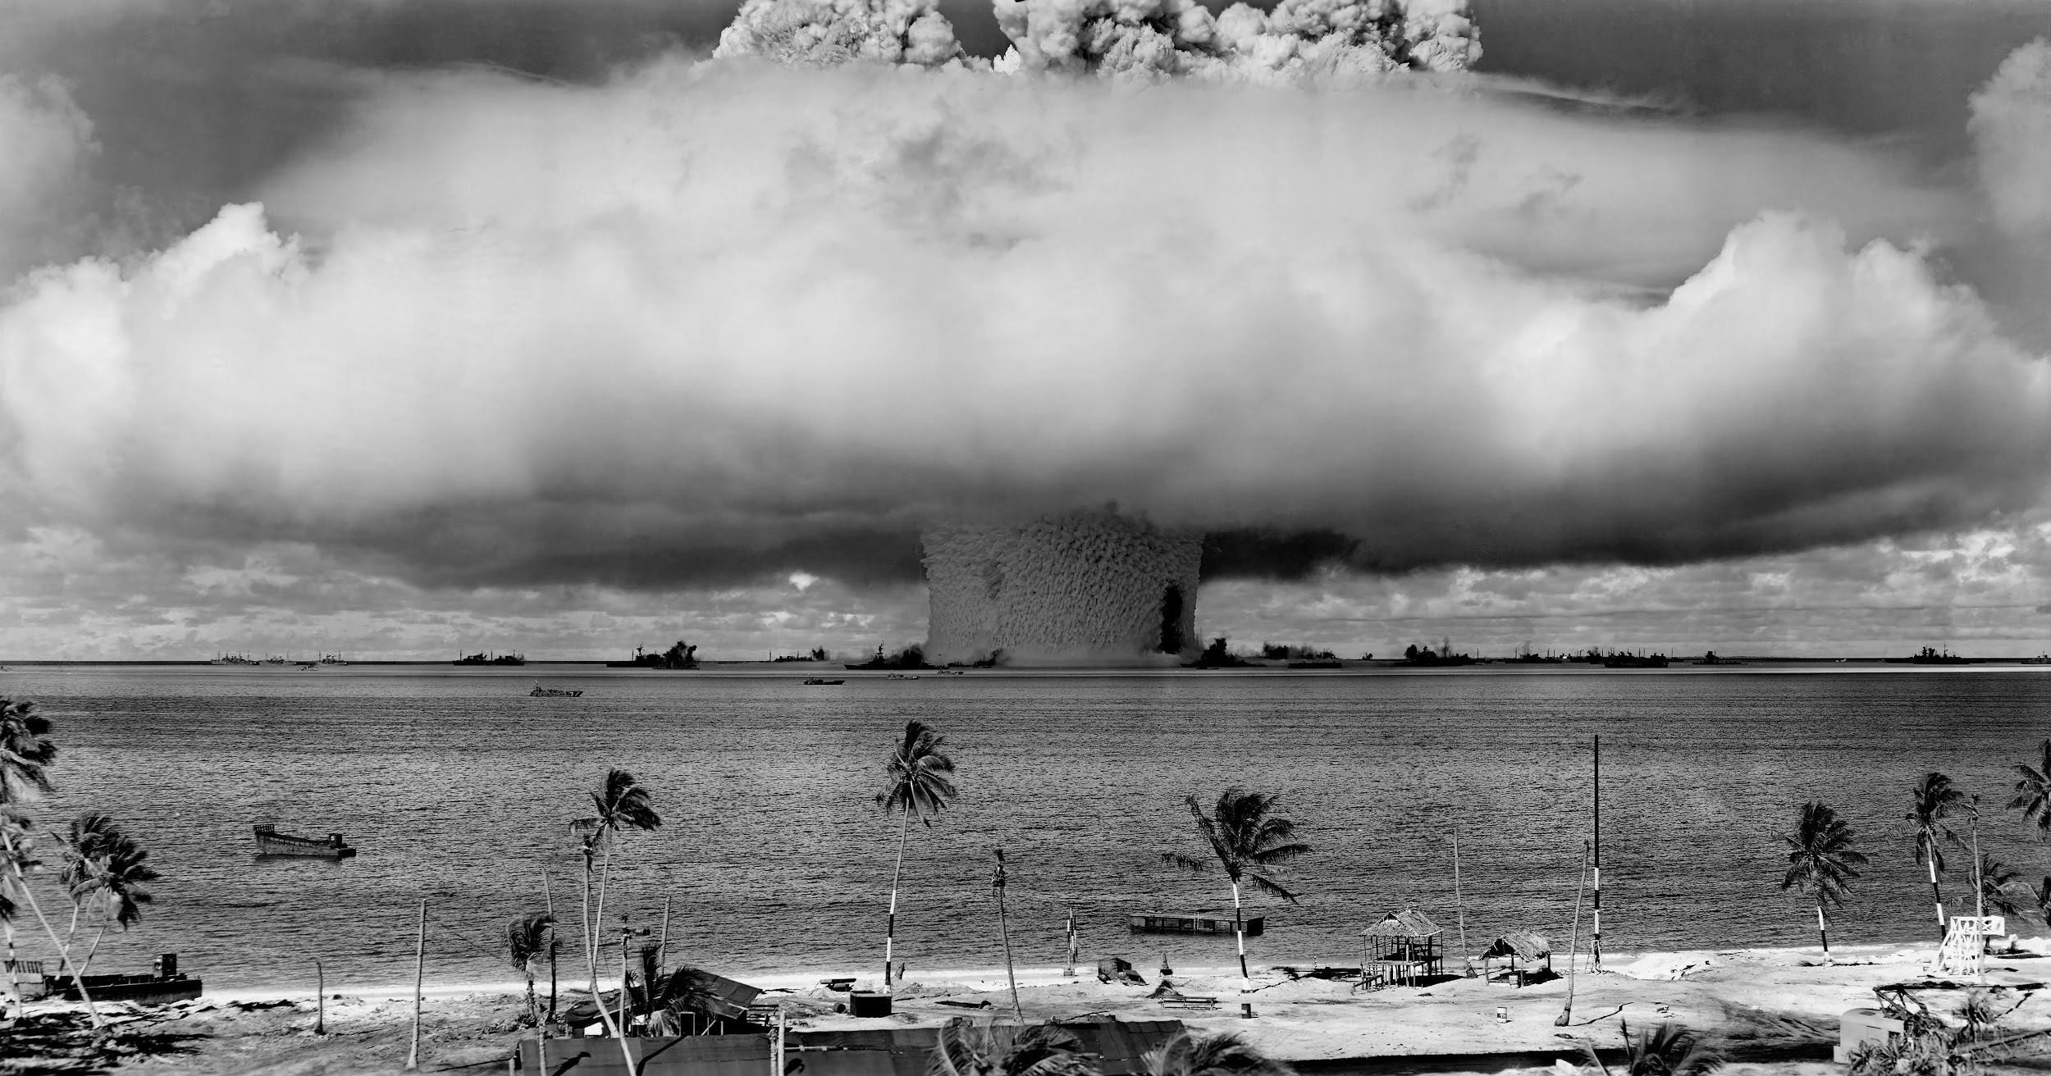
GLOBAL ATMOSPHERIC TESTING
Notes:
globally, testing was almost always done in colonized countries or on minority lands. US - Marshall Islands, Native American land.
French - tested in the Algerian Sahara, French Polynesia. UK - on aboriginal lands in Australia
It was decided that people of color were acceptable sacrifices for the production of nuclear weapons
International Physicians for the Prevention of Nuclear War estimated that testing will eventually result in 2.4 million cancer deaths
200,000 people died in Hiroshima and Nagasaki, but many more victims are average people who were incidentally exposed

Slide 10
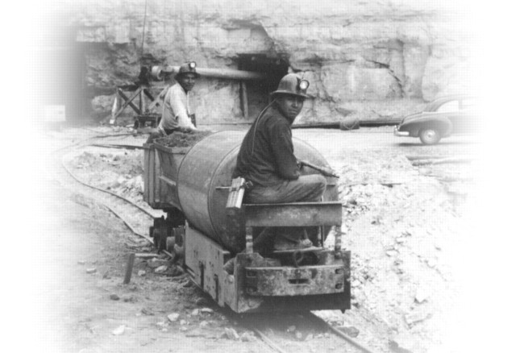
URANIUM MINING - MIDNITE MINE
Notes:
I also want to look at some local examples of groups who have been harmed, right here in WA state
Midnite Mine - uranium mine on the Spokane Tribe of Indians Reservation
Like testing, globally almost all uranium mining has happened in colonized countries or on indigenous/minority lands
At the Midnite mine, workers were not told of the health consequences of uranium mining - would bring materials home, like clothing covered in radioactive dust, balls used to crush uranium as toys for their kids
The mine closed in 1981, but clean up just began in 2017, 36 years later. During that entire time, the abandoned mine was likely poisoning land + people living there.
There is a program to compensate workers + residents, but no one has received any compensation because most people don’t even know the program exists
Communities are still bearing the health and environmental burdens of this today

Slide 11
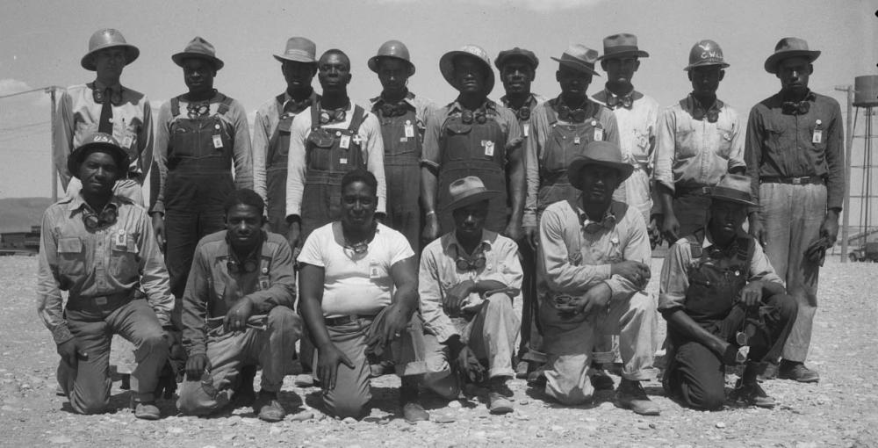
HANFORD
Notes:
Hanford was created in 1940’s in E. WA to produce bombs in WWII. The plutonium used in the bomb dropped on Nagasaki was produced at Hanford, as well as the first atomic bomb ever tested. Produced most of the plutonium used in the 60,000 nuclear weapons the US made.
Native nations displaced to create Hanford, given no compensation: Wanapum People, Yakama Nation, Confederated Tribes of the Colville, Confederated Tribes of the Umatilla Reservation, and the Nez Perce
Rampant segregation and discrimination during production - black workers were given the worst paying and most dangerous jobs. One woman called it the “Mississippi of the North”
Today, safety culture is deeply flawed, putting clean-up workers at risk, treated as disposable. Earlier this year, was found that 42 workers were exposed to plutonium, which will lodge in their body, emitting radiation, for the rest of their lives
Relatively poor community - one of the only/best employers in the area - people don’t have other options. They are the ones that have to risk their lives now to clean up waste from nuclear weapons production.
Workers feel unable/uncomfortable bringing forth safety concerns. When they do, it is often under the condition of anonymity, for fear of retaliation.

Slide 12
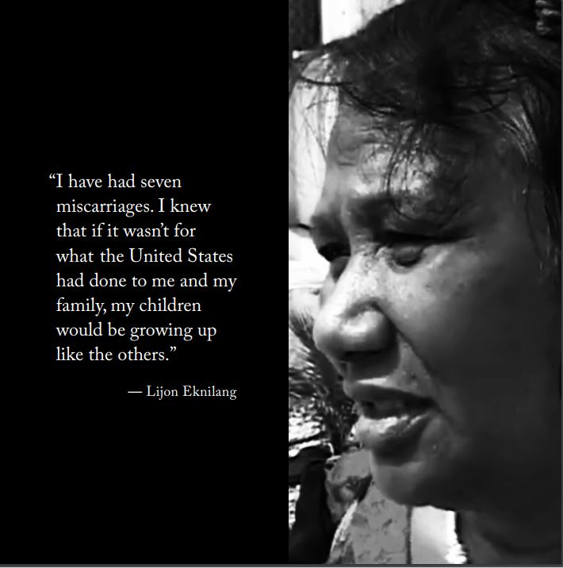
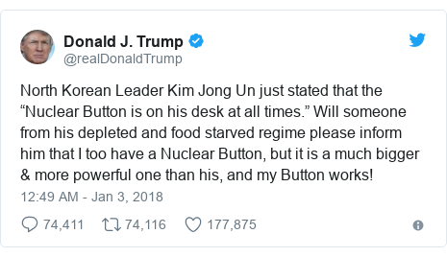
GENDER AND NUCLEAR WEAPONS
Notes:
This is also a women’s issue, in many different ways.
Women are more vulnerable to the health effects of ionizing radiation from nuclear detonations. This is written into the UN Treaty on the Prohibition of Nuclear Weapons: Cognizant that the catastrophic consequences of nuclear weapons cannot be adequately addressed... and have a disproportionate impact on women and girls. Quote from woman in Marshall Islands.
Beatrice Fihn at ICAN has written about the connection between toxic masculinity and nuclear weapons. This tweet from Trump is an excellent example of masculine posturing.
This kind of size comparison is almost funny, until you remember that he’s talking about weapons that could destroy all life on the planet, and then it feels devastatingly juvenile and scary.
Huge gender imbalance in nuclear disarmament circles - dominated by older white men, and even though there are more and more women and people of color, they have to fight to have their voices heard.

Slide 13
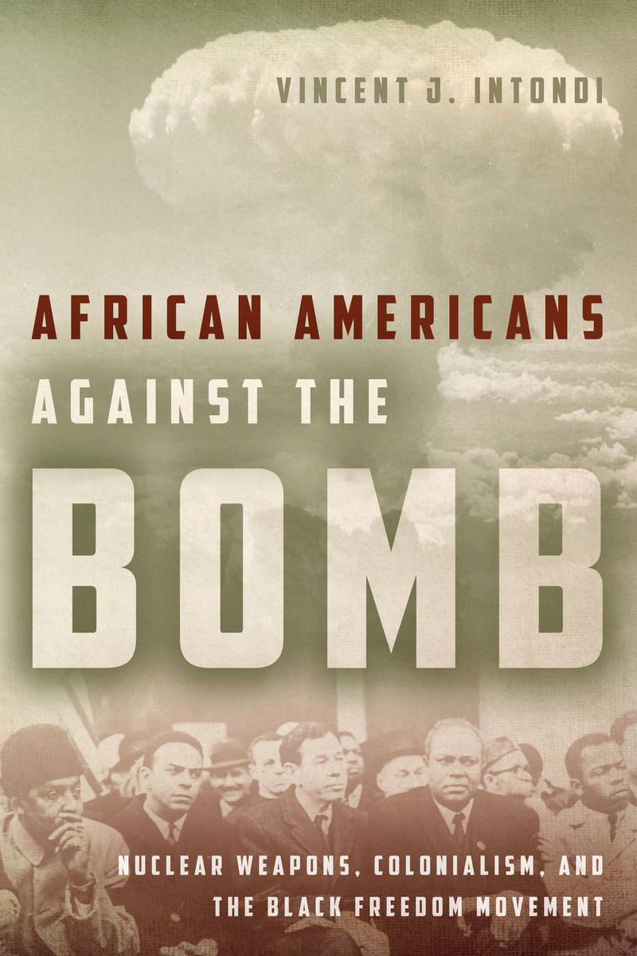
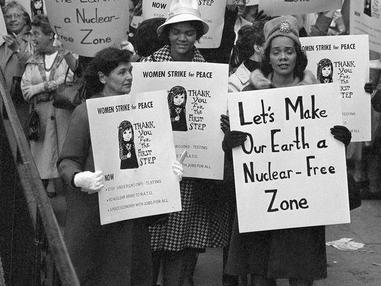
HISTORY OF INTERSECTIONALITY
Notes:
Good news is that there is a rich history of intersectionality on these issues
People have been making these connections for decades:
seeing how racism was involved in the use of nuclear weapons in Japan, how violence abroad against people of color was an extension of violence at home towards people of color
how mining uranium + testing nuclear weapons in non-white, poor nations + on land of people of color in the US was another manifestation of colonialism
how nuclear weapons and military spending was siphoning money from social services and programs desperately needed by black communities
Many prominent black activists that we celebrate for their work on civil rights were also championing peace and nuclear weapons abolition, like Martin Luther King, Jr, Bayard Rustin, Paul Robeson, Langston Hughes, Lorraine Hansberry, and Coretta Scott King

Slide 14
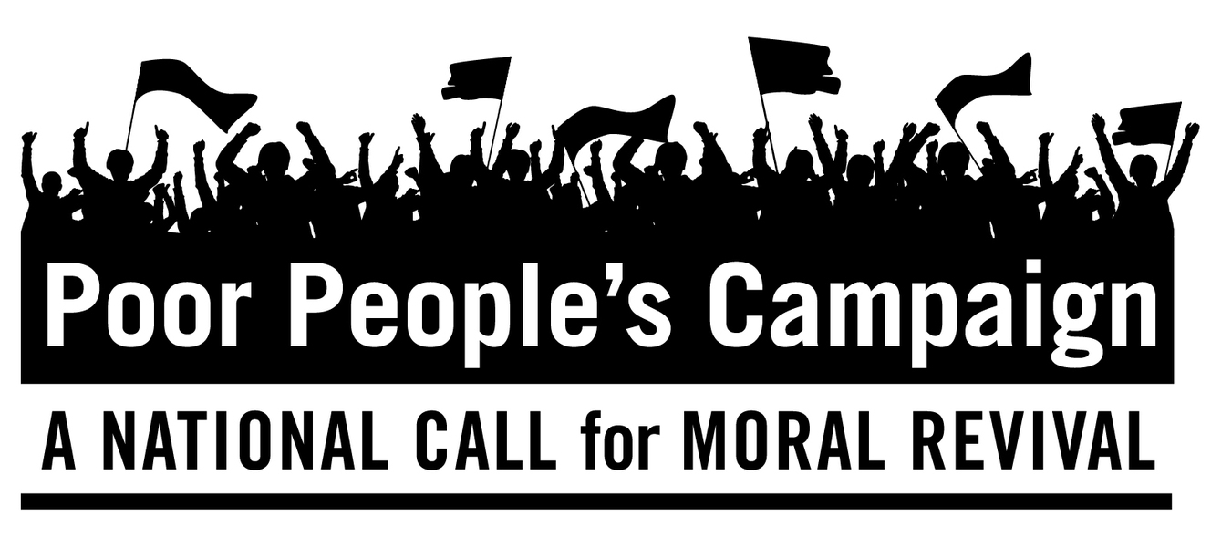
MOVING FORWARD
How can use this information to talk about nuclear weapons differently?
How can we connect with unlikely allies?
How can we support and stand in solidarity with others?
Notes:
But unfortunately, we must acknowledge a history of white activists sidelining black involvement in peace issues. From ignoring black communities in their outreach, to not sharing leadership with black activists, to insisting that civil rights activists and nuclear weapons activists should stick to their own causes, there was often a strong desire to silo these causes.
This continues today
Nuclear weapons advocacy and policy is a space largely dominated by older white men, where women and people of color often have to fight to be heard.
I see this in my own work at WPSR and with our coalition, as well as across the disarmament field, nuclear weapons activism is largely carried out by, and reaches, white activists.
And too often, we still silo our issues.
We have generally not actively worked to connect nuclear weapons issues with racial or social justice issues, and have not sought to build connections and relationships in communities of color
This is an area where we have to grow and learn. We will fail to be relevant in a new era of activism that centers on intersectionality. But also because people of color and low income communities are hit the hardest, and their stories deserve to be told, and they should be at the center of these discussions.

