Slide 1
People for Peace: the Nuclear Disarmament Network
The new arms race has mobilized a global movement of activism for the total abolition of nuclear weapons. We are a small part of this work.

Slide 2
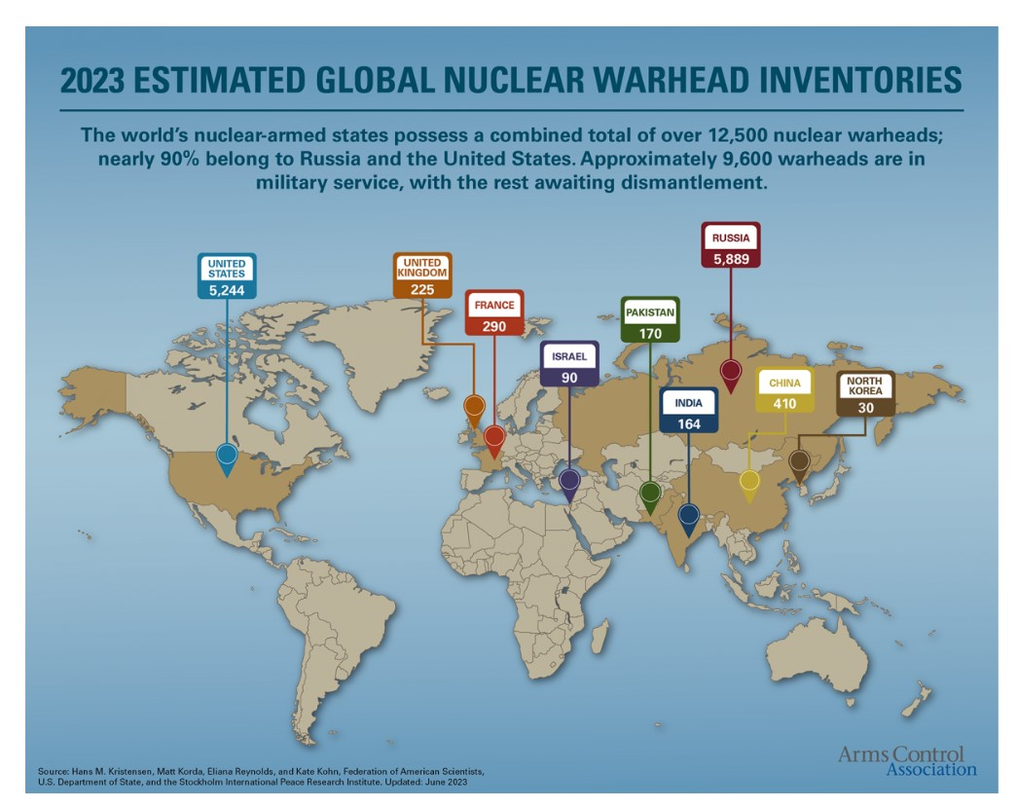
The Problem:
A New Nuclear Arms Race
How dangerous is this situation?
We don’t know in what state of readiness each of these countries hold their warheads.
For the US inventory, about 1400 are on hair trigger status, ready to be launched immediately, and the rest are in storage, but ready to be mated to their delivery systems.
We can assume that Russian warheads are similarly deployed.
Source: armscontrol.org

Slide 4
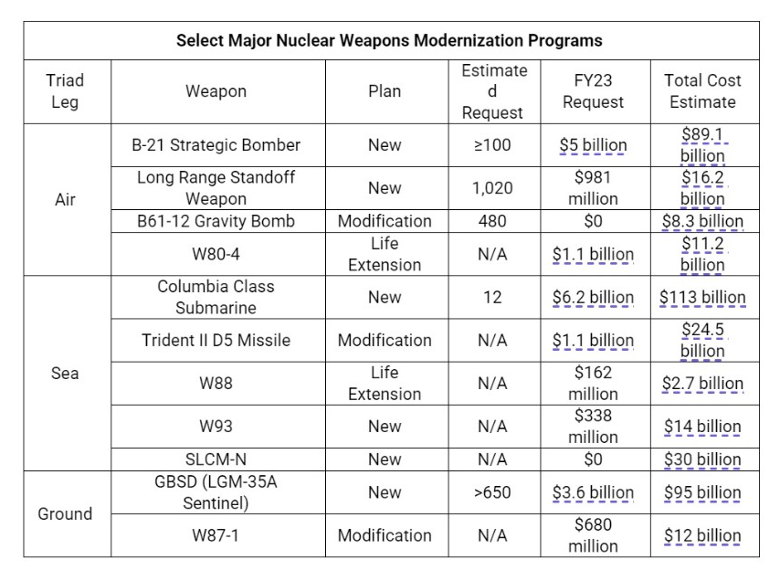
US investment strategy for new and improved nuclear weapons, as authorized in 2011, and expanded since.
Total projected cost of modernization after 30 years (2040) $ 1.7 Trillion

Slide 5
How did this happen?
In 2010, the Obama administration made a deal with Congress to fund the 30 year $1.7 Trillion “Modernization” of our nuclear arsenal in exchange for signing New START (Strategic Arms Reduction Treaty) with Russia.
Now that the U.S. has officially restarted the arms race, all the other nuclear armed nations have joined in. Russia and China are the most aggressively determined to keep up and modernize their nuclear arsenals, but UK, France, India, Pakistan, Israel, and North Korea are also upgrading their nukes and building more.
As a result, the threat of intentional or accidental nuclear war increases as well.
On top of that, NATO is expanding, now including Finland and Sweden, and every country in the organization has an agreement with the US to provide military bases for us to station our nuclear weapons in their territory. Only Ukraine and Belarus remain as buffers to European/North American expansion of the military organization which was founded in 1949 specifically to challenge Russsia.
No wonder Russia feels threatened, and so on, and so on.

Slide 7
The New Arms Race Is On!
For the last decade, we (USA) have been upgrading our stockpiles of nuclear weapons and adding new delivery systems for them all. Each annual military budget has grown by varying amounts, but now stands at about 30 % above what was allocated when New START was ratified in 2011.
2024 Military Budget is $886 Billion
2024 Nuclear Weapons Budget ( includes DOD, DOE, and NNSA) is $45 Billion.
< This graph
shows the 25 year estimated total spending on each nuclear weapon system in current modernization program.
GBSD = Ground Based Strategic Deterrence
LRSO = Long Range Standoff missile
ALCM = Air Launched Cruise Missile
NNSA = National Nuclear Security Administration (Department of Energy)

Slide 8
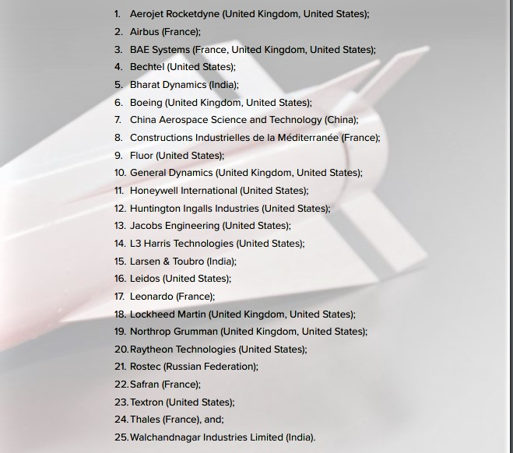
1.7 Trillion Dollars just for “Modernization”, on top of
45 Billion Dollars per year to keep up with current DOD and DOE nuclear weapons budgets
Where does that money go?
This list from Don’t Bank on the Bomb
shows the top 25 nuclear weapons producers. Parentheses indicate which nations they work for.
Northrup Grumman, Boeing,
Raytheon, Lockheed Martin, General Dynamics, Bechtel, Fluor, and Honeywell are American companies leading the profiteer parade. And there are many more.

Slide 9
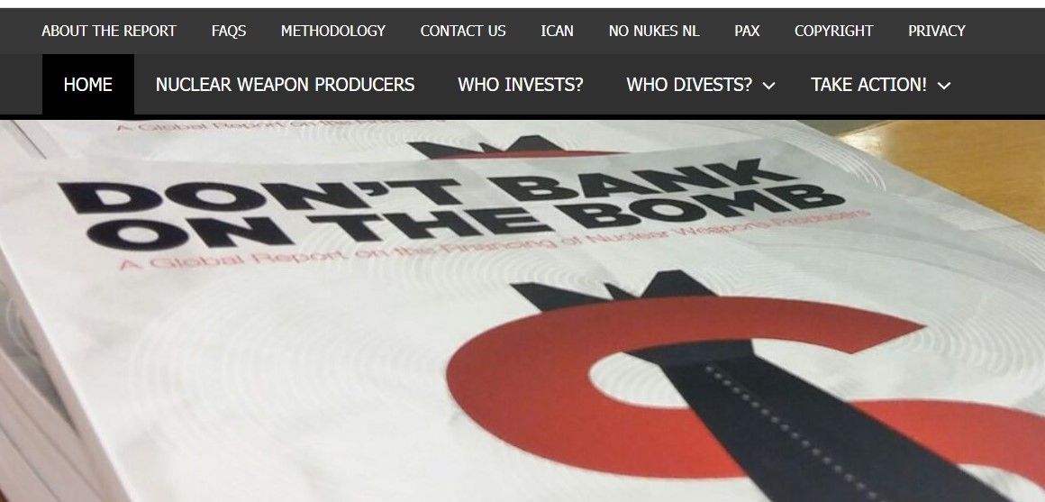
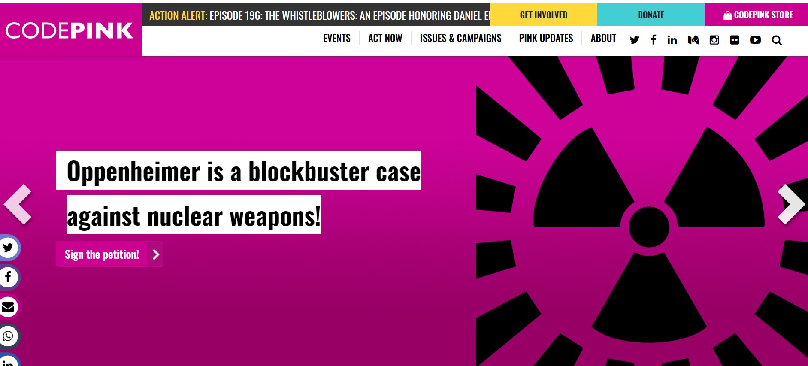
What Can We Do? Individually?
Personal and Professional Divestment
from Nuclear Weapons Producers
are major programs of
codepink.org and dontbankonthebomb.com
Any person, company, or investment fund owning shares in any of the weapons manufacturers, and their supporting companies, contributes to building and distributing these weapons of mass destruction.
Are we also responsible for the destruction these weapons inflict on nations and people, as well as the residual damage to future generations and the environment?
Divestment is the surest way to remove oneself from the process.

Slide 10
What can we do? As groups?
Depending on how deeply we each wish to involve ourselves, there are many opportunities, and the choices available have multiplied in the last few years, as more major scientific and social justice institutions have examined the issues, and concluded that the combined existential threats to life on earth, of nuclear extermination and climate change, must be prevented.
International governmental bodies like the United Nations and the International Court of Justice are focusing their efforts toward these threats, and have encouraged private and nonprofit organizations at all levels to do the same.
Each one of these organizations has a special mission to pursue, and all encourage us to join in the work they do.
UN General Assembly’s first resolution, in January 1946, was to establish a commission to deal with atomic weapons
and International Security.
The International Court was established then as well.

Slide 11
Womens International League for Peace and Freedom, established in 1915 to heal the tragedy of WW I, and prevent subsequent world wars.
United Nations founded in 1945 to prevent more world wars
International Physicians for Prevention of Nuclear War, established in 1980
↓
Physicians for Social Responsibility, founded in 1961
↓
Washington Coalition to Abolish Nuclear Weapons, 2016
People for Peace:
how the Network grows over time and space
American Friends Service Committee established in 1917
↓
Friends Committee on National Legislation, since 1943
↓
↘
→
↗
↙
←
↖
International Campaign to Abolish Nuclear Weapons, 2017
↓
TPNW
Treaty Prohibiting Nuclear Weapons
Independent Peace Groups
Ground Zero Center, Nuclear Voices, Code Pink, Hanford Challenge,
NukeWatch New Mexico, Golden Rule, Veterans for Peace, Downwinders,
Nuclear Age Peace Foundation, Olympia Peace and Justice, Whatcom Peace and Justice, Pax Christi, No More Bombs
↗
→

Slide 13
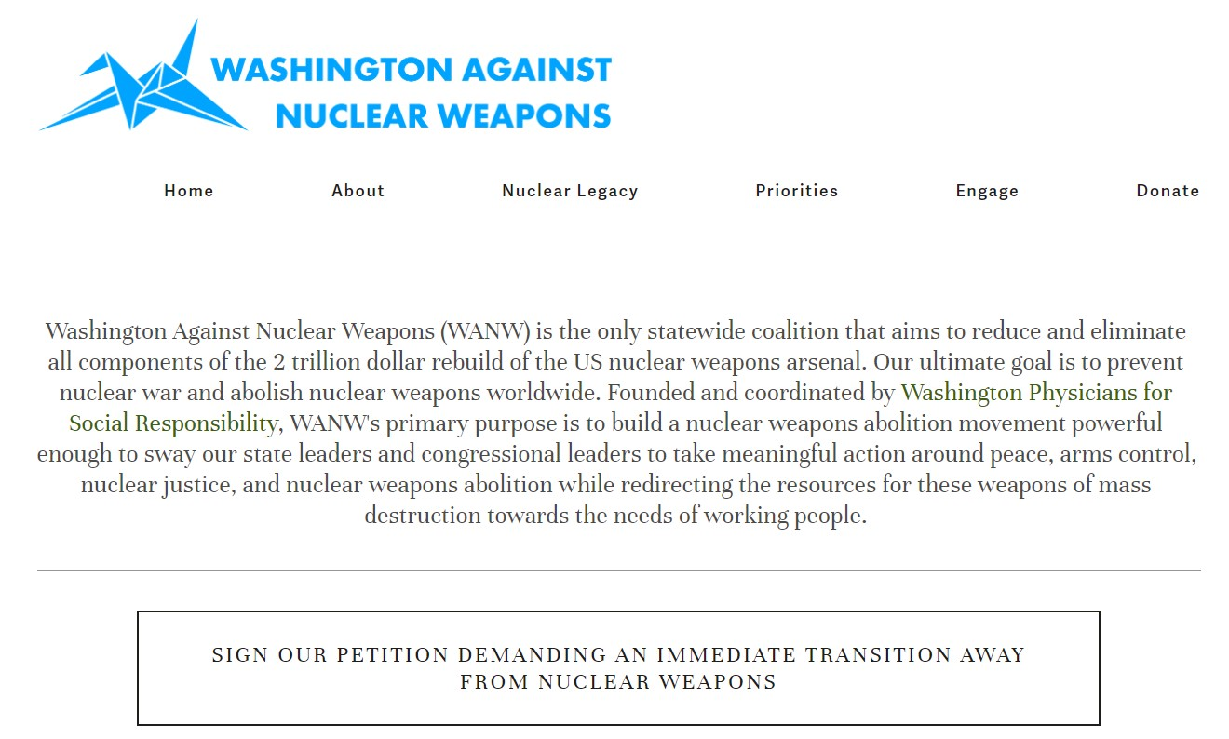
WPSR is our state’s chapter of Physicians for Social Responsibility, US affiliate
WANW coalition is a division of WPSR

Slide 14
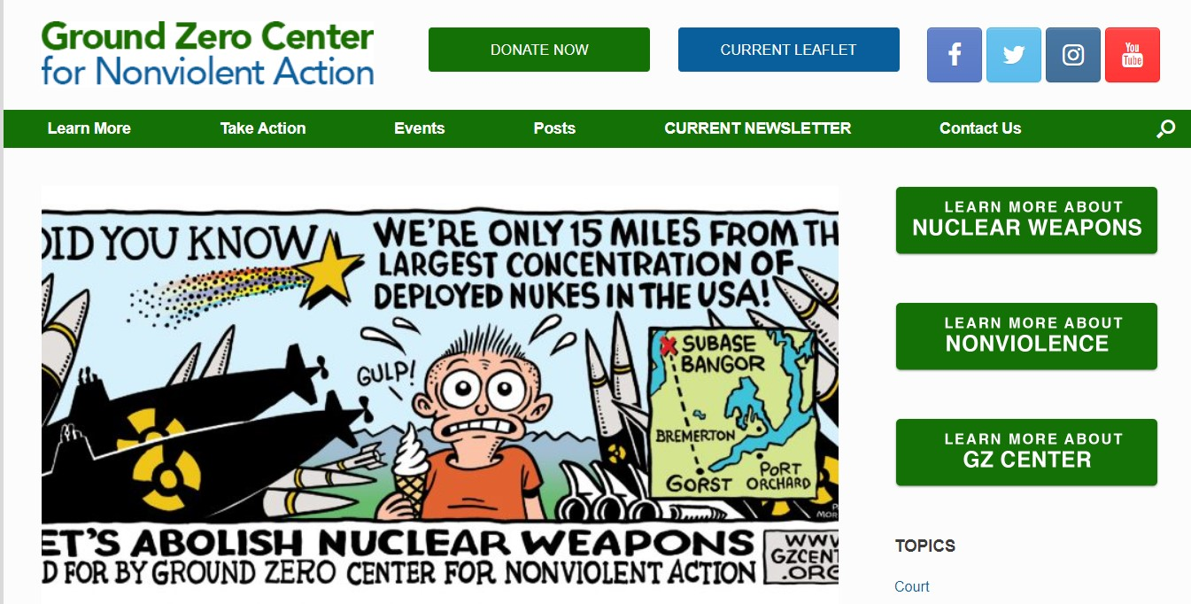
One of our most important and effective partners is Ground Zero.
Since 1977, they have stood up for Peace and Nonviolence, next door to Bangor Submarine Base, where 8 of the 14 Trident nuclear armed submarines are based.
↓
↑
This annual event commemorates the victims of the atomic bombings of Hiroshima and Nagasaki, and all victims of war and violence.
The deeply touching ceremony is held at Green Lake in Seattle, and the healing and support work goes on continually.

Slide 15
The political action wing of AFSC
AFSC has been leading war resistance since World War I.
Critical monitoring of cleanup activities at Hanford. Powerful legal team.
is a powerful advocate for many communities who have suffered from uranium mining, nuclear weapons production and testing, and nuclear waste dumping.
Founded by Lilly Adams,
first chair of WPSR’s Coalition for Abolition of Nuclear Weapons
And currently with Union of Concerned Scientists’ nuclear weapons team.

Slide 16
Resources: some of the scientific organizations we rely on for accurate information on Peace and Nuclear Disarmament issues.
Arms Control Association Bulletin of Atomic Scientists
Federation of American Scientists Union of Concerned Scientists
Nuke Watch New Mexico

Slide 17
Reaching Critical Will,
the Nuclear Disarmament division of the
Womens’ International League for Peace and Freedom
↓
↑
INTERNATIONAL CAMPAIGN TO ABOLISH NUCLEAR WEAPONS produced the Treaty for the Prohibition of Nuclear Weapons,
adopted by the United Nations in 2017 and entered into force in 2021, with 92 nations signing and 68 nations ratifying
icanw.org
https://www.wilpf.org/

Slide 18
Treaty Prohibiting Nuclear Weapons
Prior to the treaty’s adoption, nuclear weapons were the only weapons of mass destruction not subject to a comprehensive ban, despite their catastrophic, widespread and persistent humanitarian and environmental consequences. The new agreement fills a significant gap in international law.
It prohibits nations from developing, testing, producing, manufacturing, transferring, possessing, stockpiling, using or threatening to use nuclear weapons, or allowing nuclear weapons to be stationed on their territory. It also prohibits them from assisting, encouraging or inducing anyone to engage in any of these activities.
A nation that possesses nuclear weapons may join the treaty, so long as it agrees to destroy them in accordance with a legally binding, time-bound plan. Similarly, a nation that hosts another nation’s nuclear weapons on its territory may join, so long as it agrees to remove them by a specified deadline.
Nations are obliged to provide assistance to all victims of the use and testing of nuclear weapons and to take measures for the remediation of contaminated environments. The preamble acknowledges the harm suffered as a result of nuclear weapons, including the disproportionate impact on women and girls, and on indigenous peoples around the world.
The treaty was negotiated at the United Nations headquarters in New York in March, June and July 2017, with the participation of more than 135 nations, as well as members of civil society. It opened for signature on 20 September 2017 and entered into force on 22 January 2021. It is permanent in nature and legally binding on those nations that have joined it.

Slide 19
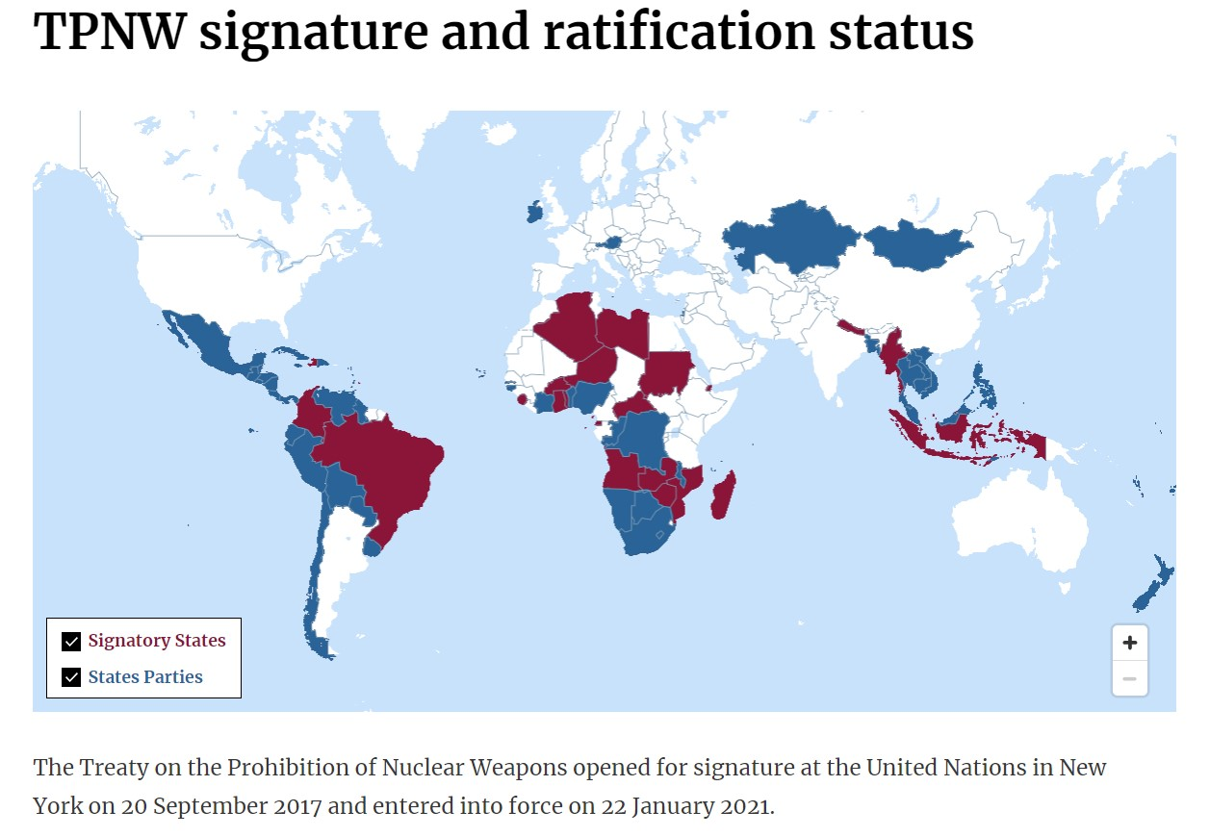
92 nations signed, 68 ratified.

Slide 20
How do we promote the TPNW?
Join in all campaigns for lobbying Congress and President to sign and ratify the Treaty Prohibiting Nuclear Weapons
H.Res.77 , H.R. 2775 , and S. ?
In the meantime, support all other bills that will move us in that direction
H.R.669 and S. 1186 Restricting First Use
And also work to improve and expand Radiation Exposure Compensation Act
More ideas are always welcome!

Slide 21
This Resolution was introduced in the House of Representatives in January 2023, cosponsored by 36 Representatives, including Rep. Pramila Jayapal, of Washington
H.R. 77 calls on the President, Secretaries of State and Defense, leaders of Congress, and the American public to embrace the TPNW, and pledge to
* Pursue a new nuclear arms control agreement with Russia, China, and all other nuclear armed nations,
* Renounce first use of nuclear weapons,
* End the President’s sole authority to launch nuclear weapons,
* Take all nuclear weapons off hair –trigger alert status, and
* Cancel the US nuclear weapons modernization program
These points are the basic components of previous proposals known as Back from the Brink legislation.
There is no equivalent resolution in the Senate

Slide 22
This bill has been introduced in the House several times in the last few sessions, and is similar to the Warheads to Windmills campaign.
There is no equivalent bill in the Senate

Slide 23
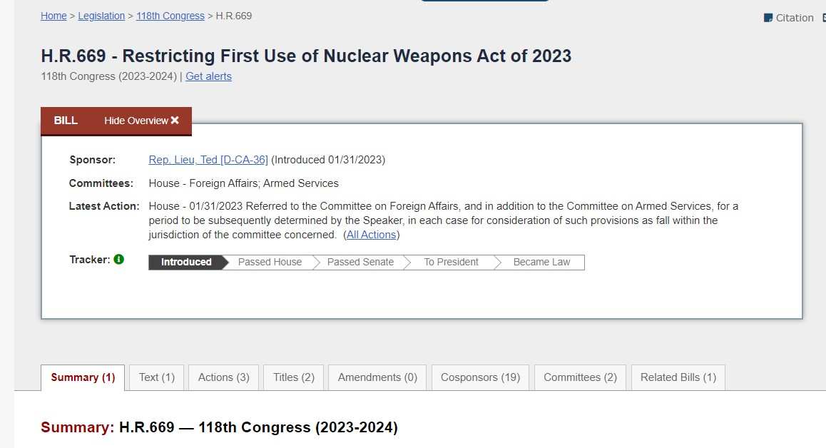
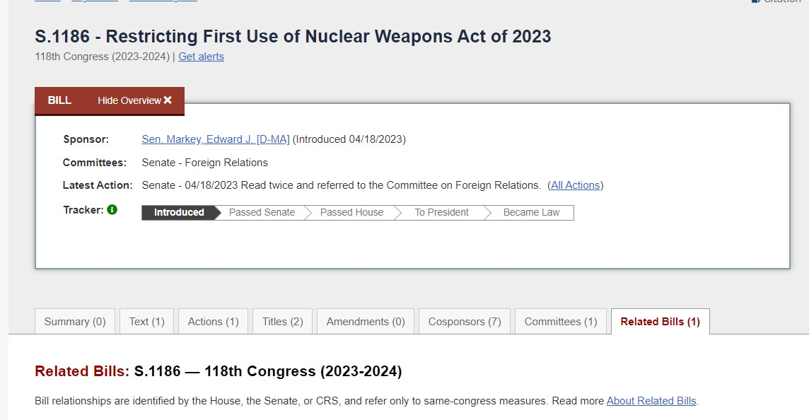

Slide 24
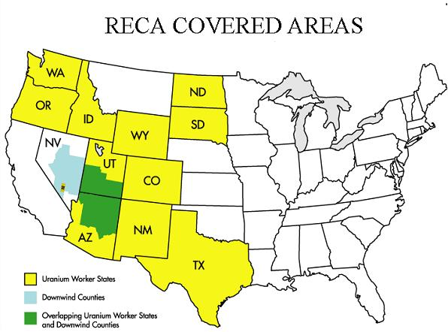
RECA
Radiation Exposure Compensation Act, Senate Bill S. 841 and House Bill 2372, first passed in 1990, to reimburse certain Americans for medical costs of treating radiation sickness: Uranium industry workers and test downwinders in Utah, Nevada, Montana, Idaho, Colorado, Guam, military participants in the cleanup of Enewetak Atoll in the Marshal Islands from 1977 to 1981. Not indigenous residents of the Marshall Islands.
The Act provides the following remunerations, as of 2023, unchanged since 1990 despite inflation:
$50,000 to individuals residing or working downwind of the Nevada nuclear test site
$75,000 for workers participating in atmospheric nuclear weapons tests
$100,000 for uranium miners, millers, and ore transporters.
RECA is due to expire this year, and is currently being considered in Congress.

Slide 25
We have our work cut out for us. Every one of the organizations named in this report have expertise to share and advice to contribute to each one of us, as individuals and members of this group.
The work is difficult, the obstacles many, and most often the benefits go to people we have never met.
Let’s do it anyway

