Slide 1
nomorebombs.org
Notes:
Hello, and thank you for having us here. I do not intend to scare anybody, there are no gruesome pictures in this presentation, just information. Some things I think many of us have forgotten, or issues we thought were already solved, or in the case of younger people, maybe something they have never heard about.

Slide 2
NUCLEAR WEAPONS
PAST
PRESENT
FUTURE?
Notes:
Well, actually we should be scared, this is pretty serious.

Slide 3
-how we got the atomic and hydrogen bombs
-what we have done with them
-how many we have now and what their status is
-what do we do with them now?
A presentation of nomorebombs.org
Disclosure: all of these images have been borrowed from online sources,
without permission.
Notes:
the first two sections will remind us of what has happened over the last 70 years, the third is the current state of affairs, and the last is our uncertain future.

Slide 4
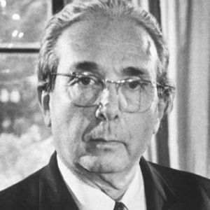
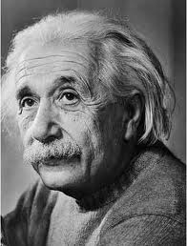
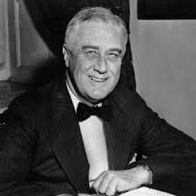
How it began
1939:
FDR receives the letter from Einstein and Szilard that starts the process leading to The Bomb.
Physicist Leo Szilard
Physicist Albert Einstein
President Franklin D Roosevelt
Notes:
During the 30s, physicists in North America, Britain, and Europe were closing in on the process of nuclear fission, or splitting the atom. They became aware of the enormous energy that would be released, and began to fear that Nazi Germany might build the first A-bomb. When they shared this information with President Roosevelt, he authorized more research.

Slide 5
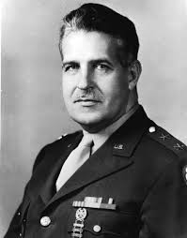
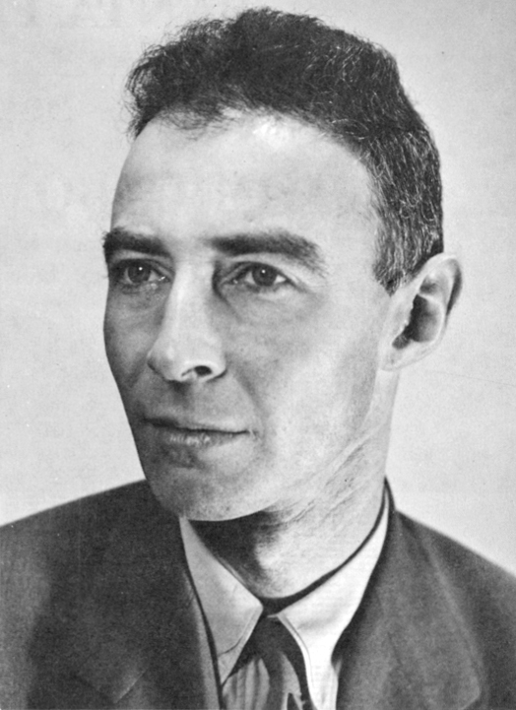
1942:
Manhattan Project begins. In just over three years, it will grow to include the fuel production reactors at Hanford WA and Oak Ridge TN, numerous research facilities and weapons factories, and the prime nuclear weapons laboratory at Los Alamos, NM.
General Leslie Groves
Dr J Robert Oppenheimer
Notes:
When the US entered the war, they got serious about building the A-bomb, and spent $2 Billion, or $30 Billion in todays money, on the biggest and most secret government program ever.

Slide 6
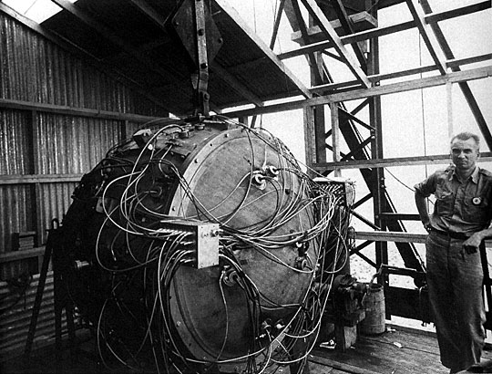
The Trinity Bomb in its tower.
Ultimate product of the Manhattan Project, built at Los Alamos.
Implosion design, fueled by Hanford plutonium.
Notes:
In three years, they built this, the world’s first atomic bomb.

Slide 7
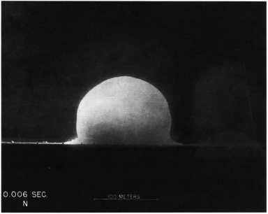
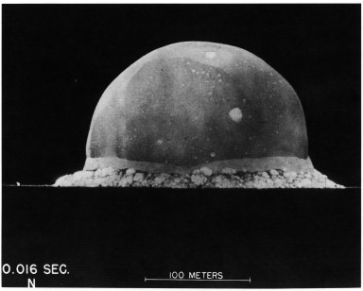
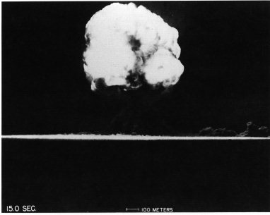
5:30 AM July 16, 1945
Trinity:
The first nuclear explosion, Alamagordo Bombing Range, NM
16 kiloton yield
Notes:
And detonated it in mid July 1945, in the New Mexico desert.

Slide 8
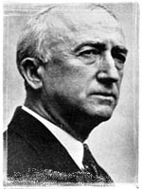
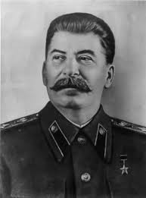
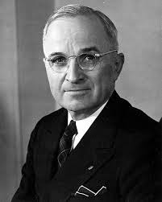
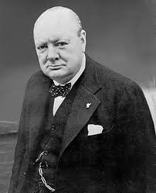
POTSDAM CONFERENCE: July 15-28, 1945
Germany has surrendered, Roosevelt has died, Stalin and Churchill meet with Truman to decide how to divide up Europe, and finish off Japan.
Truman gets Trinity news, but doesn’t tell Stalin. Byrnes advises Truman to demand
unconditional Japanese surrender, while delaying Soviet invasion from Manchuria.
The stage is set.
Sec of State
James Byrnes
US President
Harry Truman
Soviet President
Joseph Stalin
British PM
Winston Churchill
Notes:
By then, the war in Europe was over. Our new president, Harry Truman, suddenly realized he had the world’s biggest weapon in his holster

Slide 9
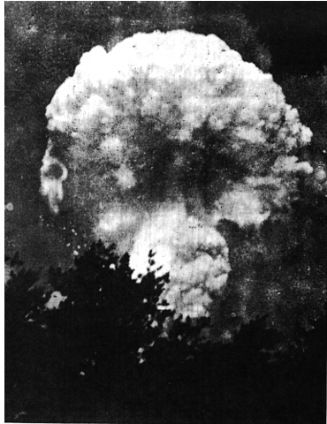
HIROSHIMA
Aug 6, 1945
16 Kiloton blast
80,000 dead
Notes:
So he showed it off, here

Slide 10
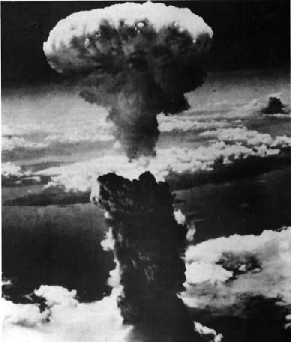
NAGASAKI
Aug 9, 1945 : 21 Kiloton blast
70,000 killed immediately,
another 70,000 over the next year
Notes:
And here.

Slide 11
1930s
economic chaos→
fear of Hitler → building A-Bomb →
destroying a completely different enemy →
creating a new enemy → building more bombs →
new enemy building more bombs →
through the next 60 years →
and more bombs →
and more bombs →
and more bombs →
and where will it all end?
like the nuclear chain reaction itself, the cascade of
consequences spreads out over time, with a life of its own.
Notes:
Here is a diagram of unintended consequences……did those first scientists have a clue about what would follow from their research?

Slide 12
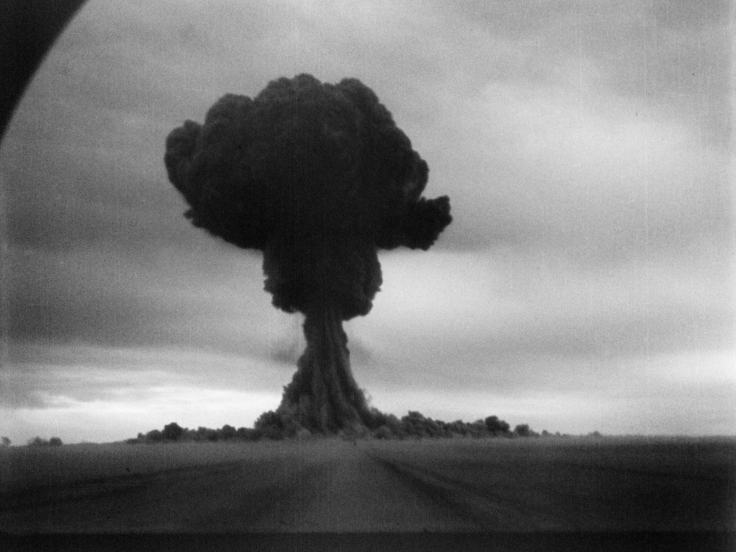
COLD WAR ESCALATION
After 1945, US and USSR Atomic bomb and Hydrogen (thermonuclear) bomb production increased dramatically, as did the tests.
Soviet Union’s first atomic bomb test Sept 1949,
Semipalatinsk, Kazakhstan. 22 Kiloton
Notes:
Of course, the Soviet Union caught up quickly, and the nuclear arms race was on.

Slide 13
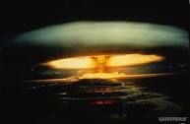
In the Republic of the Marshall Islands alone, the US conducted 67 nuclear weapon tests, from 1946 to 1958,
devastating this helpless Pacific community.
First US Hydrogen Bomb
Nov 1, 1952, Enewetak Atoll, RMI
10 Megaton
Notes:
We soon upgraded to the H-bomb, much more destructive.

Slide 14
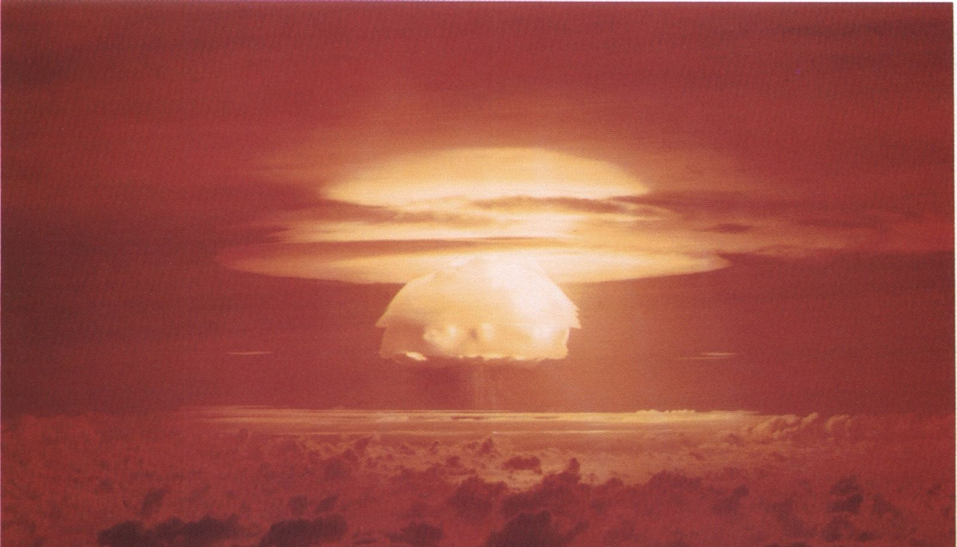
Largest US Thermonuclear Test
Mar 1, 1954
Bikini Atoll, Marshall Islands
15 Megaton yield, about 1000 times Hiroshima bomb
Most widespread radioactive fallout event in history.
Notes:
This was our grand finale in the Marshall Islands.

Slide 15
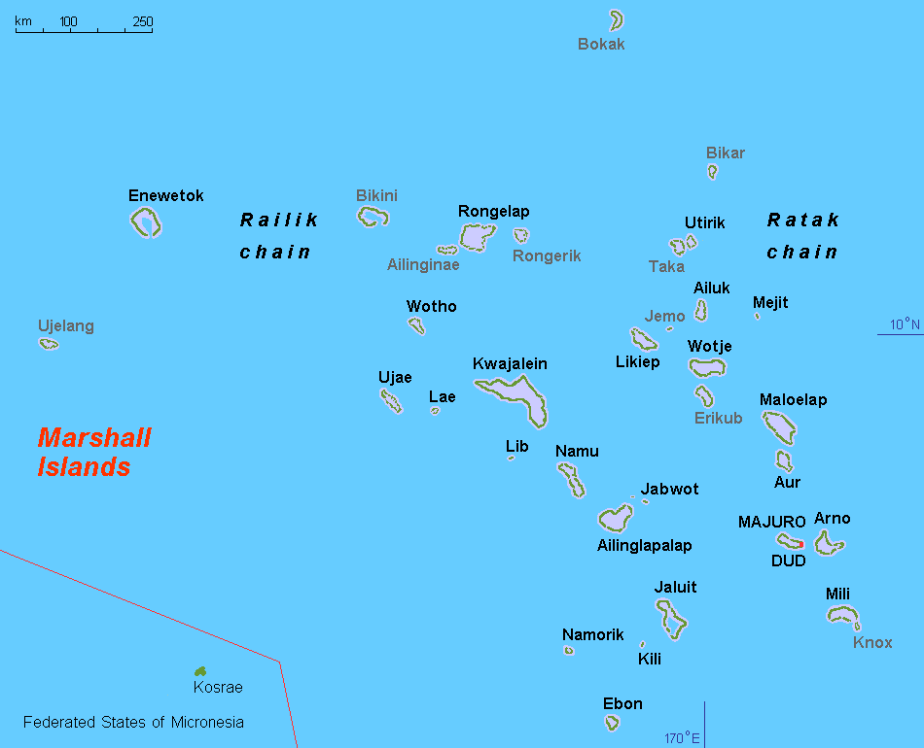
The northern half of the archipelago was contaminated
Notes:
The reason they are suing us in the International Court of Justice.

Slide 16
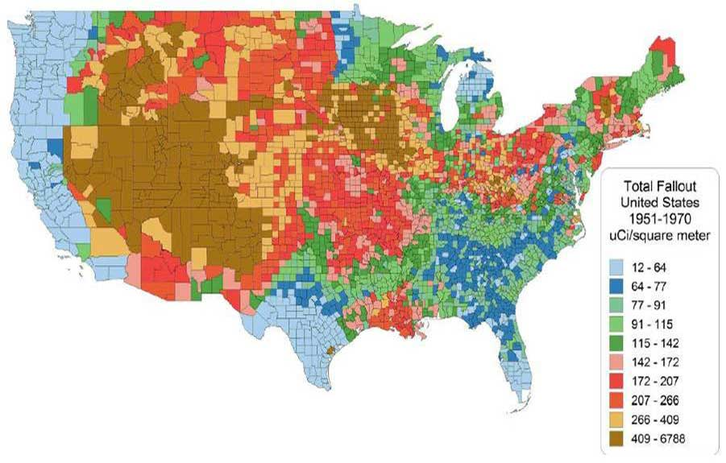
2 decades of Cumulative Radioactive Fallout from Nevada Test Site:
1951-1992, 100 atmospheric and 800 underground nuclear explosions
Notes:
We did another 900 tests at Yucca Flats Nevada, and spread fallout in lighter doses across the US.

Slide 17
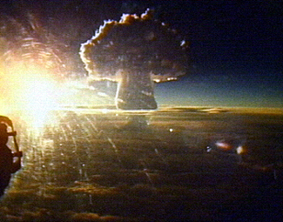
Tsar Bomba
Largest Thermonuclear Test ever, Oct 30, 1961
Novaya Zemlya, Russian Arctic Island
55 Megaton yield
Notes:
And the Soviet Union was doing the same thing.

Slide 18
Meanwhile, we spread our bombs all over Europe and America,
and things started going wrong. The Cuban Missile Crisis was not the only time we flirted with catastrophe.
Here are a few of the hundreds of Accidents and Near Misses:
1956, a B-47 landing at Lakenheath Air Base, Britain, crashed into a storage hut full of atomic bombs, scattering them across the field.
4 crewmen died, but none of the bombs exploded.
1958, a B-47 accidentally dropped an H-bomb at Myrtle Beach, SC. The high explosives
detonated, but the nuclear core did not.
Notes:
Naturally, there were accidents, about 1000 of which were reported, although we may have never heard of them.

Slide 19
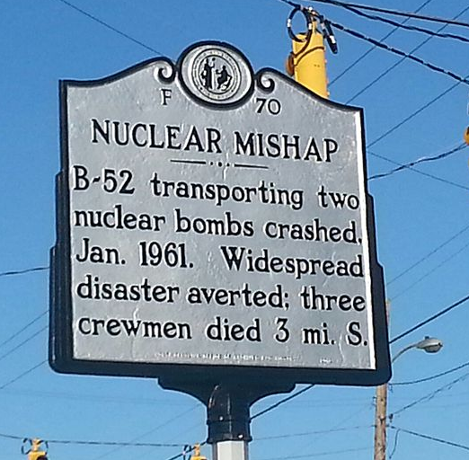
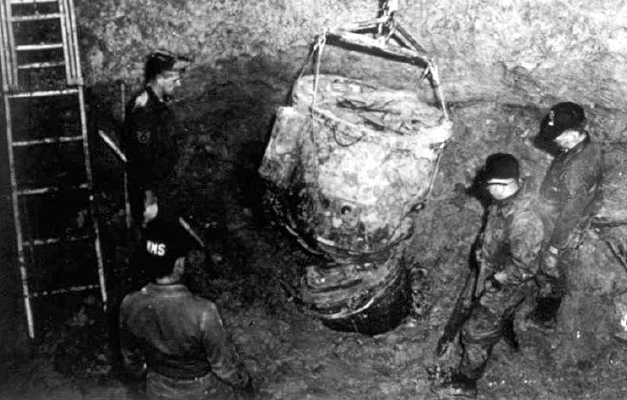
Goldsboro, NC, B-52 crashed with 2 H-bombs, 1961
Removing part of the H-bomb casing.
Nuclear Core remains, buried in the mud.
Notes:
One of the cores is still there, about 20 feet down.

Slide 20
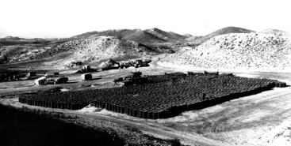
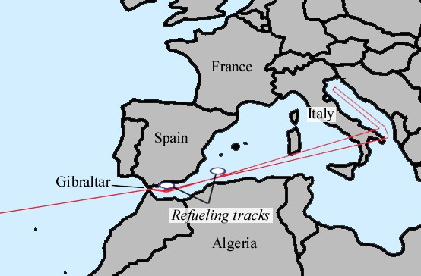
Tragedy over Palomares, Spain, 1966
B-52 collided with KC-135 tanker, both crashed. 7 crewmen killed, 3 H-Bombs fell on land, 1 into Mediterranean
2000 Tons of radioactive contaminated soil, in barrels, from cleanup around Palomares, ready for shipment back to US, for burial.
*
Notes:
This was one of the worst. Ever hear of it?

Slide 21
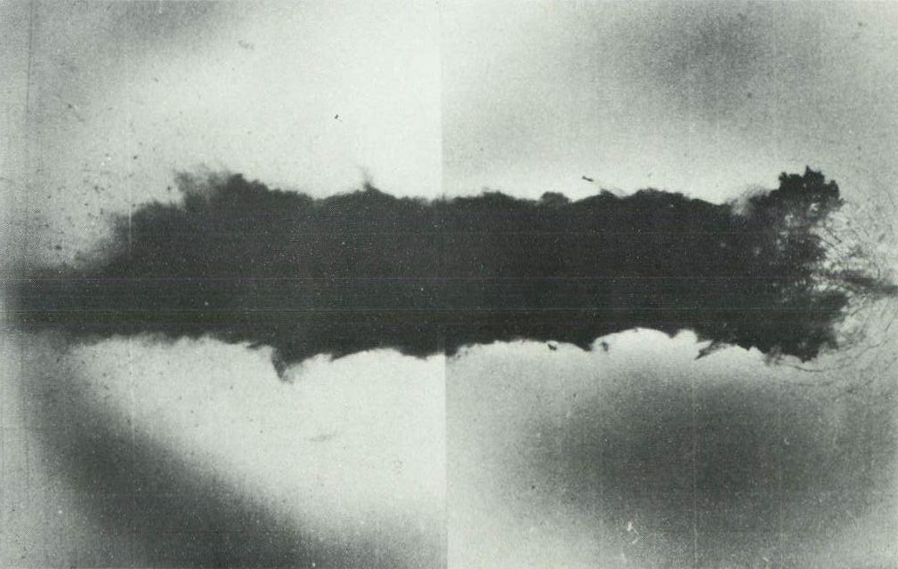
Thule, Greenland, Crash Landing, 1968
Half mile long radioactive scorching of sea ice in Baffin Bay,
Where a B-52 crashed and 4 H-bombs were breached by detonation of their conventional explosives.
One airman died.
Notes:
Or this one?

Slide 22
And they are still happening:
- 1980, at Damascus, Arkansas, a multiple warhead ICBM exploded in its silo. The exploding fuel threw one warhead half a mile. The nuclear material did not detonate, but there was a release of radioactive fallout.
- 1995, Russian radar mistook a Norwegian weather rocket for a US ICBM, and an alert was sounded. A full scale launch of Russian ICBMs toward US targets was initiated, and finally cancelled by Russian President Boris Yeltsin with minutes to spare.
- 2007, a B-52 was accidentally loaded with 6 nuclear missiles at Minot Air Force Base, North Dakota, flown to Barksdale AFB in Louisiana, and left parked there unguarded for 36 hours, until somebody noticed.
Notes:
More recently, a dirty explosion in Arkansas, a really close call in Moscow, and an open invitation to disaster in Louisiana. We have been extraordinarily lucky!

Slide 23
1970
Non Proliferation Treaty
signed by 190 countries
-Nuclear armed nations agreed to share nonmilitary technology
-Unarmed nations agreed not to make nuclear weapons
As a result,
Canada, South Africa, Brazil, Australia, and other countries, who had started weapons programs, shut them down.
Notes:
Back to the history, here was a very good agreement, brokered by the UN, signed by President Nixon. It did reduce the number of nuclear states.

Slide 24
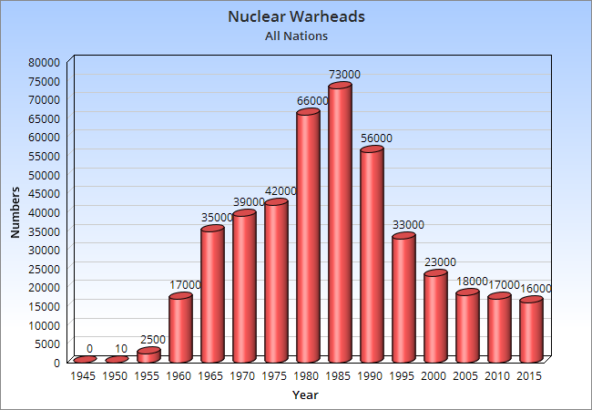
THE RACE CONTINUED
Both US and USSR continued testing & upgrading their nuclear technology, and other nations joined the Nuclear Club: Britain, France, China, and Israel, then India and Pakistan, and most recently North Korea.
By the mid 1980s, the combined total peaked at about 73,000, and only began to decline when the USSR collapsed.
Notes:
But the 2 superpowers actually escalated their production of nuclear weapons. Only the collapse of Russia’s economy intervened, and then we slowed down too.

Slide 25
START, 1994
Strategic Arms Reduction Treaty
began to rein in US and Russia together,
Setting goals of 6000 warheads each
NEW START, 2011
Was to reduce both arsenals to 1500 each
We have failed to reach either goal.
As of 2015,
US has 7000, Russia 8000,
And including the other 7 members of the nuclear club, there are now about
16,000 nuclear warheads worldwide.
Notes:
START was signed by Yeltsin and Clinton, and both of these treaties made official policy of what both countries were already doing, but we have not reached either goal. There are still about 16,000 nuclear warheads alive and well in the world.

Slide 26
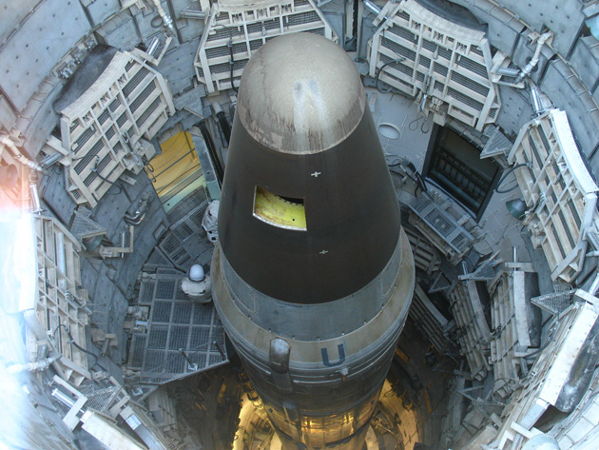
Ready to go
Notes:
This missile has three of them, it’s one of ours, and it is still aimed at a Russian target.

Slide 27
So we, the United States, have about 7000 nuclear warheads:
76 B-52 bombers, which can carry 8 bombs or 20 cruise missiles, and 18 B-2 bombers, which can deliver 16 bombs each.
450 ICBMs in silos, with up to 3 warheads each.
288 Trident missiles, each carrying 4 warheads, aboard 14 submarines. And many more in storage, awaiting deployment.
These warheads are of varying ages, all of them several decades old, and the electronics associated with their launch and security systems are obsolete.
What do we do with them?
Notes:
This our present condition.

Slide 28
Current Nuclear Weapons Budget Plans call for a 30 year “modernization”,
Costing $30 Billion annually,
Or a Trillion dollars overall, with almost nothing for disarmament.
Notes:
And this is what is being proposed in the budgets of the Defense and Energy Departments.

Slide 29
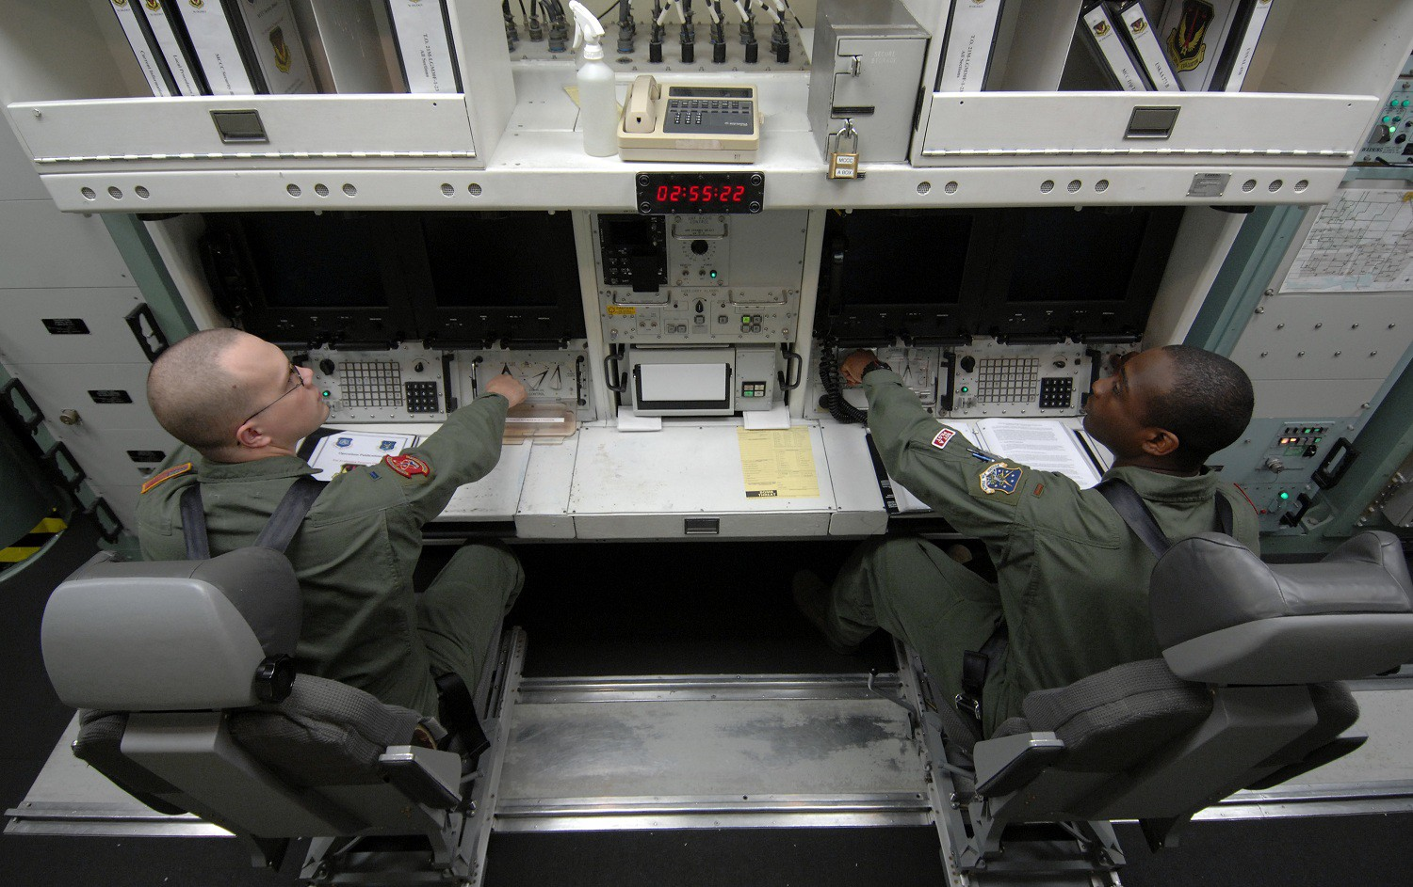
M.A.D.
Mutually Assured Destruction
This is the insane game we have been playing for 70 years, perhaps we have pushed our luck long enough?

Slide 30
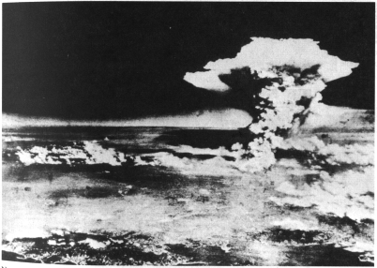
Is this to be our nation’s legacy?

Slide 31
We do have a choice. Right now Congress, Pentagon, and Energy Department planners are deciding whether to:
* abide by the treaties we have signed, and resume in good faith our stated common goal of eliminating nuclear weapons,
or to:
* renege on those promises, and continue to build more, bigger, and better bombs.
Not knowing what future elections will bring, this may be our best opportunity to effect positive change in the direction our government moves. And it is certain that Russia won‘t disarm without us.
Notes:
We do have a choice. I can’t tell anybody else what to do. I only know what I think about all this, and I have been studying the issue for a long time, and I can only recommend that if you are at all interested in the future of humanity, and want to get involved, there are some groups of very smart people who are already working very hard to turn the nuclear ship around.

Slide 32
Here are some organizations working towards nuclear disarmament, and all need our help.
Nuclear Age Peace Foundation
Nuclear Zero
Ploughshares Fund
International Campaign to Abolish Nuclear Weapons
American Friends Service Committee
Union of Concerned Scientists
Council for a Livable World
International Physicians for the Prevention of Nuclear War
Global Zero
Peace Action Network
Don’t Bank on the Bomb
And there are more. Please check them out, and get involved with the ones that best fit your own objectives.
Notes:
My website has links to all of them. Each one has their own special focus, I think you can find one that is doing what you want done.

Slide 33
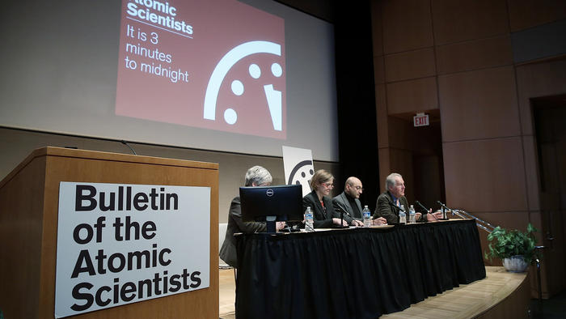
We can still wake up
Notes:
This is one of the smartest organizations, and they tell us we still have a little time.

Slide 34
And we can do more than write checks and sign online petitions:
-We can contact our representatives and demand an end to funding of more nukes, and swift accomplishment of our treaty obligations.
-We can talk with our friends, family, and neighbors , and share information. Like this.
-We can divest, and encourage our friends and family to divest, in the financial institutions that are getting rich from the nuclear military industrial complex.
-We can elect representatives at all levels of government that support nuclear disarmament, and then hold them to their promises.
The important thing is: WE MUST ACT, because Congress won’t without us..
Notes:
Regardless of whether you find any group you want to support, there are other ways to do something, as individuals, in our own communities.

Slide 35
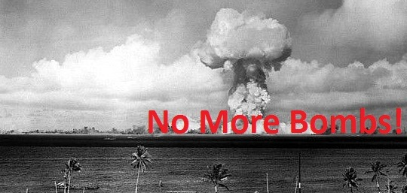
For more information, go to www.nomorebombs.org
To offer suggestions, please contact me:
tracy@nomorebombs.org
Notes:
This presentation, and a much more thorough, printable pdf document, and updates, and links to the groups listed here, and lists of books, and movies, are all on my website. Please check it out if you have any interest in this issue. Thank you for your time.

