Slide 1
NUCLEAR WEAPONS AND WA STATE

Slide 2
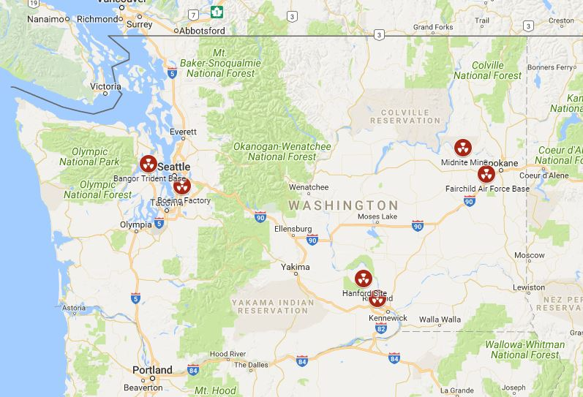
NUCLEAR WEAPONS IN WASHINGTON
Notes:
WA state has a particular connection to nuclear weapons
Just 20 miles from Seattle is the largest collection of deployed (ready to use) nuclear weapons in the US.
Hanford Nuclear Site near the Tri-Cities, where nuclear weapons were produced in WWII
Uranium mining at Midnite Mine on the Spokane Tribe of Indians Reservation
Spokane - one of the largest populations of Marshallese Islanders in the US
PNNL Lab – carries out nuclear non-proliferation work with the National Nuclear Security Administration
Boeing – one of the largest nuclear weapons producer in the US

Slide 3
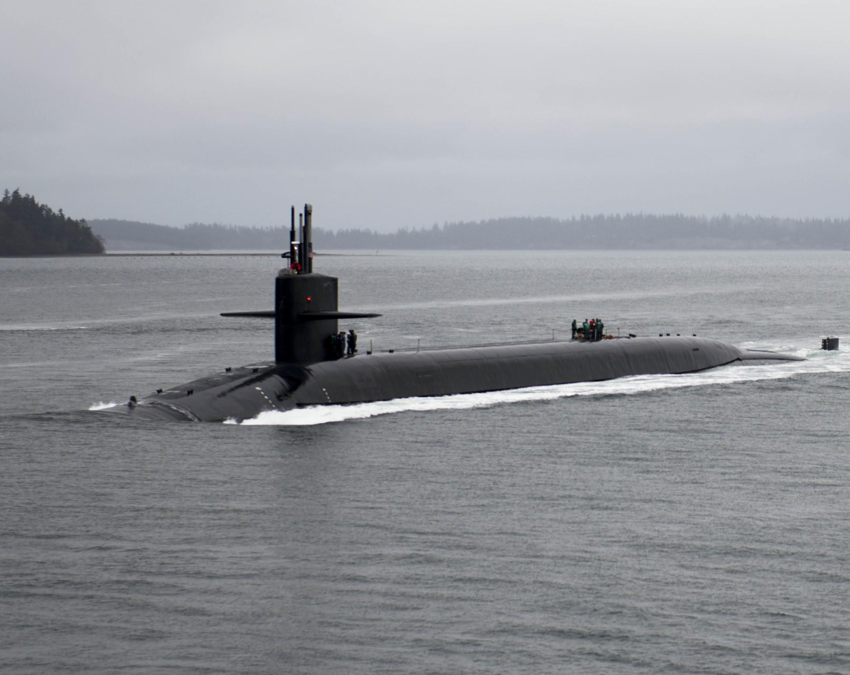
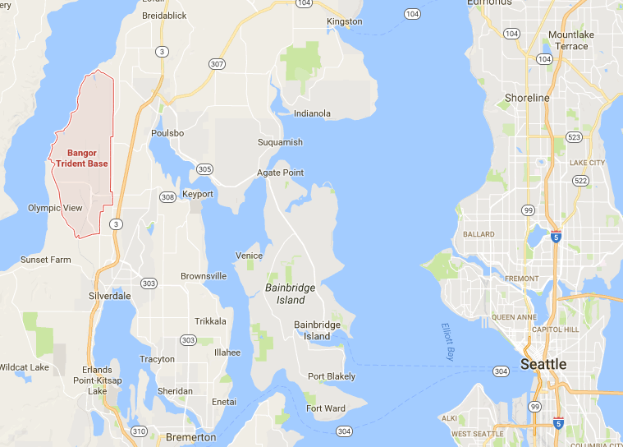
Naval Base Kitsap-Bangor
Notes:
If WA were a country, we’d be the 3rd largest nuclear weapons country in the world
Largest collection of deployed or “ready to use” nuclear weapons in the US
Held on 8 nuclear submarines, each of which has the power equal to over 5000 Hiroshima bombs.
This makes us a target in a nuclear conflict

Slide 4
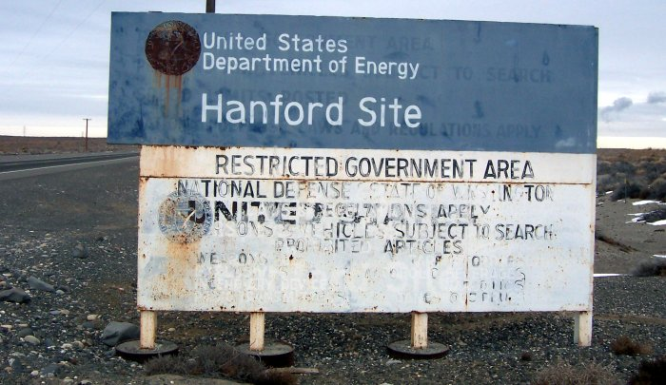
HANFORD - PRODUCTION
Notes:
Hanford was created in 1940’s in E.WA to produce bombs in WWII. The plutonium used in the bomb dropped on Nagasaki was produced at Hanford, as well as the first atomic bomb ever tested. Produced most of the plutonium used in the 60,000 nuclear weapons the US made.
Workers were often not told that they were making bombs, dealing with radioactive material, until bombs were dropped in Hiroshima and Nagasaki.
At the height of plutonium production in 1957, eight plutonium production reactors dumped a daily average of 50,000 curies of radioactive material into the Columbia River. By comparison, only 15-24 curies of iodine-131 were released at Three Mile Island.
The site had been used for thousands of years by the Wanapum People year-round, and during the winter by the Yakama Nation, Confederated Tribes of the Colville, Confederated Tribes of the Umatilla Reservation, and the Nez Perce. They were all displaced and given no compensation.
In most cases, people of color were only able to get the worst paying jobs. Faced discrimination, harassment, segregation. – “Mississippi of the North”
Sources:
http://crosscut.com/2016/05/hanford-nuclear-reservation-african-americans/
http://www.atomicheritage.org/history/african-americans-and-manhattan-project
http://www.tri-cityherald.com/news/local/hanford/article62991407.html
http://www.thestranger.com/features/feature/2015/12/09/23231378/black-americans-came-to-washington-state-from-around-the-country-to-help-build-the-atomic-bomb
http://www.hanfordproject.com/greenrun.html
http://www.toxipedia.org/display/toxipedia/Green+Run+-+Hanford
https://static1.squarespace.com/static/52311edfe4b0830625de8366/t/591338bb579fb311a54b8fb8/1494432037246/accountability-audit.pdf
https://www.thenation.com/article/meet-the-private-corporations-building-our-nuclear-arsenal/
http://www.ucsusa.org/nuclear-weapons/us-nuclear-weapons-policy/us-nuclear-weapons-facilities.html#.WVVBJYjysdV
https://www.scientificamerican.com/article/nuclear-weapons-site-alarms-shut-off-scientists-inhale-uranium/

Slide 5
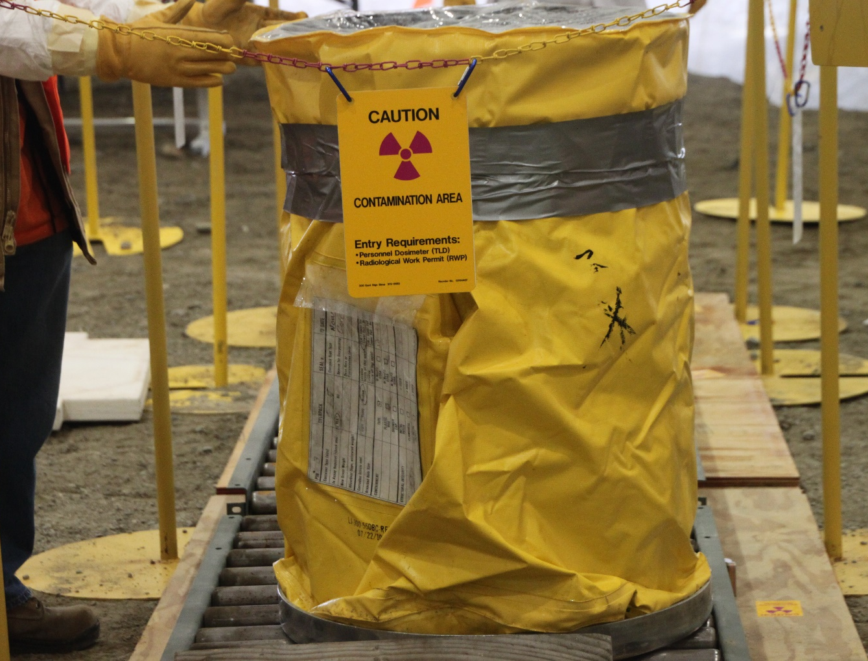
HANFORD - CLEANUP
Photos: US Department of Energy
Notes:
Nuclear weapons leave a legacy of waste that has no clear solution – deadly, pervasive, and unprecedented
Hanford clean up exemplifies this – most contaminated nuclear site in the western world, largest environmental clean up in the world
Expected to cost $115 billion to clean up. Starting in 1989, was originally scheduled to be done in 30 years, by 2020. Now expected to take at least 75 more years to complete.
Large volumes of radioactive waste have since been stored in 177 underground tanks, 67 of which have leaked a total of approximately one million gallons into the surrounding soil.
Safety at Hanford is seriously flawed. Earlier this year, was found that 42 workers were exposed to plutonium, which will lodge in their body, emitting radiation, for the rest of their lives
Sources:
http://www.tri-cityherald.com/news/local/hanford/article141630829.html
http://www.spokesman.com/stories/2017/mar/06/hanford-ill-worker-compensation-bill-passes-house/
https://www.pressreader.com/usa/the-washington-post/20070512/281487861916682
http://www.hanfordchallenge.org/

Slide 6
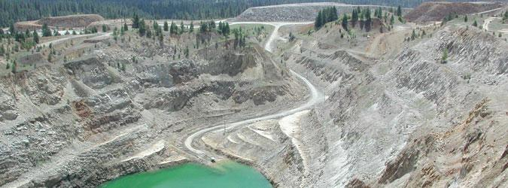
Midnite Mine - Uranium Mining
Notes:
Nuclear weapons are made from uranium or plutonium, which is also derived from uranium.
Worldwide, almost all uranium mining for nuclear weapons has happened in non-nuclear weapons states, especially in colonized countries, or in minority areas.
In the US, that has meant on Navajo and other Native American Nations’ land – largely in SW US, but we also have a mine in WA
Midnite Mine – just west of Spokane, on reservation of Spokane Tribe of Indians
EPA says people should not hunt, fish, gather food by waterways because they are so contaminated
Workers were often not told about the health impacts and dangers of mining uranium. People brought contaminated materials back to their homes, some became toys that kids played with, some materials were used to build structures that still exist today.
Companies have avoided cleanup costs for years. Mine closed in 1981 - cleanup only just started in 2017, 36 years later
There’s a program to compensate people, but not a single person in the Spokane Tribe, or worker at Midnite Mine has received any money, since no one knows this program even exists.
Sources:
http://www.npr.org/sections/health-shots/2016/04/10/473547227/for-the-navajo-nation-uranium-minings-deadly-legacy-lingers
http://www.nytimes.com/2009/07/27/us/27navajo.html?_r=0&mtrref=undefined
https://www.epa.gov/navajo-nation-uranium-cleanup
https://energy.gov/sites/prod/files/2014/09/f18/Defense-RelatedUraniumMinesReporttoCongress-FINAL.pdf
https://cumulis.epa.gov/supercpad/cursites/csitinfo.cfm?id=1001070
http://www.seattletimes.com/pacific-nw-magazine/radioactive-remains-the-forgotten-story-of-the-northwests-only-uranium-mines/

Slide 7
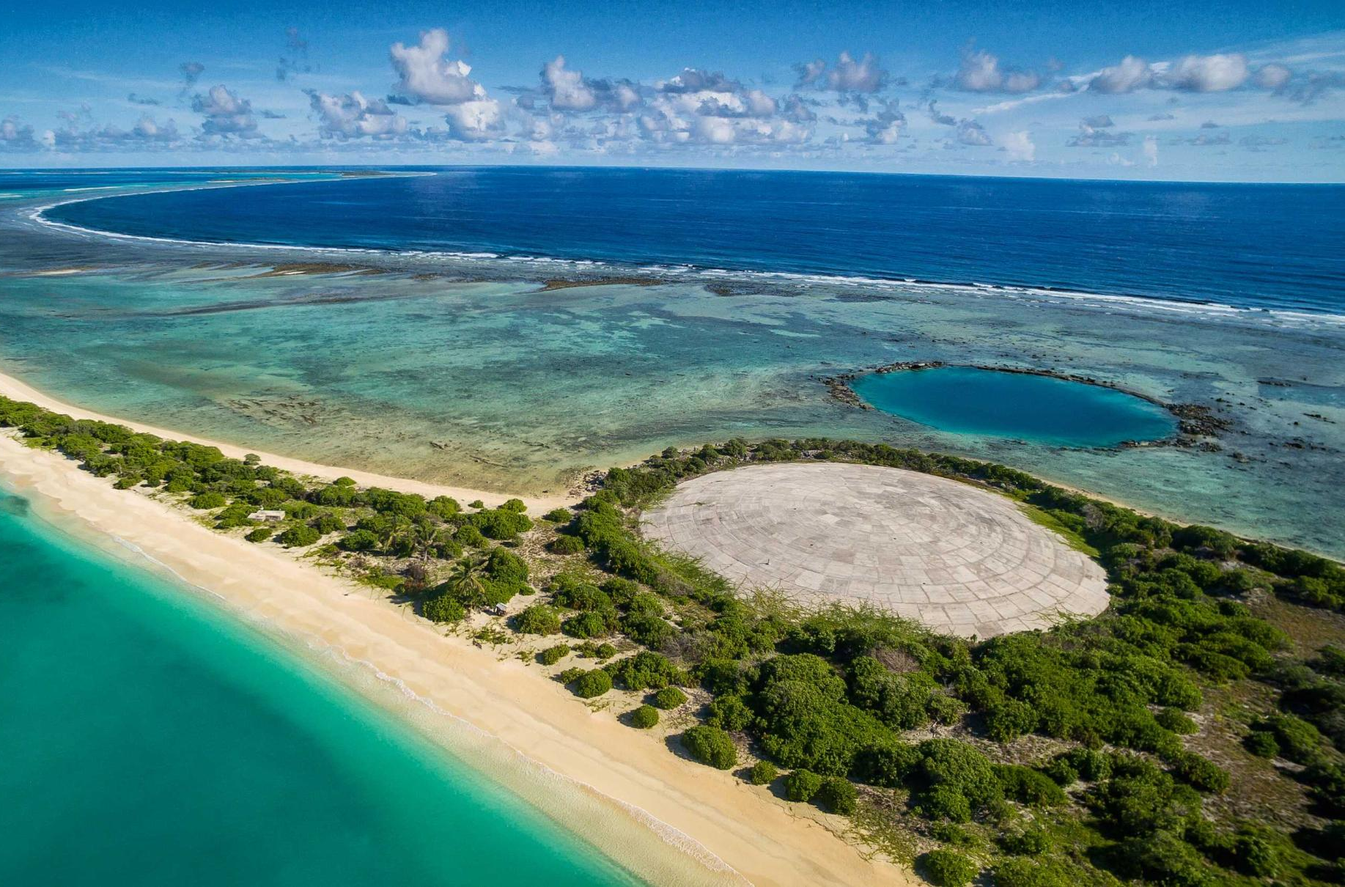
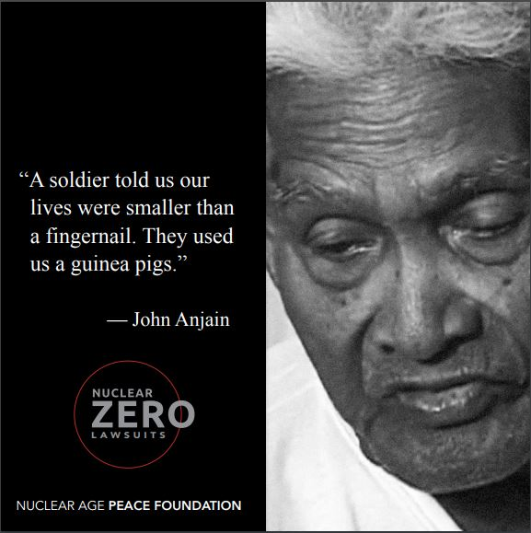
TESTING - MARSHALL ISLANDS
Photo: Greg Nelson, Australian Broadcast Company
Notes:
The United States tested weapons in the Marshall Islands and in Nevada. Nearly 200 tests that spread radiation over the entire country, thousands of miles.
We carried out 67 tests in the Marshall Islands, a US colony in the Pacific ocean
One test in Marshall Islands completely vaporized an entire island. Residents were “guinea pigs” for US government. Picture is of a dome covering 85000 cubic meters of radioactive material, dumped by the US govt into an unlined pit, that has never been cleaned up and is now leaking
We have stopped nuclear weapons testing, but Marshallese Islanders continue to face massive health impacts from testing. WA state, have one of the largest populations of Marshallese islanders in the country, in Spokane. For decades they weren’t able to receive medical care for the health consequences of testing, until a law changing that was passed this year.
Sources:
https://www.theguardian.com/world/2014/mar/02/bikini-atoll-nuclear-test-60-years
https://energy.gov/sites/prod/files/DOENTSAtmospheric.pdf
https://www.ctbto.org/nuclear-testing/the-effects-of-nuclear-testing/the-united-states-nuclear-testing-programme/

Slide 8
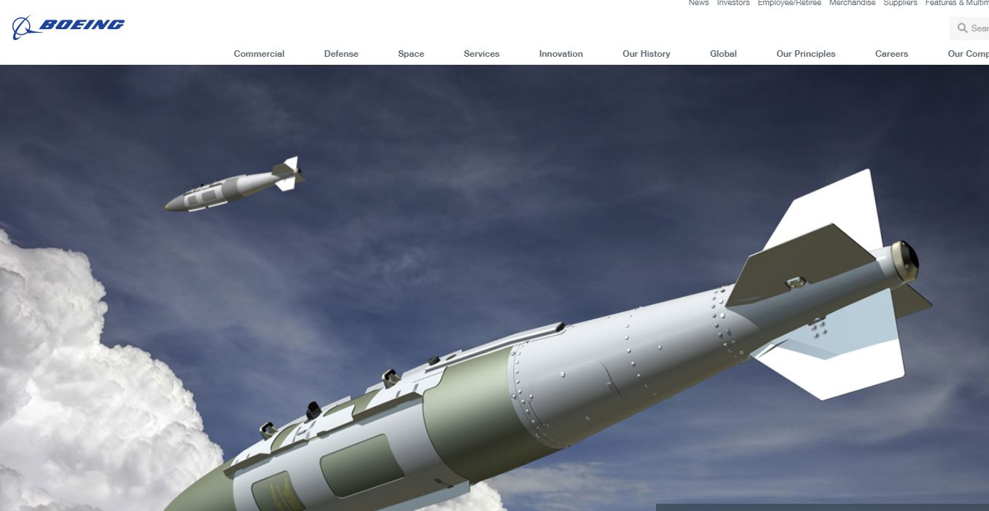
BOEING - PRODUCTION
Notes:
Boeing - one of the largest nuclear weapons producer in the US. This is a picture from their website, about some of the nuclear weapons they produce.
In charge of development + production of intercontinental ballistic missiles
Just got $349 million contract from Air Force to start re-building our land based missiles, and work on other kinds of weapons as well
Think about other weapons of mass destruction - companies aren’t proud to produce chemical weapons, shamed if they do so. But that’s still not the case with nuclear weapons.
People don’t realize that companies like Boeing are making nuclear weapons.
Source: https://www.dontbankonthebomb.com/boeing/

Slide 9
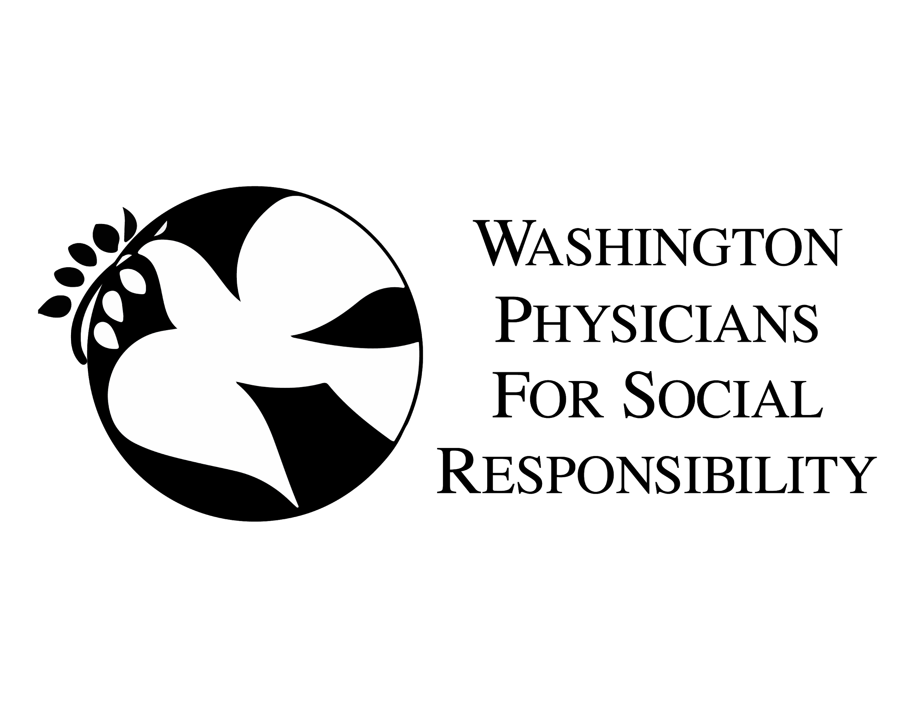
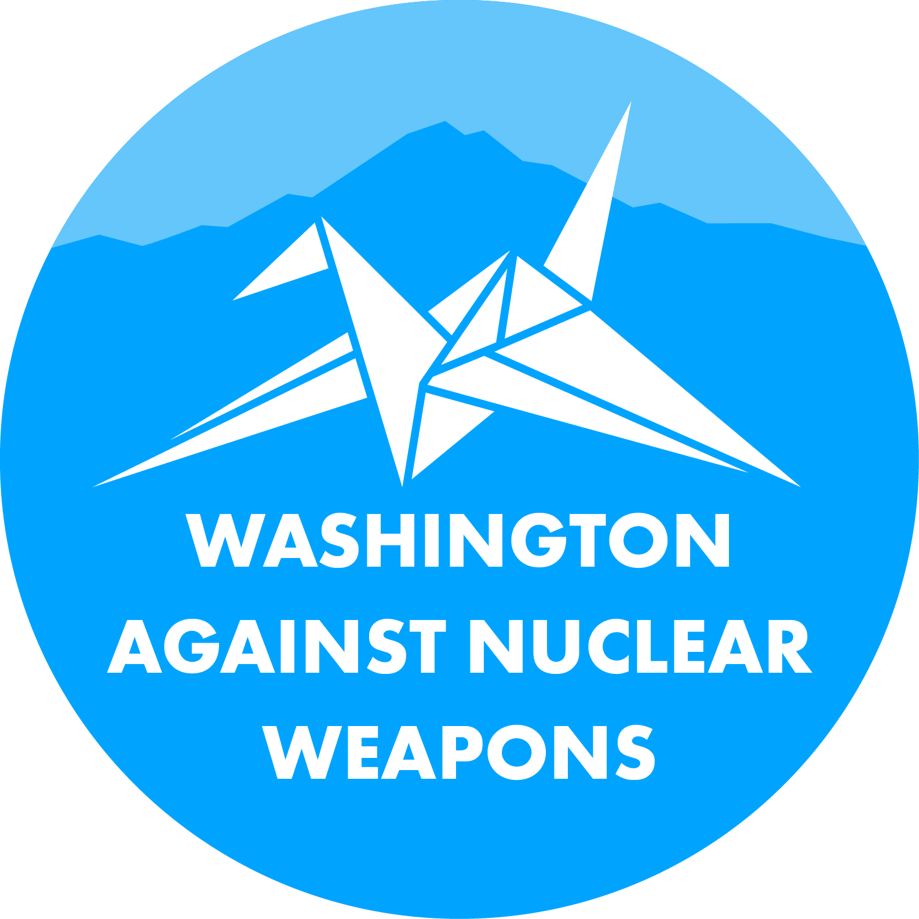
OUR COALITION
Notes:
Coalition – started recognizing that there were a lot of groups working on this issue, and that we would be stronger not only if we worked together, but also if we also collaborated with groups that don’t traditionally work on nuclear weapons.
Now there are 38 groups involved (as of Monday!) - statewide, diverse issue areas – peace, faith, labor, health, environmental, social justice
Taking on educational and awareness work, congressional advocacy, grassroots action, and expanding the coalition itself – more geographic areas and diverse backgrounds – communities of color, youth, women, labor groups

Slide 10
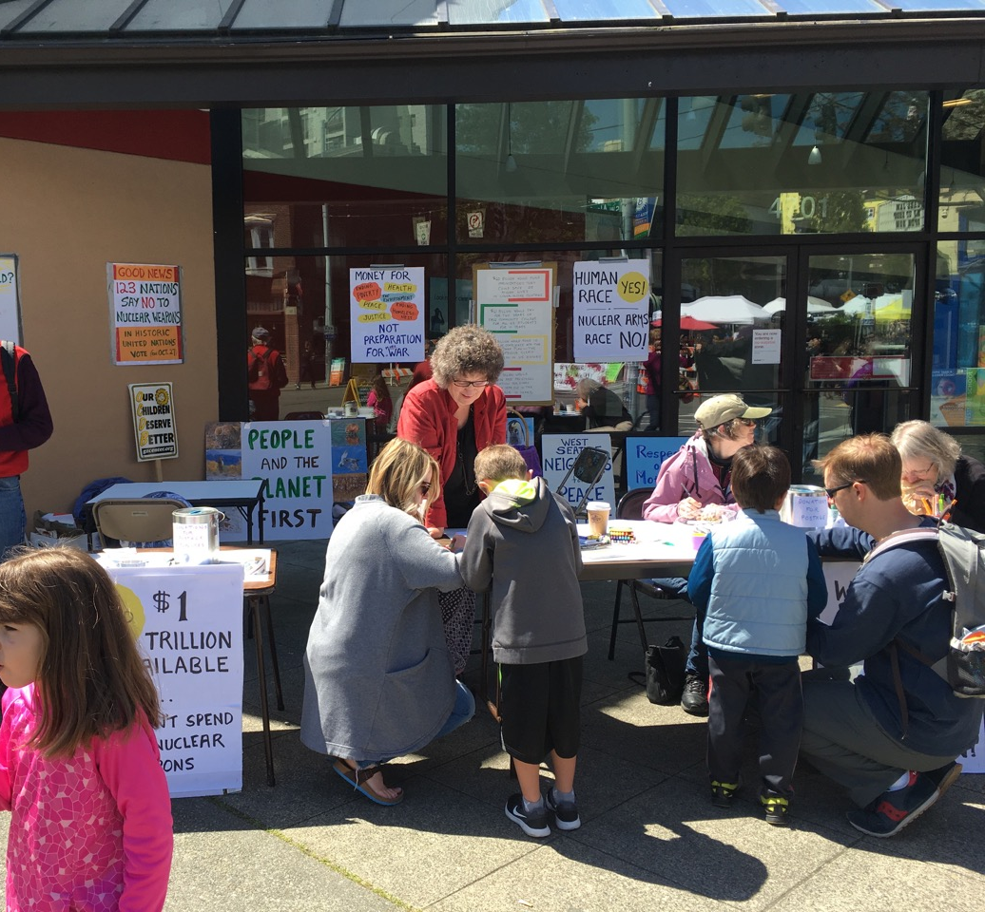
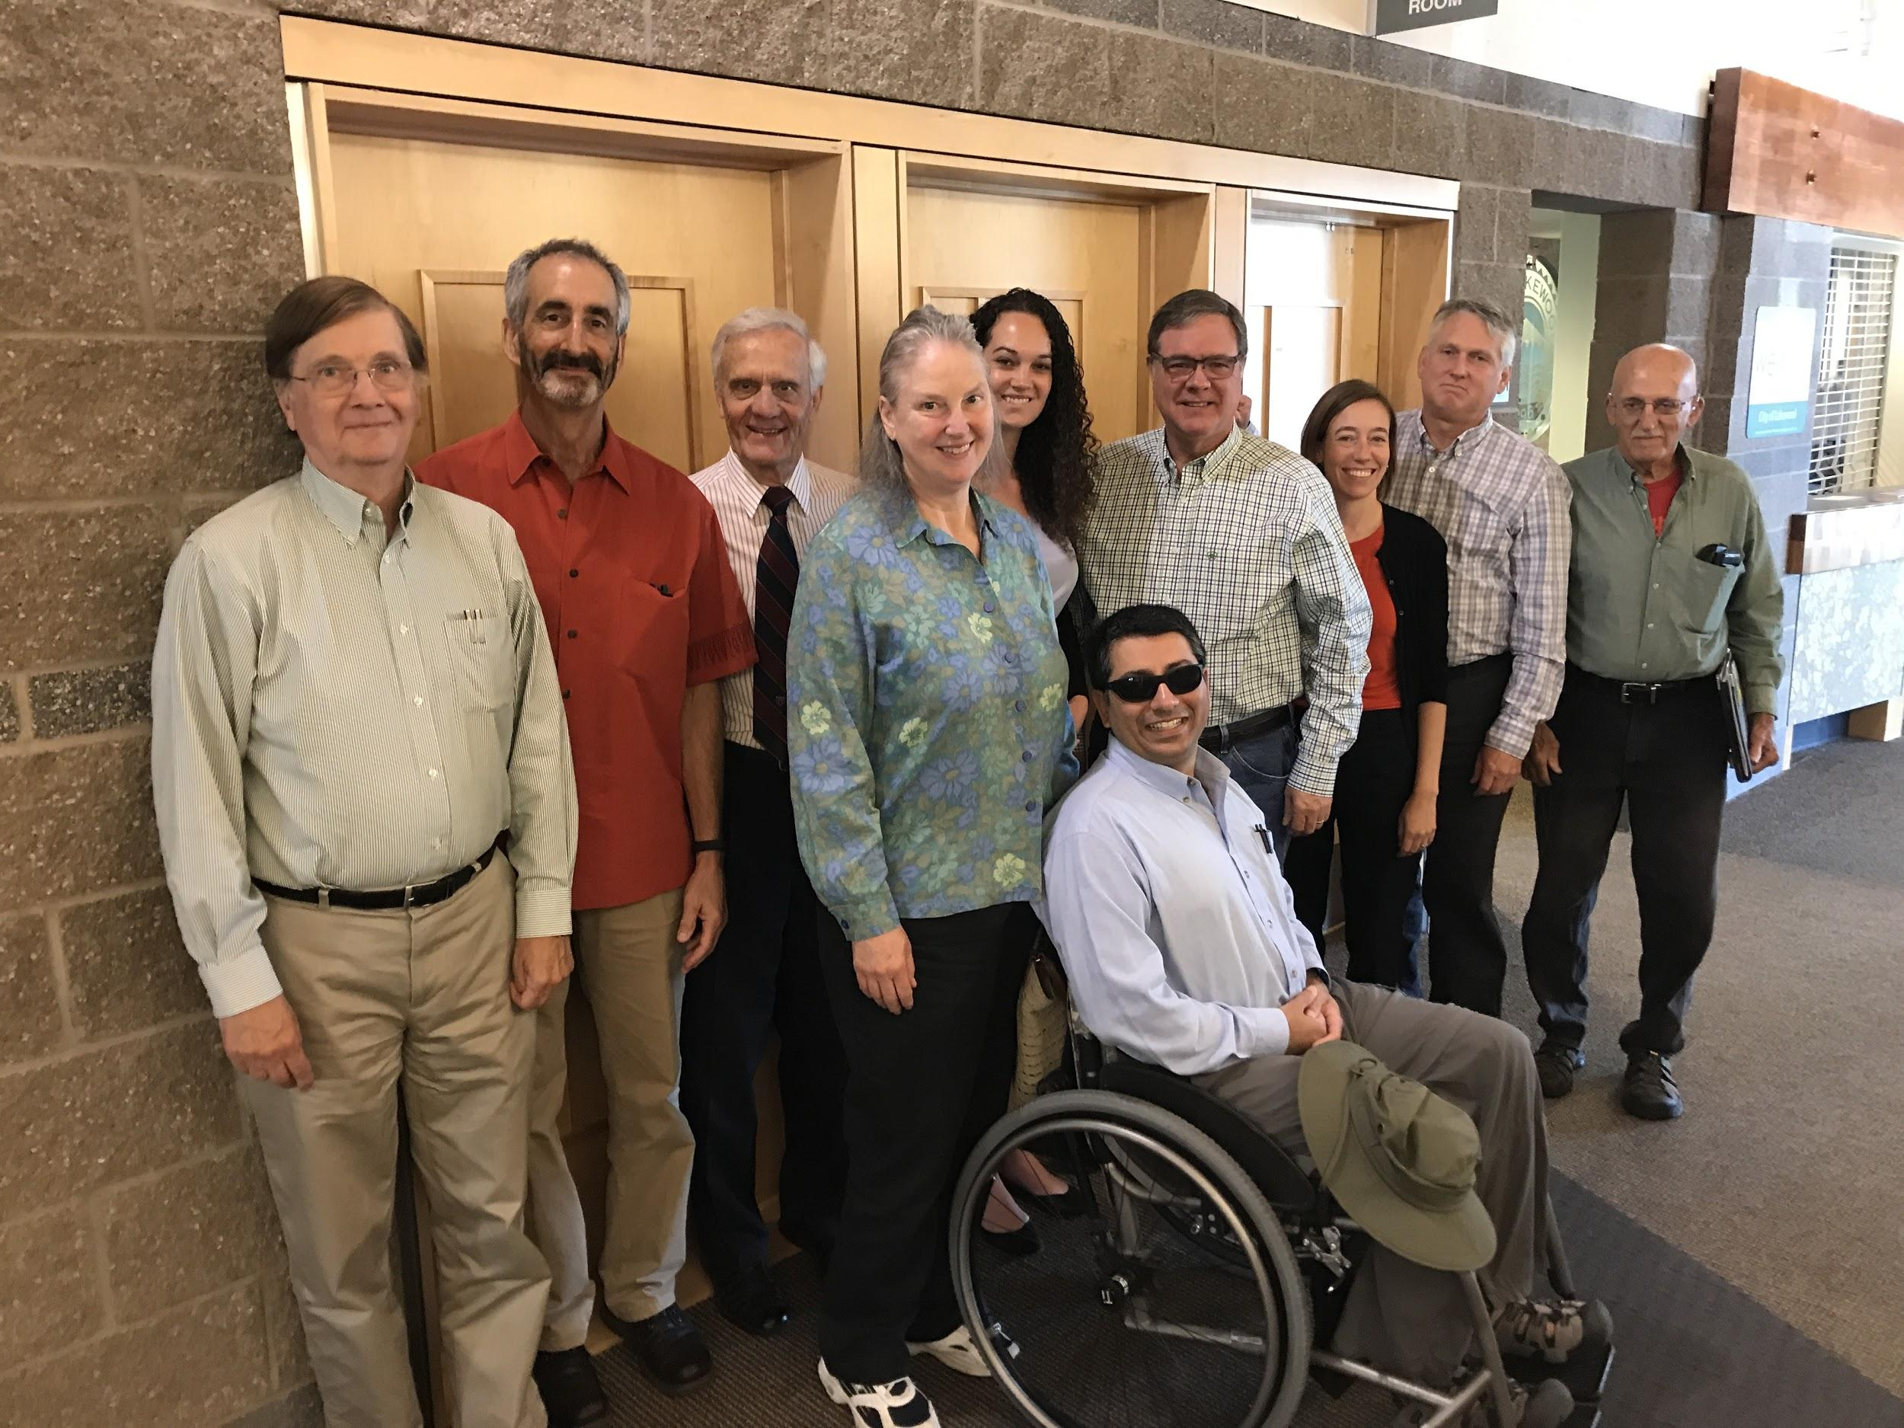
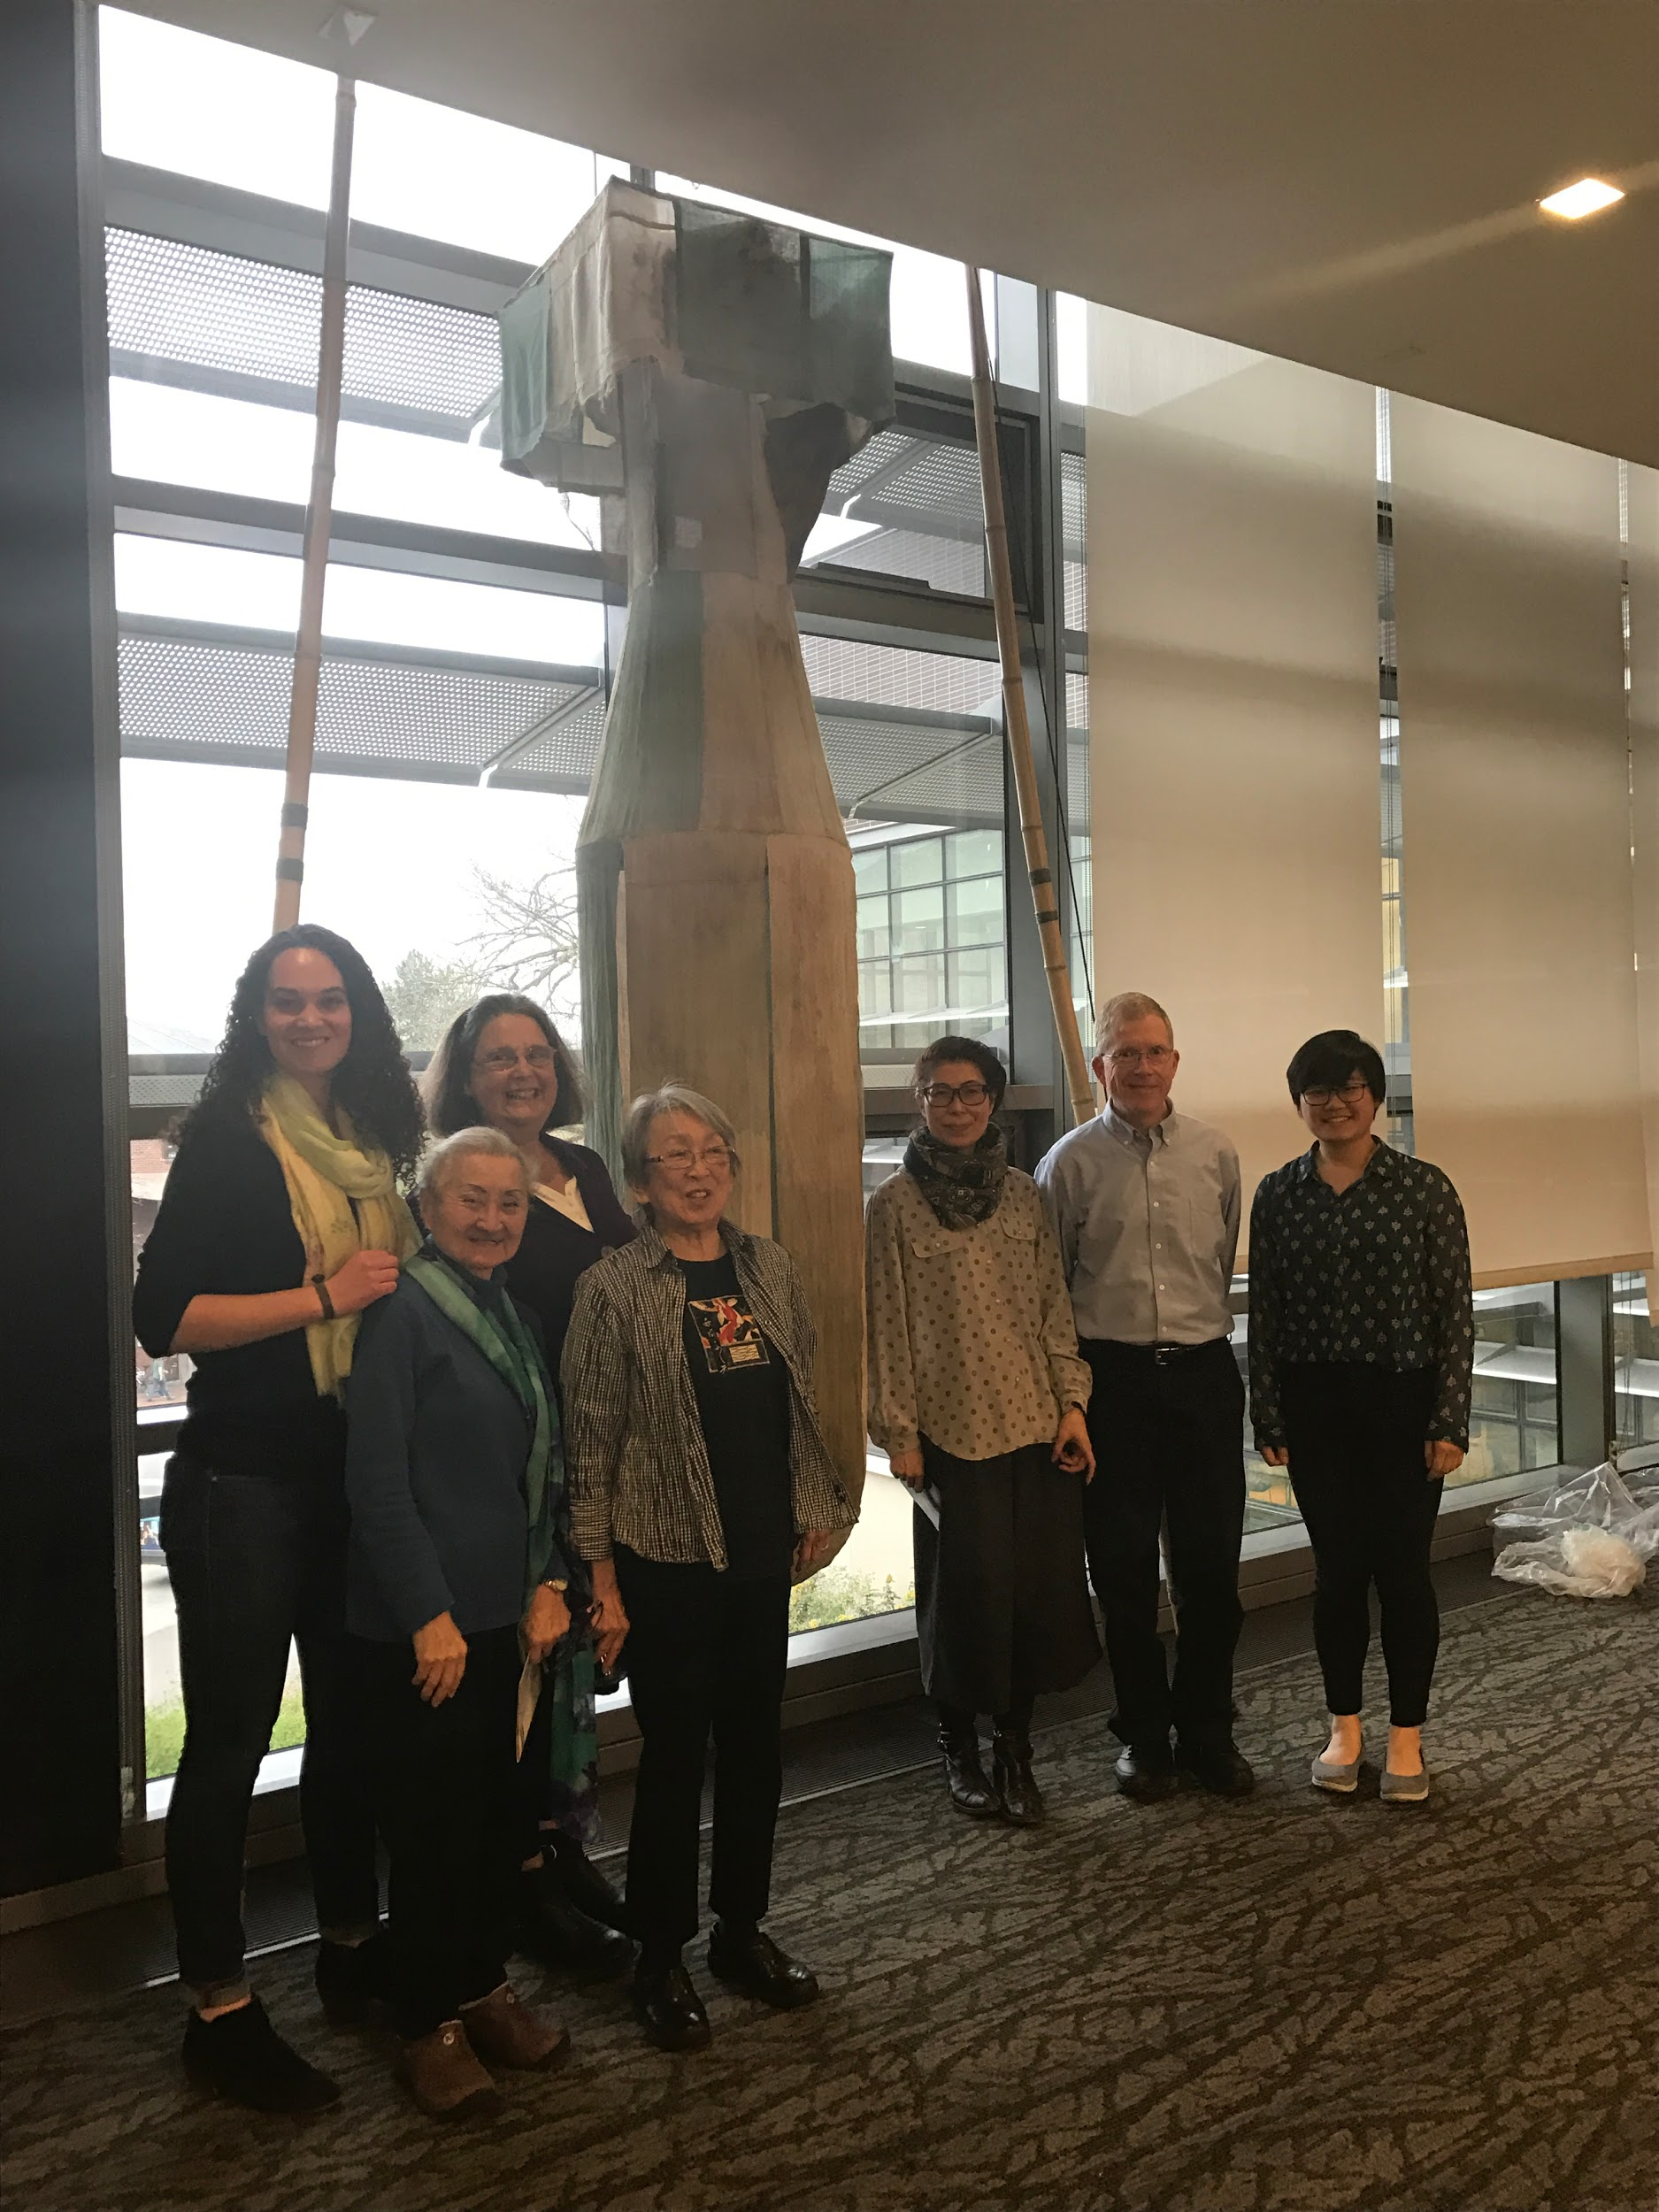
WHAT WE DO
JOIN US AT WANWCOALITION.ORG
Notes:
Grassroots advocacy - building our networks across the state and exerting grassroots influence on our members of Congress
Lobbying - meet directly with our members of Congress to push them to promote and support better nuclear policy
Education - raise awareness of nuclear weapons issues, especially working to reach new audiences
you can learn more about our work and how to get involved at our new website: wanwcoalition.org

