Slide 1
NUCLEAR WEAPONS AND SOCIAL JUSTICE: BUILDING AN INTERCONNECTED MOVEMENT
LILLY ADAMS – SECURITY PROGRAM ORGANIZER
Notes:
Agenda:
Talk about current issues around nuclear weapons
Ways that the we talk about this issue – different messaging
Social justice – really important way to make this issue urgent today
Workshop – communicating this issue to others, prep your own pitches and do a group brainstorm on how we can connect more. Have time at the end for questions and discussion.

Slide 2
WASHINGTON PHYSICIANS FOR SOCIAL RESPONSIBILITY
Notes:
PSR started in 60’s – physicians, understanding that, because it would be so devastating, there is no possible cure for use of nuclear weapons, only way forward is prevention
WPSR started in early 80’s, also around nuclear weapons
Based in Seattle, but work all across the state
Work on climate and health, nuclear weapons, and income inequality

Slide 3
YOUR TOP FUNDING PRIORITY?
Education?
Health care?
Affordable housing?
Notes:
if you had control of the budget, what would you prioritize?
Have a few people share theirs

Slide 4
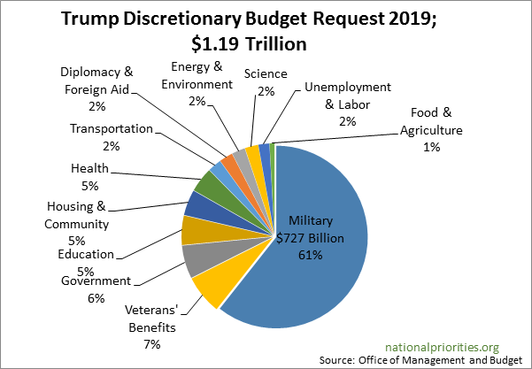
TRUMP’S 2019 BUDGET REQUEST
Notes:
Here’s how the government prioritizes our spending though
This is Trump’s budget proposal for 2018 – note – only discretionary spending, does not include mandatory spending like social security, medicare and Medicaid, spending on the national debt, etc.
Pull some examples (eg, if someone said health – point out that it only gets 5%)

Slide 5
SPENDING ON NUCLEAR WEAPONS
$1.7 trillion over 30 years, with inflation
$4.6 million every hour, for the next 30 years
WHAT COULD WE SPEND THAT MONEY ON INSTEAD?
Notes:
1.7 trillion with inflation
Not just maintaining, but rebuilding every part of our arsenal – warheads, missiles, etc
Money is actually provoking a new arms race, because it’s forcing other nuclear weapons states to keep up
Started in Obama administration
Let’s go back to what you said you’d like to prioritize. What could $1.2 trillion dollars do for that issue?

Slide 6
Notes:
Often thought of as a Cold War era issue, but it is just as important as it was. But, it has largely flown under the radar since 1991.
Why care now? The world still has 15,000 nuclear weapons, in the hands of 9 countries.
The weapons we have are also very different – up to 100’s of times more powerful and destructive than those used in Hiroshima and Nagasaki

Slide 7
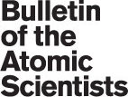
GLOBAL CONTEXT
Notes:
Nuclear experts warn us that we’re closer now than we have been in the past 30 years to a nuclear catastrophe – either through conflict or accidental use.
The Bulletin of the Atomic Scientists has set the metaphorical doomsday clock to 2 minutes to midnight – closest we’ve ever been. Due to the extremely unstable situation of nuclear weapons and threat of climate change. Moved even closer than last year, when we were at 2.5 minutes.
Extremely dangerous global situations:
Escalating threats with North Korea. With such unpredictability on both sides, we could be one tweet or one missile test from a nuclear tragedy.
Deteriorating relationship between the US and Russia, especially around arms control treaties
India and Pakistan, both have over 100 nuclear weapons, have been in conflict for decades, and Pakistan has a policy of first use.
Threats to the Iran Deal
Now – US policy sparking a world-wide nuclear arms race.
The nuclear context is the most dangerous it’s been since the height of the cold war.

Slide 8
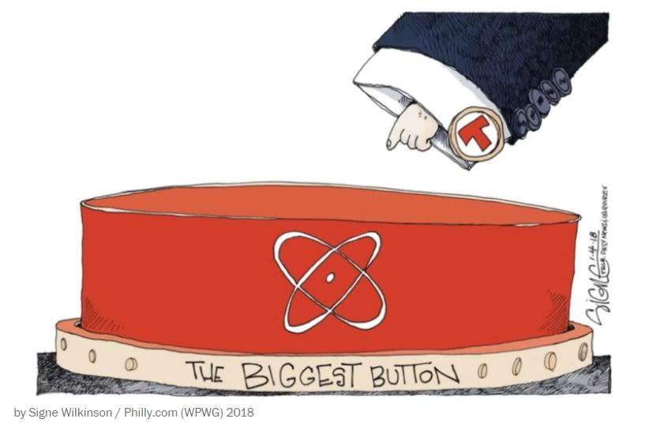
THE US NUCLEAR POSTURE REVIEW
Notes:
No surprise to anyone by now that the Trump admin wants the “biggest nuclear button” in the world
New policy Released early Feb
Complete departure from previous nuclear weapons policy – increases the role of nukes in our military and govt
New, more “usable” low-yield nuclear weapons
Expands the situations in which we would use nuclear weapons
Almost completely ignores diplomacy and disarmament
It’s been the policy of the US to work towards a world without nuclear weapons since Reagan, and to recognize that nuclear weapons should never be used. That seems to be going out the window.

Slide 9
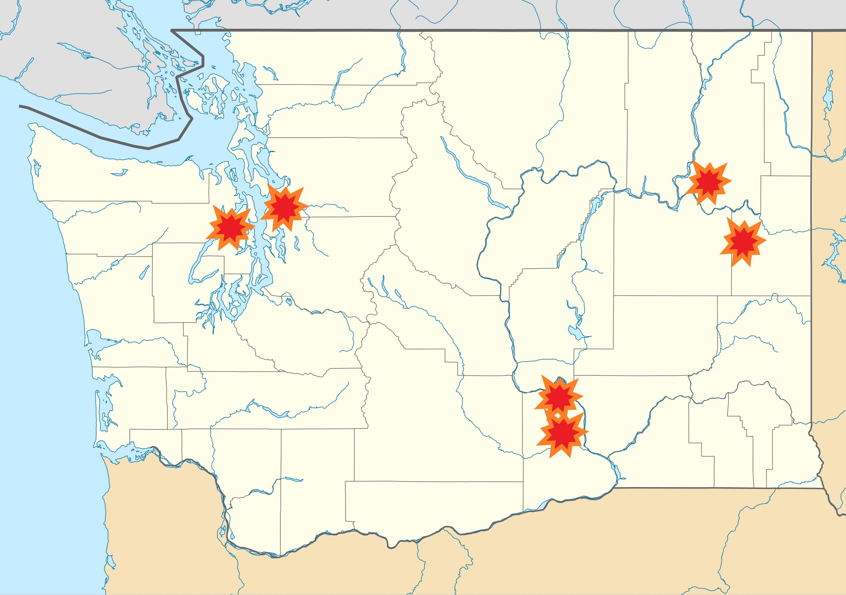
NUCLEAR WEAPONS IN WASHINGTON
Notes:
WA state has a particular connection to nuclear weapons
Just 20 miles from Seattle is the largest collection of deployed (ready to use) nuclear weapons in the US. Held on 8 nuclear submarines, each of which has the power equal to over 5000 Hiroshima bombs.
If WA were a country, we’d be the 3rd largest nuclear weapons country in the world
Hanford near the tri-cities
Uranium mining at Midnite Mine on the Spokane Tribe of Indians Reservation
Fairchild Air Force Base – site of land-based missiles
PNNL Lab – carries out nuclear non-proliferation work with the National Nuclear Security Administration
Boeing – one of the largest nuclear weapons producers in the US – Boing has just become the largest nuclear weapons producer in the US, according to money spent, as of 2017

Slide 10
WHY FIND INTERSECTIONALITY?
Notes:
We get used to talking about issues in one particular way. We often think about what resonates with us, but not others.
Studies have shown that this is not an issue that people relate to today – seems like an issue from another era
People today have many concerns, and want to take action, but those concerns are not generally nuclear weapons
Question for the group – what are the biggest concerns that people are thinking about today?
Maybe – environment, social justice, women’s rights

Slide 11
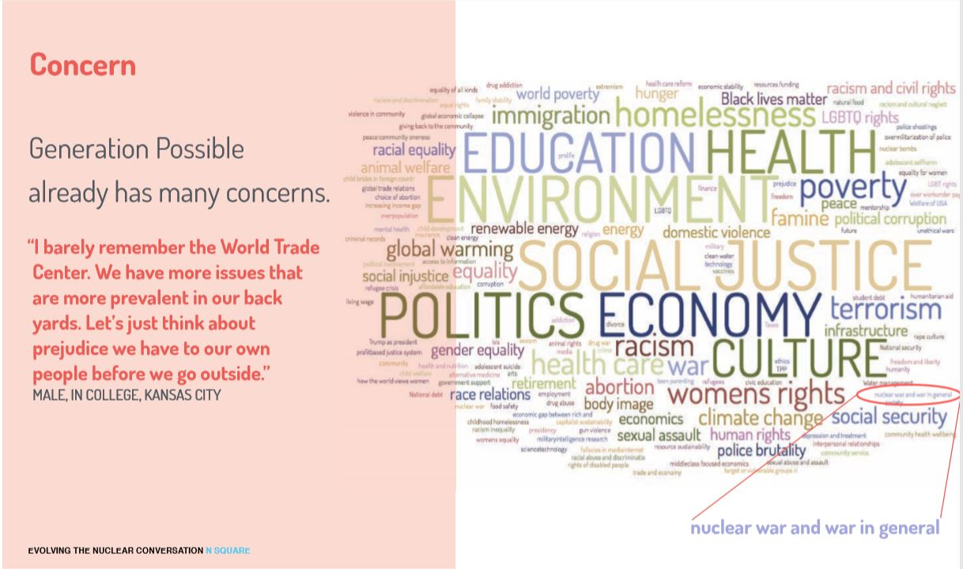
Notes:
This is from N-square and some research they did on what issues Millennials are concerned about
The size of the word corresponds to how much people talk about this issue or care about it
Not even nuclear war, but war in general – barely registers
Talking from experience, nuclear weapons was never an issue I thought I needed to be concerned about, never something I thought I would work on
So, it’s crucial to be able to connect nuclear weapons to other issues that people care about today

Slide 12
SPENDING ON NUCLEAR WEAPONS
$1.7 trillion over 30 years, with inflation
$4.6 million every hour, for the next 30 years
WHAT COULD WE SPEND THAT MONEY ON INSTEAD?
Notes:
Go back to this slide
What does $4.6 million/hour mean to people who are struggling financially. What kind of social programs could this fund?
Children’s health care, early education, raising minimum wage, affordable housing, etc
Someone who works with Latino community in Seattle said – admin is cutting “bread and butter” programs – food stamps, money for schools, Medicaid, that help people every day, but dumping money here.
If a budget is a reflection of our priorities, it’s clear that nuclear military might is valued over basic needs in our communities.

Slide 13
10 YEARS OF NUCLEAR WEAPONS FUNDING
School lunches for one million students, for 10 years
4 years of community college for 9 million students
Early childhood education for every 3-4 year old in the US
$400 billion for nukes
$5 billion
$120 billion
$260 billion
Notes:
It’s still hard to visualize this money. Over 10 years, not including inflation – $400 billion
Ex: Thinking about what I’d like to see money go towards, I also think about education
Math isn’t perfect, but roughly:
School lunches for 1 million students, for 10 years, would cost about 5 billion
Obama made a plan to pay for community college for 9 million high school students – would have cost roughly $120 billion over a decade to provide 4 yrs of school
then keep going - $260 billion would provide early childhood education for every 3-4 yr old in the US
Then we’d still have $15 billion left over
So, we could provide free college across the country and early childhood education for every child in the US…or make the deadliest weapons ever created even deadlier, only hoping that they will never be used

Slide 14
CRADLE TO GRAVE
Mining
Production
Testing
Use
Clean-up
Notes:
Spending on nuclear weapons is only one piece of the puzzle
The entire process of creating our nuclear weapons, to their testing and use, to the legacy they leave behind, is done at the expense of the people involved, often communities of color and low income populations
I’d like to take a few minutes to go through the injustices associated with each of these stages
Cradle to grave – life cycle of a product

Slide 15
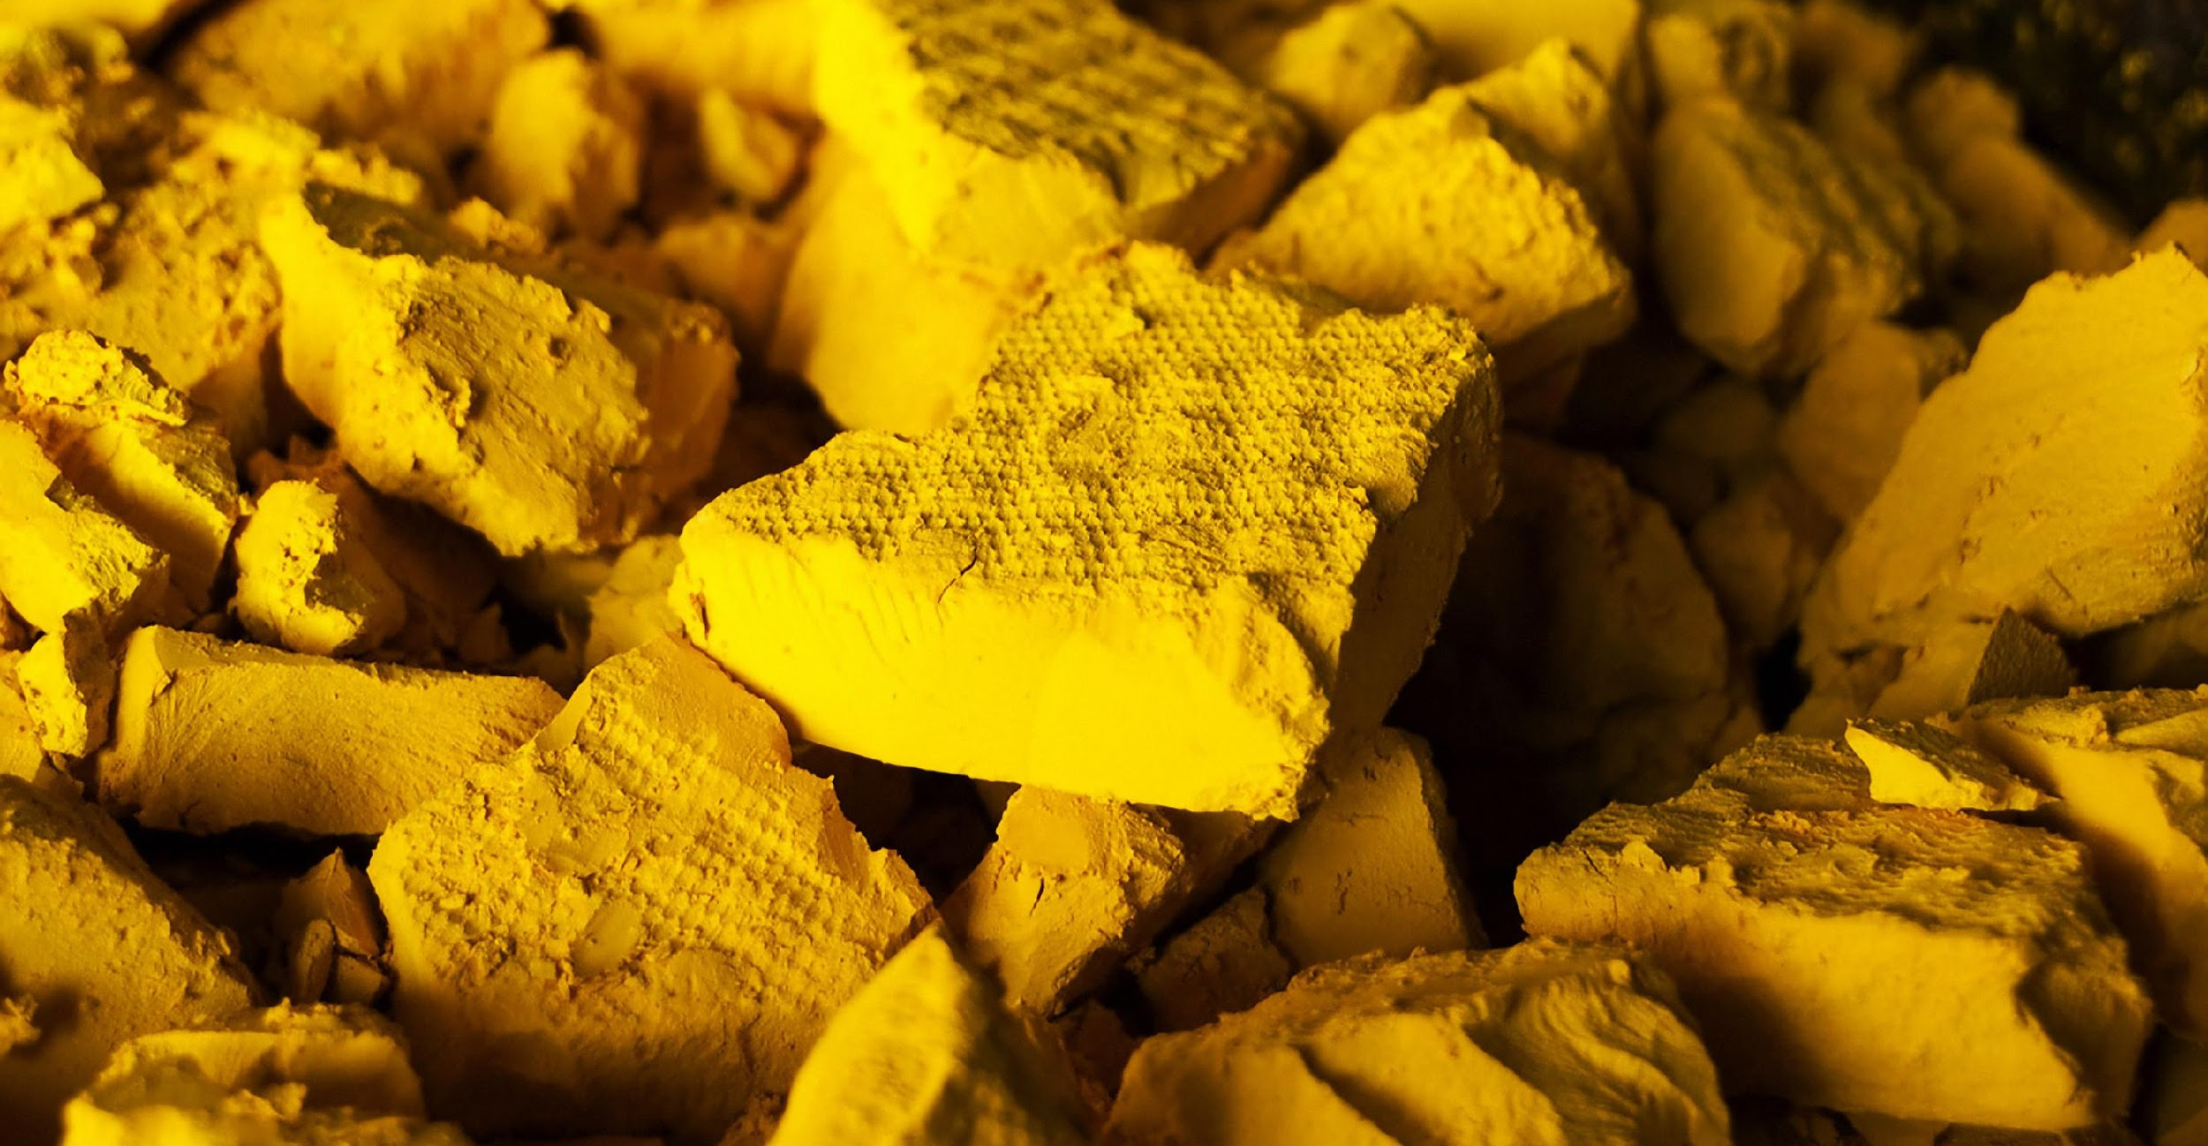
Mining
Production
Testing
Use
Clean-up
Photo: US Nuclear Regulatory Commission
Notes:
Nuclear weapons are made from uranium or plutonium, which is also derived from uranium.
Worldwide, almost all uranium mining for nuclear weapons has happened in non-nuclear weapons states, especially in colonized countries, or in minority areas.
In the US, that has meant on Navajo and other Native American Nations’ land – largely in SW US.
Midnite Mine – just west of Spokane, on reservation of Spokane Tribe of Indians
EPA says people should not hunt, fish, gather food by waterways because they are so contaminated
Workers were often not told about the health impacts and dangers of mining uranium. People brought contaminated materials back to their homes, some became toys that kids played with, some materials were used to build structures that still exist today.
Uranium was trucked through middle of reservation, by homes. Again, people were unaware of health consequences.
Companies have avoided cleanup costs for years. Mine closed in 1981 - only just came to an agreement in 2014 of who would pay
There’s a program to compensate people, but not a single person in the Spokane Tribe, or worker at Midnite Mine has received any money, since no one knows this program even exists.
Has been some outside interest in renewing mining there – controversial currently. Jobs vs health.
Sources:
http://www.npr.org/sections/health-shots/2016/04/10/473547227/for-the-navajo-nation-uranium-minings-deadly-legacy-lingers
http://www.nytimes.com/2009/07/27/us/27navajo.html?_r=0&mtrref=undefined
https://www.epa.gov/navajo-nation-uranium-cleanup
https://energy.gov/sites/prod/files/2014/09/f18/Defense-RelatedUraniumMinesReporttoCongress-FINAL.pdf
https://cumulis.epa.gov/supercpad/cursites/csitinfo.cfm?id=1001070
http://www.seattletimes.com/pacific-nw-magazine/radioactive-remains-the-forgotten-story-of-the-northwests-only-uranium-mines/

Slide 16
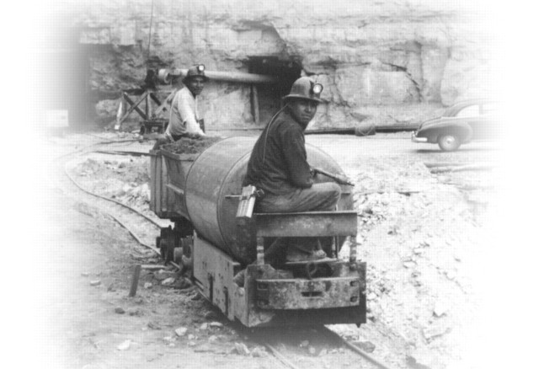
Racial Justice Connection
Indigenous people, minorities, colonized countries were exploited and harmed to mine uranium for nuclear weapons.
Communities are still bearing the health and environmental burdens of this today, and are not adequately compensated by the government

Slide 17
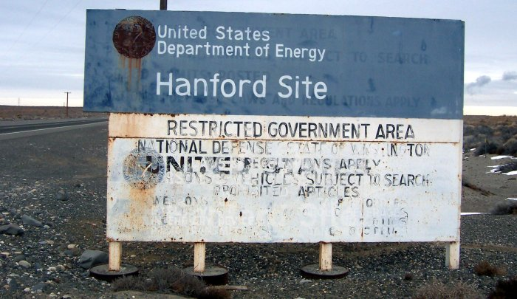
NUCLEAR WEAPONS PRODUCTION
Mining
Production
Testing
Use
Clean-up
Notes:
Over 500,000 workers in weapons complex sites during the Cold War were exposed to radiation or harmful chemicals
Hanford was created in 1940’s in E.WA to produce bombs in WWII. The plutonium used in the bomb dropped on Nagasaki was produced at Hanford, in E. WA, as well as the first atomic bomb ever tested. Produced most of the plutonium used in the 60,000 nuclear weapons the US made.
The site had been used for thousands of years by the Wanapum People year-round, and during the winter by the Yakama Nation, Confederated Tribes of the Colville, Confederated Tribes of the Umatilla Reservation, and the Nez Perce. They were all displaced and given no compensation.
The roughly 1,500 residents of the nearby cities were also displaced to make way for the Hanford Site.
Workers were often not told that they were making bombs, dealing with radioactive material, until bombs were dropped in Hiroshima and Nagasaki.
In most cases, people of color were only able to get the worst paying jobs. Faced discrimination, harassment, segregation. – “Mississippi of the North”
Massive contamination concerns over course of history – one egregious example was the Green Run - secret experiment done in 1949 by the Air Force – purposefully released a significant amount of radioactive material into the air, to see what the effects would be. No warnings were given, and no follow up w/residents was ever done. Only recently discovered.
Today, we still have about 8 key facilities across the country that do research, but also produce new materials for bombs, and other components. This includes “plutonium pits” – radioactive trigger for bombs, and are pursuing entirely new warheads.
Work is carried out largely by private companies
Sources:
http://crosscut.com/2016/05/hanford-nuclear-reservation-african-americans/
http://www.atomicheritage.org/history/african-americans-and-manhattan-project
http://www.tri-cityherald.com/news/local/hanford/article62991407.html
http://www.thestranger.com/features/feature/2015/12/09/23231378/black-americans-came-to-washington-state-from-around-the-country-to-help-build-the-atomic-bomb
http://www.hanfordproject.com/greenrun.html
http://www.toxipedia.org/display/toxipedia/Green+Run+-+Hanford
https://static1.squarespace.com/static/52311edfe4b0830625de8366/t/591338bb579fb311a54b8fb8/1494432037246/accountability-audit.pdf
https://www.thenation.com/article/meet-the-private-corporations-building-our-nuclear-arsenal/
http://www.ucsusa.org/nuclear-weapons/us-nuclear-weapons-policy/us-nuclear-weapons-facilities.html#.WVVBJYjysdV
https://www.scientificamerican.com/article/nuclear-weapons-site-alarms-shut-off-scientists-inhale-uranium/

Slide 18
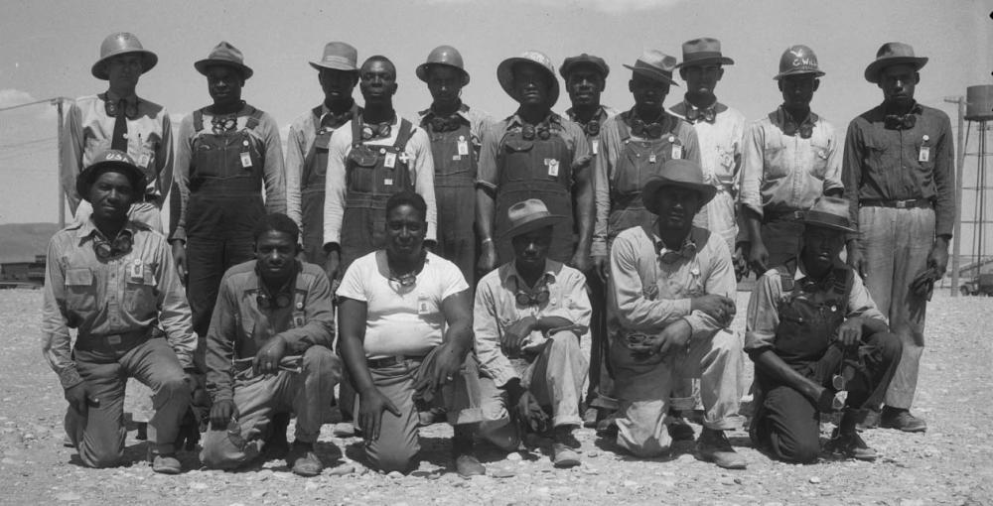
Racial Justice Connection
Indigenous populations displaced and rights ignored to produce nuclear weapons
Rampant segregation and discrimination at production facilities

Slide 19
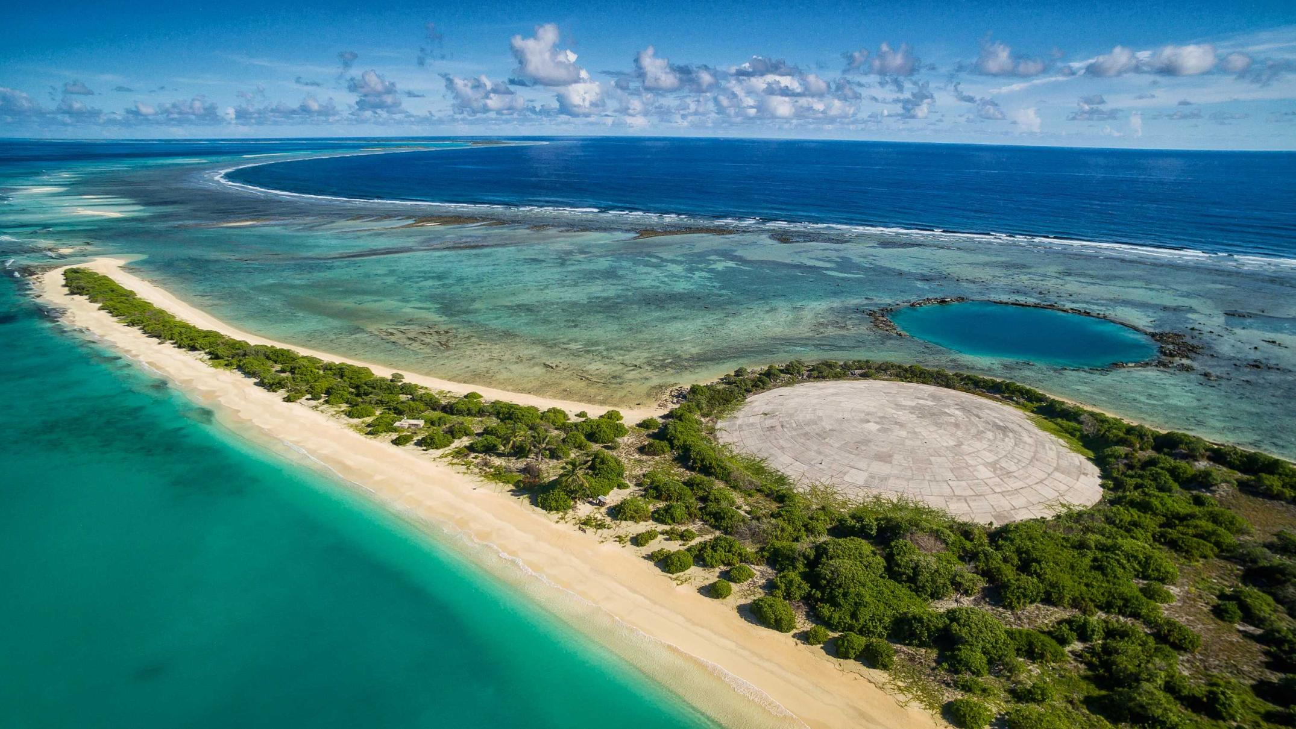
Mining
Production
Testing
Use
Clean-up
Photo: Greg Nelson, Australian Broadcast Company
Notes:
As with uranium mining, nuclear weapons testing was often done in areas with minority populations or in colonized countries.
The United States tested weapons in the Marshall Islands and in Nevada. Nearly 200 tests that spread radiation over the entire country, thousands of miles.
It was estimated by International Physicians for the Prevention of Nuclear War that exposure to radioactive material from tests will eventually result in 2.4 million cancer deaths.
One test in Marshall Islands completely vaporized an entire islands. Residents were “guinea pigs” for US government. Picture is of a dome covering 85000 cubic meters of radioactive material, dumped by the US govt into an unlined pit. Next to it, a crater formed by an atomospheric nuclear test.
The US relocated hundreds of inhabitants from their homes, testing still led to contamination of inhabited areas and exposure to dangerous and near-lethal levels of radiation.
The populations of these islands suffered malnutrition and sometimes starvation when they were relocated to different islands, as well as birth defects, tumors, and other diseases from radiation exposure.
Some islands are still too radioactive for habitation. Original inhabitants and descendants live in exile, a state of “indefinite displacement.
We have stopped nuclear weapons testing, but health impacts continue.
Marshallese were able to work and live in US, but not citizens, so couldn’t receive medicare or Medicaid.
Law just passed in WA state to allow Marshallese Americans to receive health care – large population of Marshallese Americans in Spokane – one of the largest in the country. But this should be provided by the federal government, which is still failing this community in the rest of the country.
Sources:
https://www.theguardian.com/world/2014/mar/02/bikini-atoll-nuclear-test-60-years
https://energy.gov/sites/prod/files/DOENTSAtmospheric.pdf
https://www.ctbto.org/nuclear-testing/the-effects-of-nuclear-testing/the-united-states-nuclear-testing-programme/

Slide 20
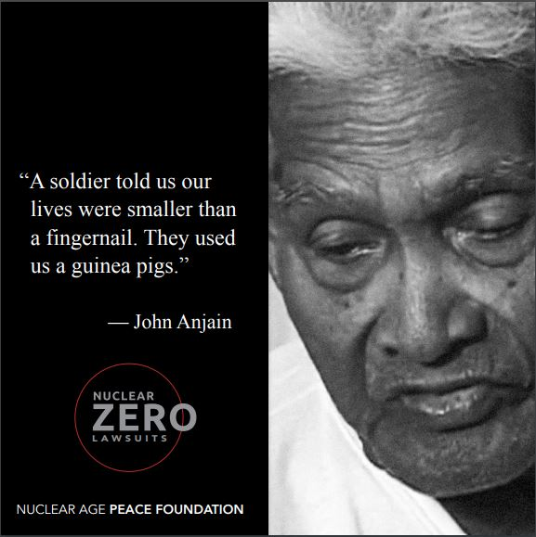
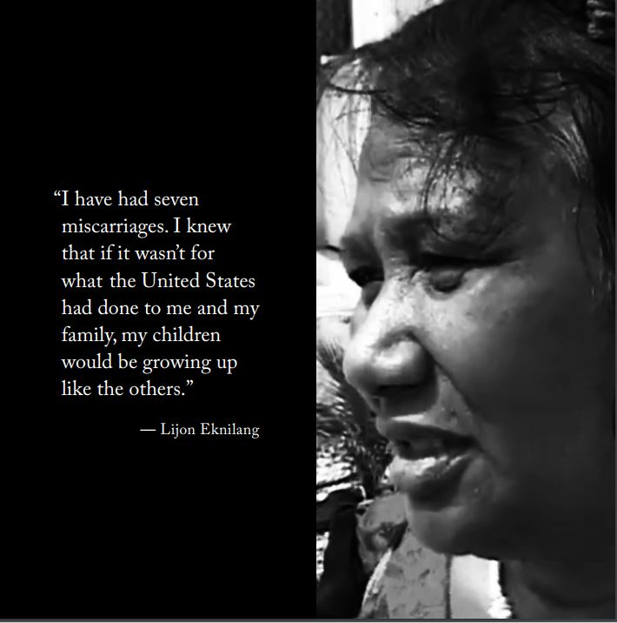
Racial Justice Connection
Residents of a US colonized country used as guinea pigs and treated as disposable
60 years later, compensation, care, and clean-up still not provided by the US government

Slide 21
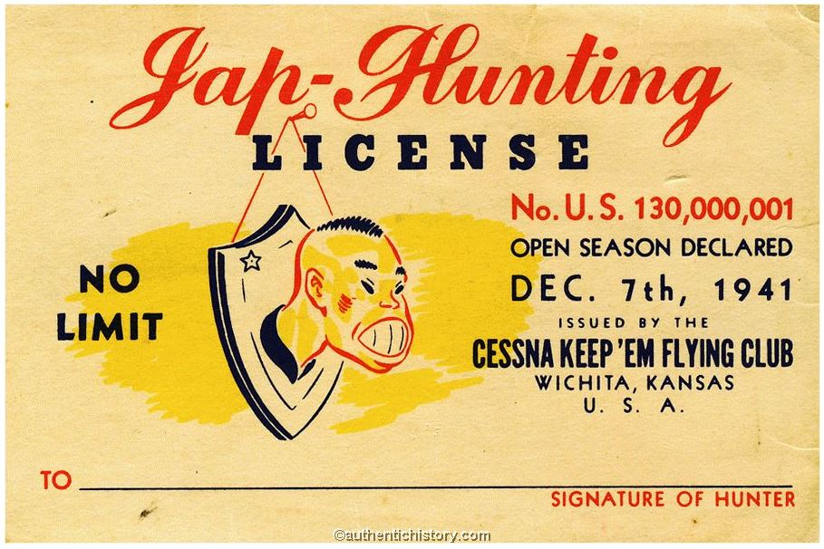
USE OF NUCLEAR WEAPONS
Mining
Production
Testing
Use
Clean-up
Notes:
Nuclear weapons have only ever been used in conflict by the United States
Used on Hiroshima and Nagasaki in 1945, in an effort to end WWII. It resulted in approx. 100,000 deaths almost instantly, and roughly 1000,000 people died later from radiation poisoning and other injuries/illnesses
Indiscriminate – killing combatants and non-combatants, although the purpose of nuclear weapons are not to be used on the battle field, but to destroy cities and infrastructure. Many have argued that their use was racially motivated – propaganda and anti-Japanese sentiment was extreme at that time.
WPSR would argue that because of the nature of their destruction – wiping out entire populations, that they threaten genocide, especially when considering that our weapons are up to 75 times more destructive than those used in Hiroshima and Nagasaki
Lots of debate over their use in 1945, but there is lots of evidence showing that they were not necessary to end the war

Slide 22
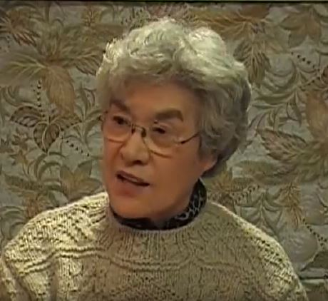
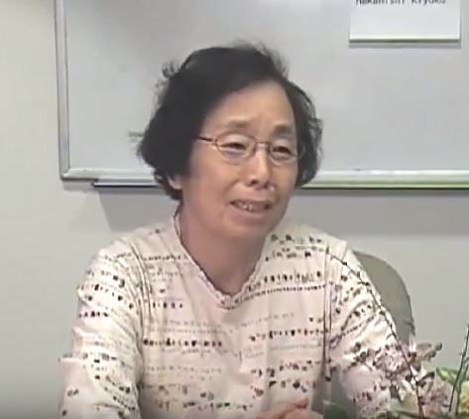
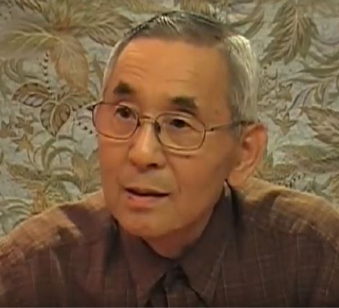
Racial Justice Connection
Some argue that use for nuclear weapons in World War II was racially motivated and justified
Today, nuclear weapons threaten genocide

Slide 23
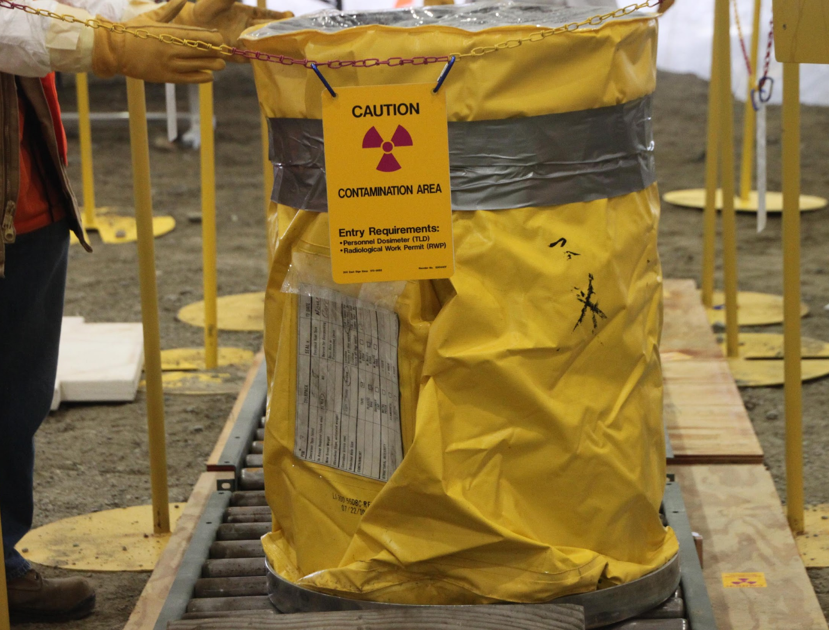
CLEANUP OF NUCLEAR WASTE
Mining
Production
Testing
Use
Clean-up
Photos: US Department of Energy
Notes:
Nuclear weapons leave a legacy of waste that has no clear solution – deadly, pervasive, and unprecedented
Hanford clean up exemplifies this – most contaminated nuclear site in the western world, largest environmental clean up in the world
Expected to cost $115 billion to clean up. Starting in 1989, was originally scheduled to be done in 30 years, by 2020. Now expected to take at least 75 more years to complete.
Large volumes of radioactive waste have since been stored in 177 underground tanks, 67 of which have leaked a total of approximately one million gallons into the surrounding soil.
Safety at Hanford is seriously flawed. Earlier this month, was found that 31 workers ingested plutonium
Sources:
http://www.tri-cityherald.com/news/local/hanford/article141630829.html
http://www.spokesman.com/stories/2017/mar/06/hanford-ill-worker-compensation-bill-passes-house/
https://www.pressreader.com/usa/the-washington-post/20070512/281487861916682
http://www.hanfordchallenge.org/

Slide 24
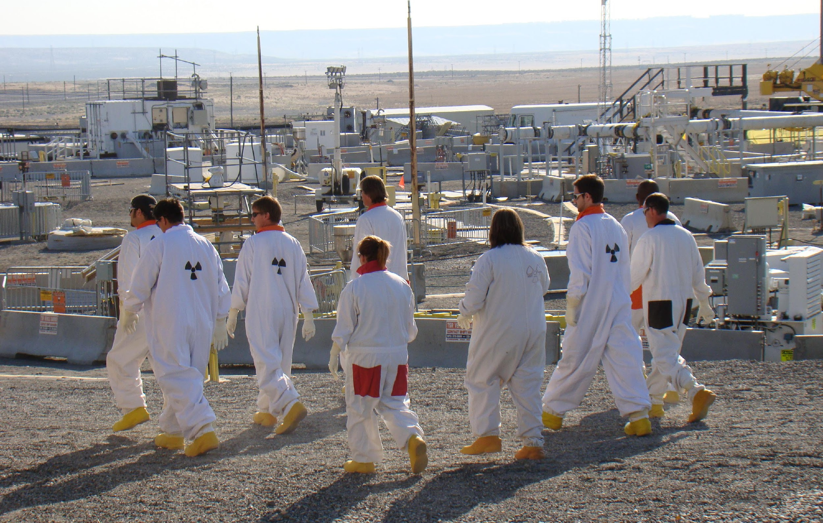
Social Justice Connection
Safety culture is deeply flawed, putting workers at risk
Clean up workers are treated as disposable

Slide 25
CRADLE TO GRAVE
Mining
Production
Testing
Use
Clean-up
Notes:
Two big take-aways:
every stage of nuclear weapons hurts our communities, and nuclear weapons are hurting our communities today.
Trend of military might, advances in our weapons put before people and their well-being
Human cost of this massive nuclear undertaking not considered
Our spending on nuclear weapons is obscene, and irresponsible, when there are so many other important programs to fund.
We tend to think of nuclear weapons as only a national security/military issue, but they are also a social and racial justice issue

Slide 26
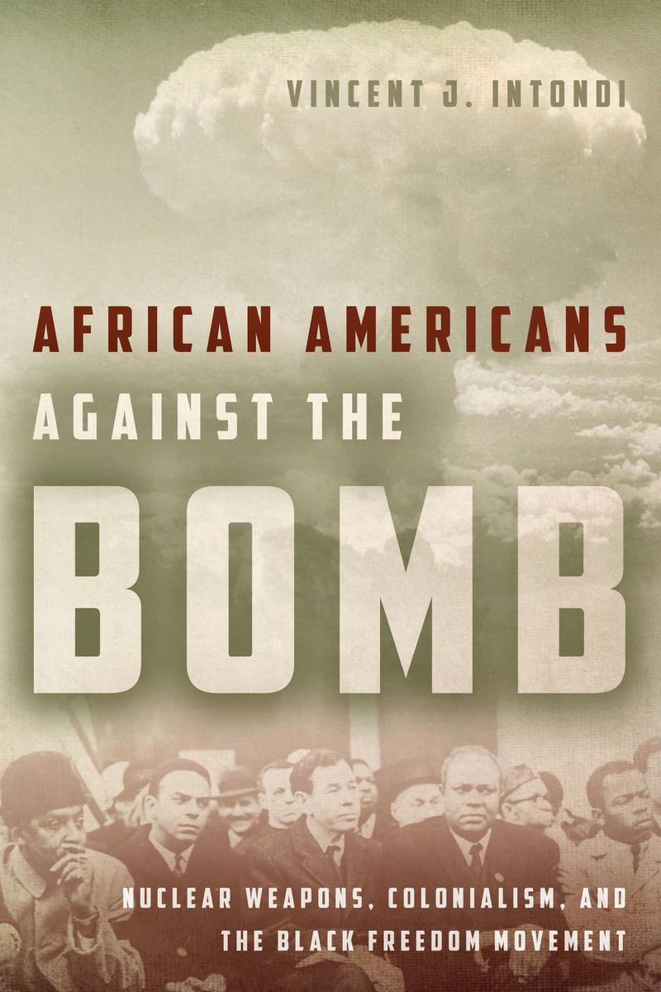
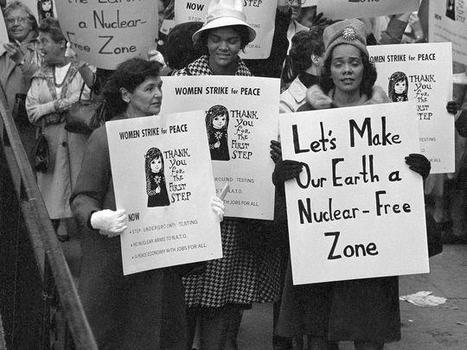
A HISTORY OF INTERSECTIONALITY
Notes:
Good news is that there is a rich history of intersectionality on these issues
People have been making these connections for decades:
seeing how racism was involved in the use of nuclear weapons in Japan, how violence abroad against people of color was an extension of violence at home towards people of color
how mining uranium + testing nuclear weapons in non-white, poor nations + on land of people of color in the US was another manifestation of colonialism
how nuclear weapons and military spending was siphoning money from social services and programs desperately needed by black communities
Many prominent black activists that we celebrate for their work on civil rights were also championing peace and nuclear weapons abolition, like Martin Luther King, Jr, Bayard Rustin, Paul Robeson, Langston Hughes, Lorraine Hansberry, and Coretta Scott King

Slide 27
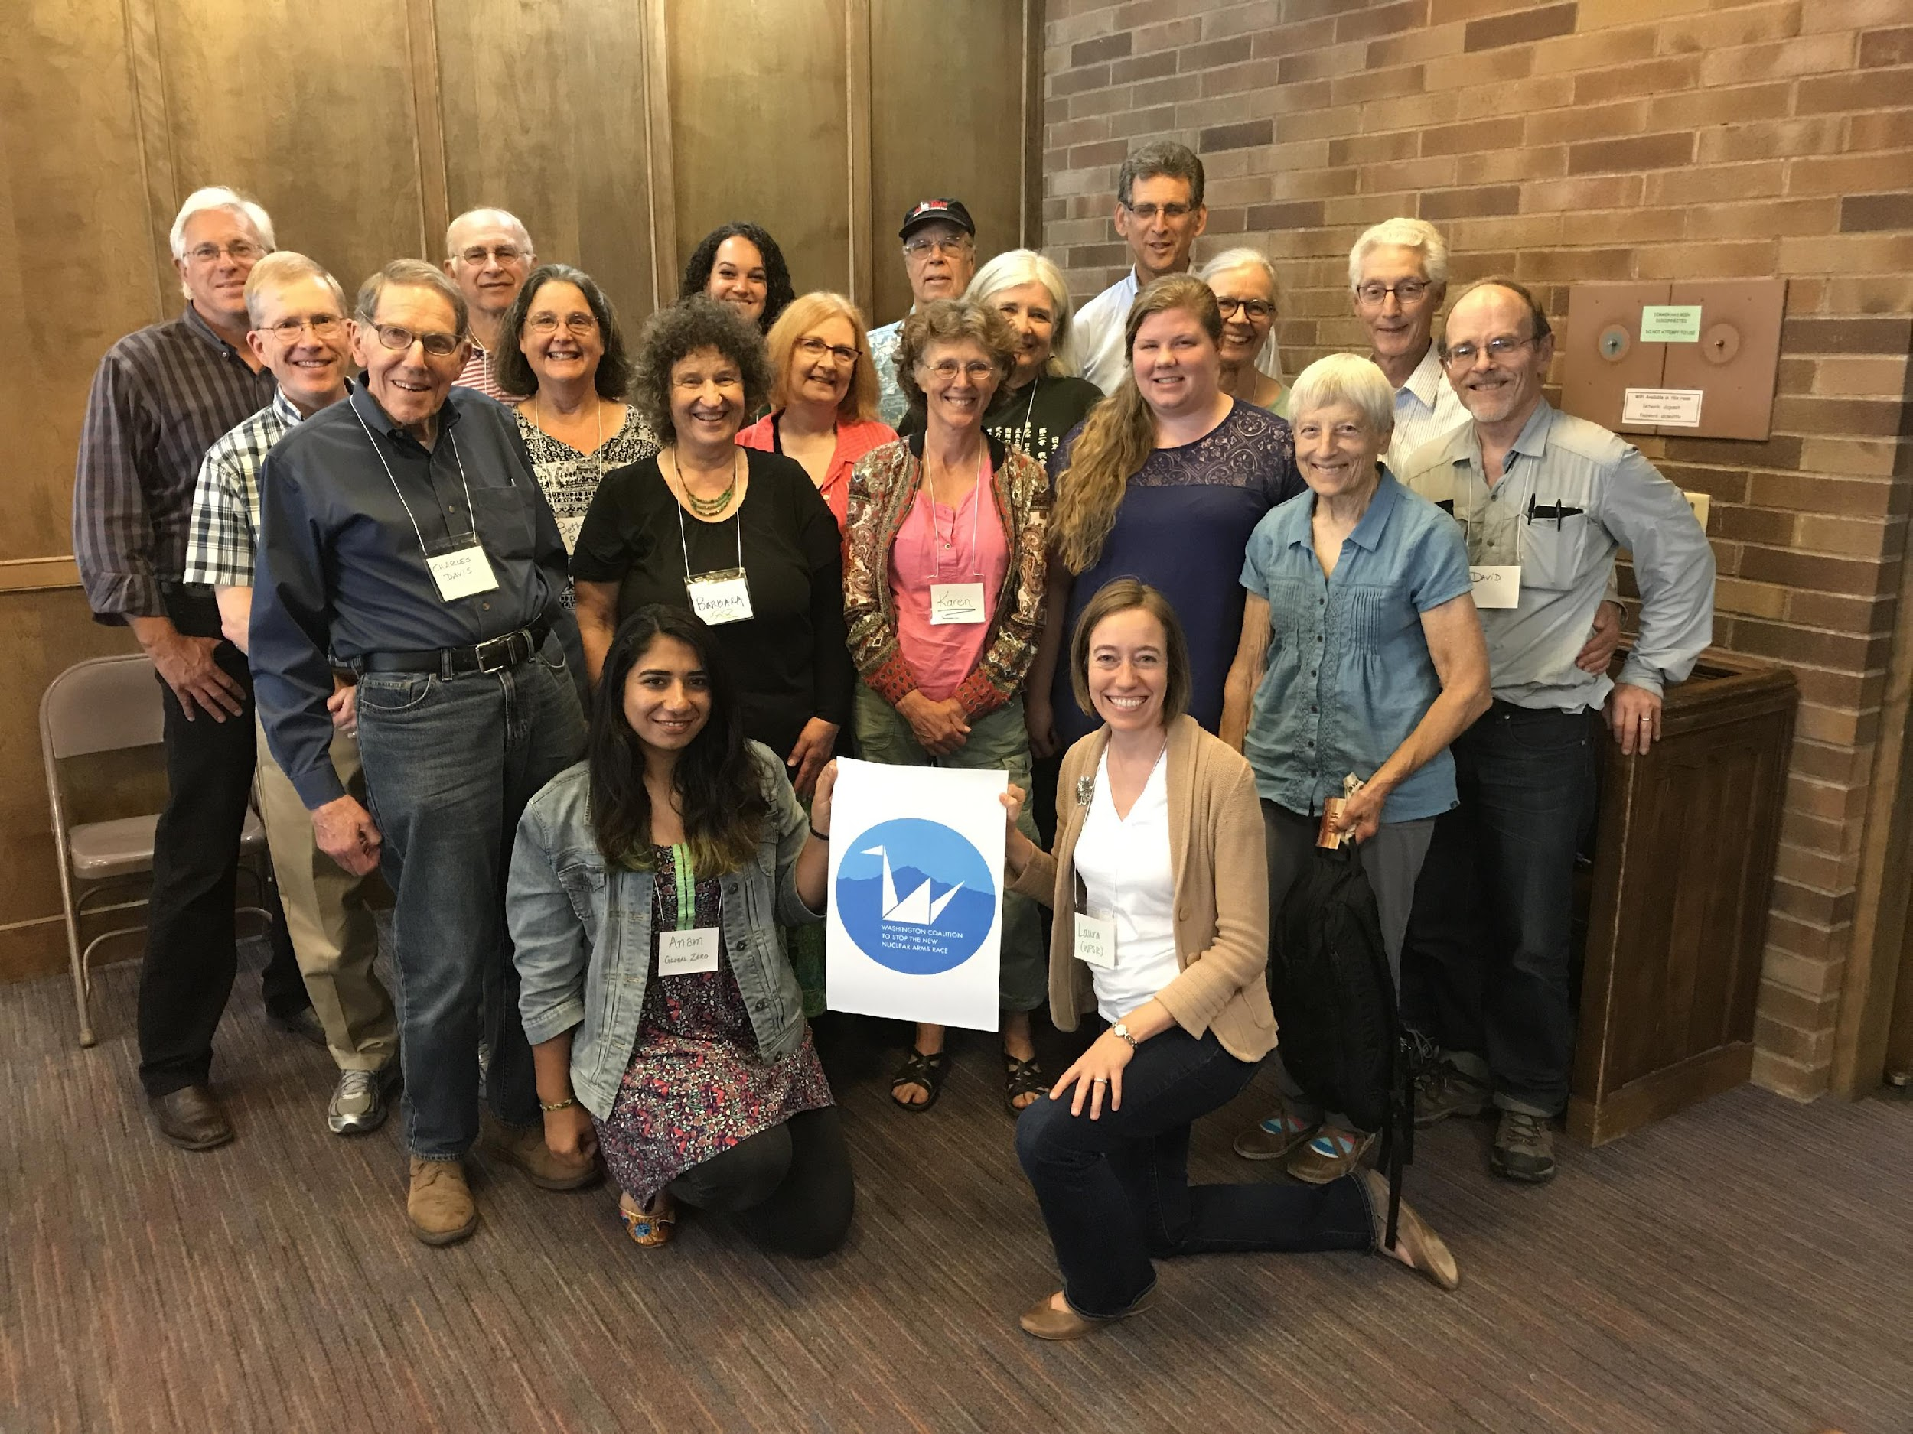
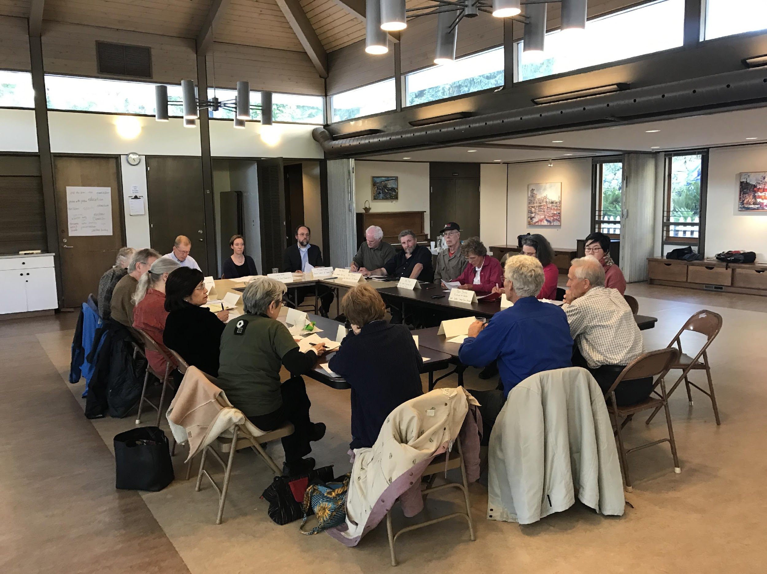
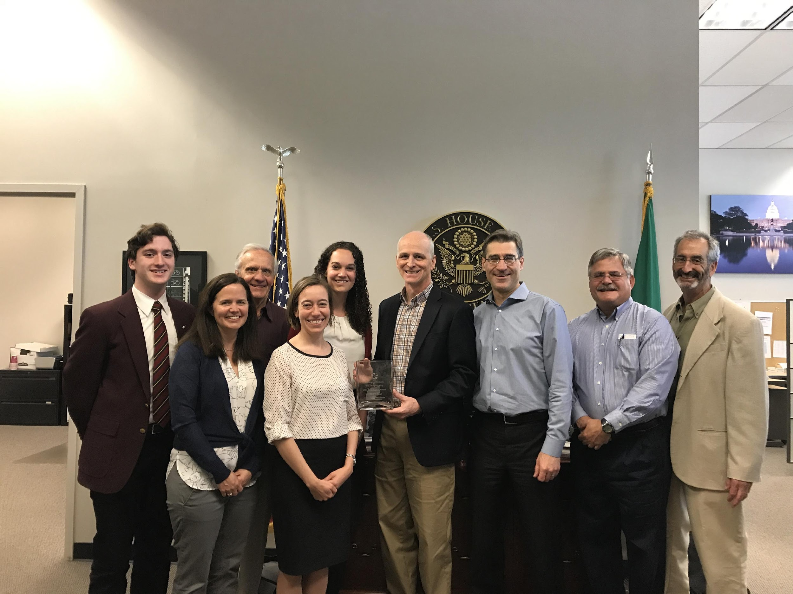
A CULTURE OF EXCLUSION
Notes:
But unfortunately, also a history of white activists sidelining black involvement in peace issues. From ignoring black communities in their outreach, to not sharing leadership with black activists, to insisting that civil rights activists and nuclear weapons activists should stick to their own causes, there was often a strong desire to silo these causes.
This continues today
Nuclear weapons advocacy and policy is a space largely dominated by older white men, where women and people of color often have to fight to be heard.
I see this in my own work at WPSR and with our coalition, as well as across the disarmament field, nuclear weapons activism is largely carried out by, and reaches, white activists. (see photos)
And too often, we still silo our issues.
We have generally not actively worked to connect nuclear weapons issues with racial or social justice issues, and have not sought to build connections and relationships in communities of color
This is an area where we have to grow and learn, both because people of color and low income communities are hit the hardest, and their stories deserve to be told, and they should be at the center of these discussions. But also because otherwise we will fail to be relevant.

Slide 28
YOUR REACTIONS
What is your reaction to this information?
Is this new information? If so, why do you think you haven’t heard about it before? If not, why is it not discussed more?
Why is public action taking so long?
Notes:
Get a few responses to these – 5 minute section
Moment to process the info

Slide 29
PROGRESS AND CHANGE
International
The Treaty on the Prohibition of Nuclear Weapons
ICAN wins the Nobel Peace Prize
National
Progress on disarmament since the Cold War
Members of Congress speaking out, especially in WA
New legislation and debate on nuclear weapons policy
Local
Washington Against Nuclear Weapons

Slide 30
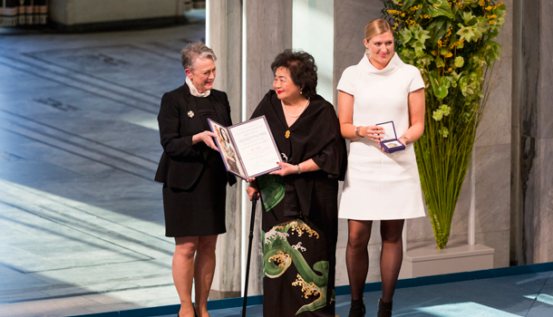
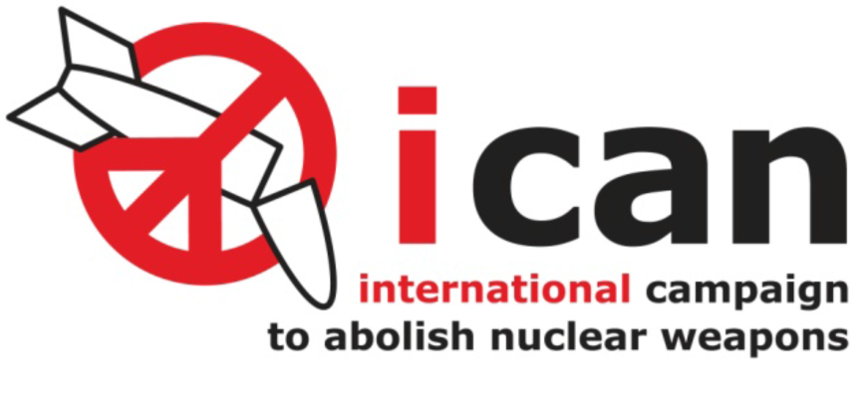
INTERNATIONAL
Notes:
Treaty passed in 2017 – 122 countries voting yes to ban nuclear weapons – strong message that the rest of the world sees these weapons as inhumane, with no place in the world. Stigmatizes
Picture of Beatrice Finh, ED of ICAN, and Setsuko Thurlow, hibakusha, receiving nobel prize. Setsuko has been waiting for 70 years to see this happen, historic moment.

Slide 31
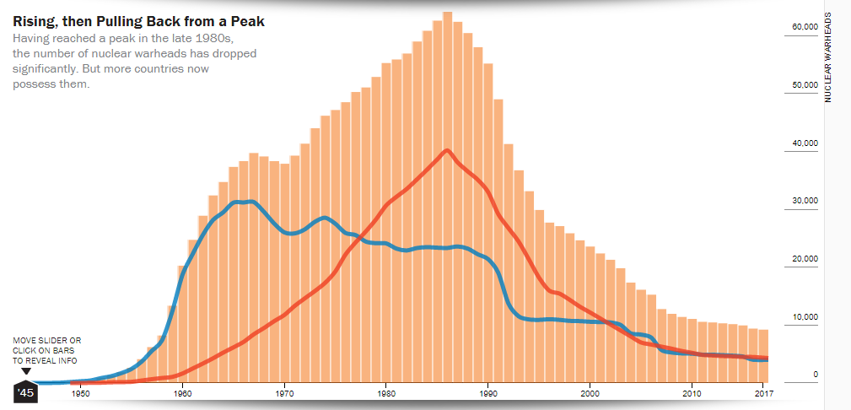
NATIONAL
Graph: The Bulletin of the Atomic Scientists
Notes:
National – have gone from nearly 65,000 nuclear weapons in the world to 15000. Largest reductions in the US have occurred under republican presidents – does not have to be a partisan issue
We have strong advocates for reducing nuclear weapons, and some for eliminating them – here in WA, Rep Smith, Jayapal, Cantwell
Many bills introduced questioning President’s authority to launch nuclear weapons, to use nuclear weapons first – represents a big shift in thinking, started a debate on this issue

Slide 32
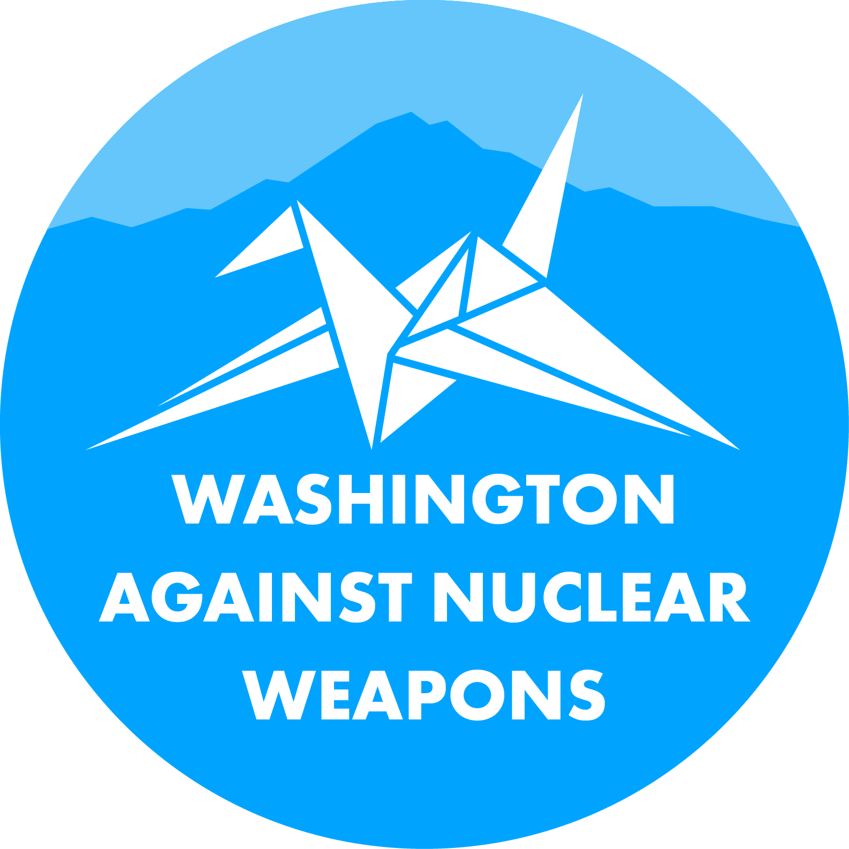
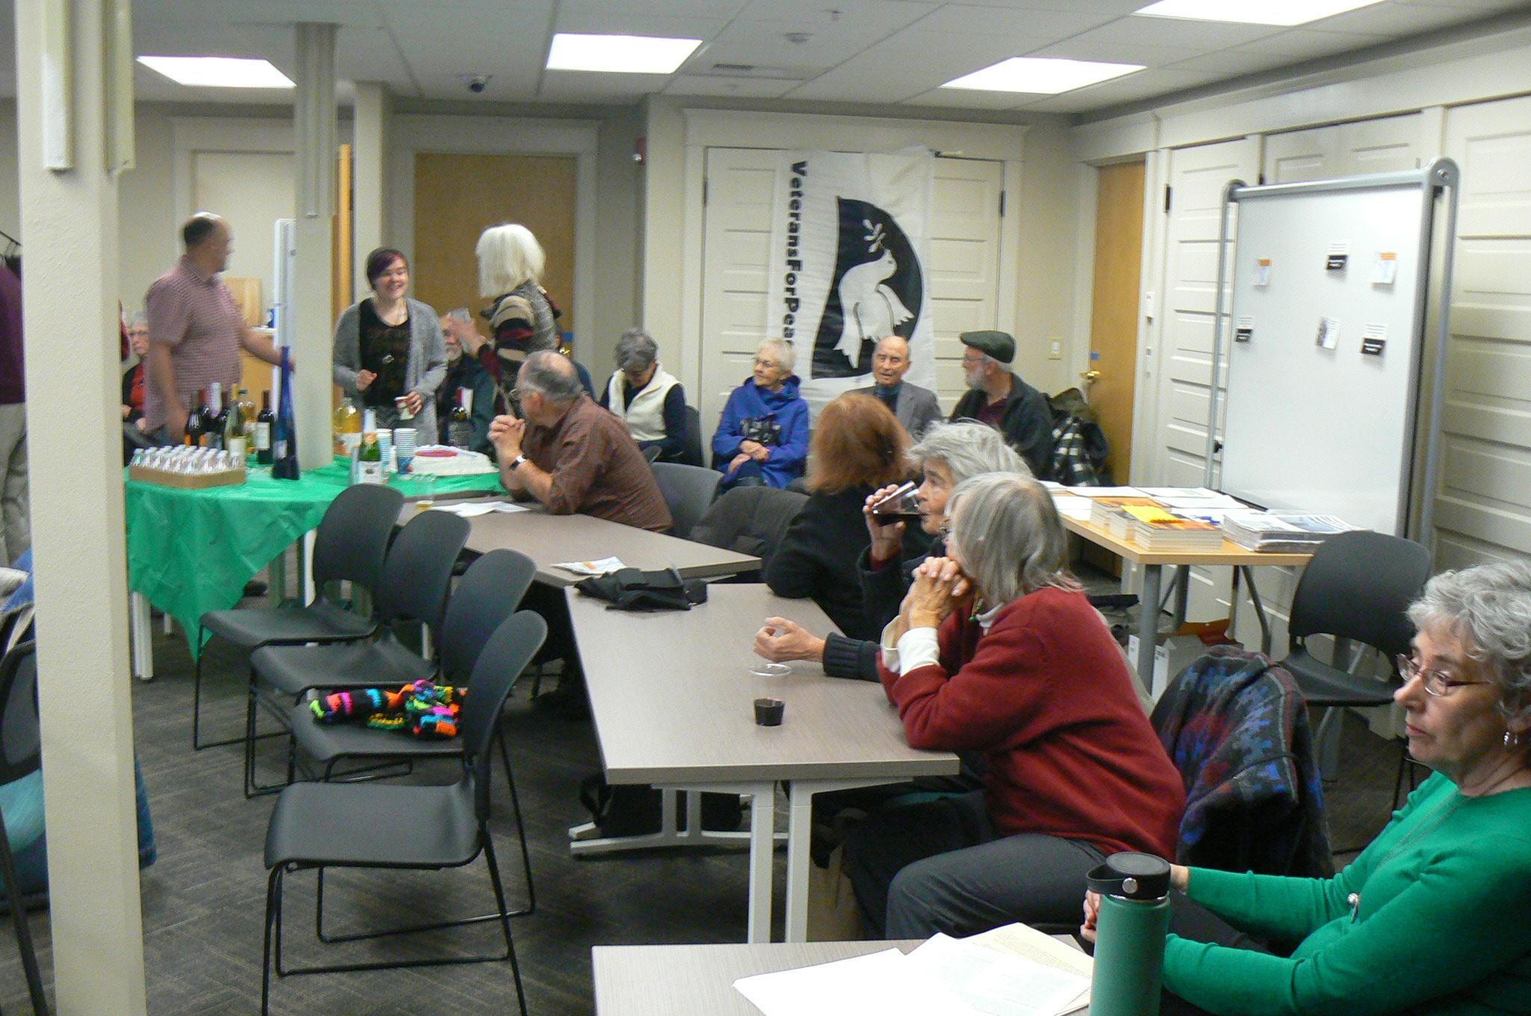
LOCAL
Notes:
Coalition – started recognizing that there were a lot of groups working on this issue, and that we would be stronger not only if we worked together, but also if we also collaborated with groups that don’t traditionally work on nuclear weapons.
Now has 34 groups involved (as of Monday!) - statewide, diverse issue areas – peace, faith, labor, health, environmental, social justice
Taking on educational and awareness work, congressional advocacy, grassroots action, and expanding the coalition itself – more geographic areas and diverse backgrounds – communities of color, youth, women, labor groups
In Spokane – 3 groups, have held events, media, grassroots advocacy

Slide 33
NUCLEAR WEAPONS ACTIVISM IN NW WASHINGTON

Slide 34
GUIDING QUESTIONS
What could nuclear weapons organizing look like in the Bellingham/NW area?
What would be impactful and effective in this community and region?
What would people in this room like to achieve?
Notes:
Take notes, have group discussion

Slide 35
CONNECTING IN YOUR COMMUNITY
What organizations in the area might be interested in organizing against nuclear weapons?
Who are some powerful players in the area?
Usual suspects and unusual suspects
Notes:
Come up with 5 key priority groups to connect with

Slide 36
TAKING THE NEXT STEP
What connections do people already have with these groups? How can we build on these relationships?
How can we build new connections?
How should we organize ourselves?
What happens next?
Notes:
Take notes

Slide 37
THANK YOU!
Notes:
Time for discussion.
Starting questions:
What was new information?
What was most interesting/compelling?
Was anything unclear? Do you still have unanswered questions?
Why do you think we don’t hear more about this issue?
After hearing this, how do you feel this relates to your life/community/friends + family?
After hearing this, do you think this is an issue you would take action on – calling MOC, attending an event, etc?

