Slide 1
NUCLEAR WEAPONS 101

Slide 2
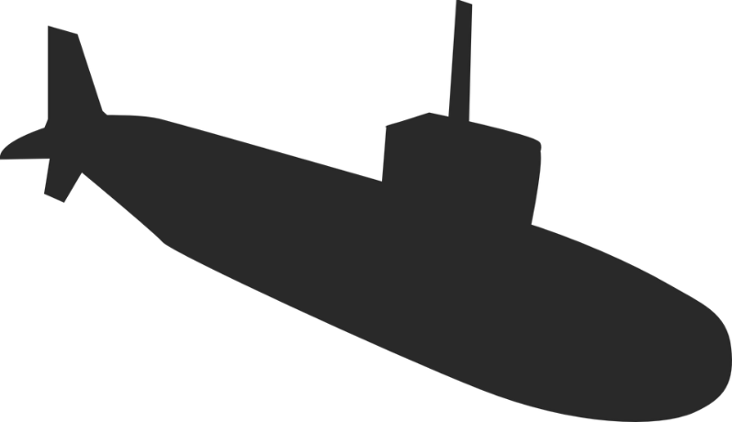
HOW MANY NUCLEAR WEAPONS DOES THE US HAVE?
Notes:
Question for the audience: How many nuclear weapons do you think the US has today? Get a few answers
The US has nearly 6,500 nuclear weapons
Nearly 1000 of those are on hair-trigger alert, meaning they can be launched within minutes.
The President also has sole authority to launch them, and doesn’t need to consult anyone else in the military or government.

Slide 3
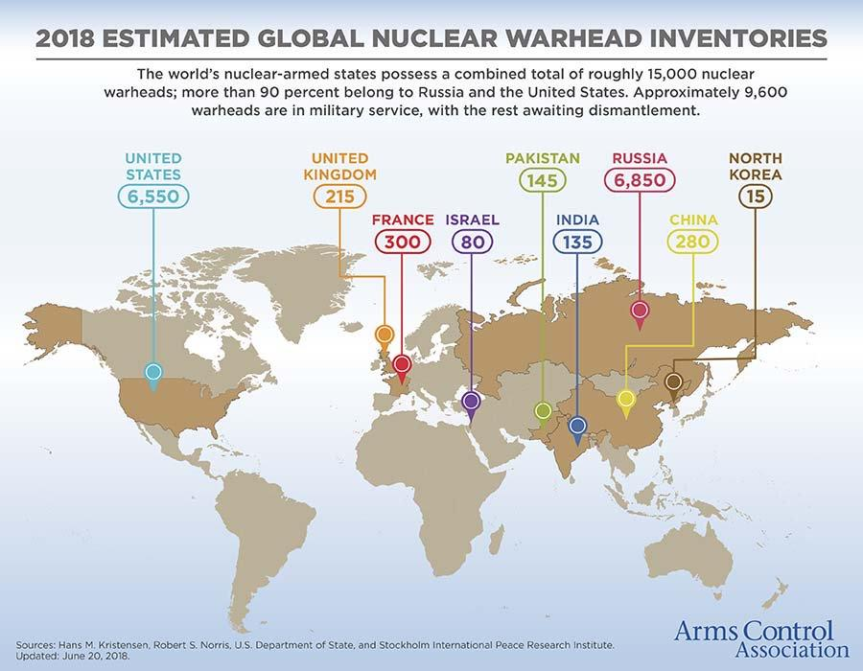
Notes:
This is often thought of as a Cold War era issue, but it is just as important as it was during that time.
Unfortunately, it has largely flown under the radar since 1991.
The world still has nearly 15,000 nuclear weapons, in the hands of 9 countries.
The US and Russia have over 90% of those
The weapons we have today are up to 100 times more powerful than those used in 1945

Slide 4
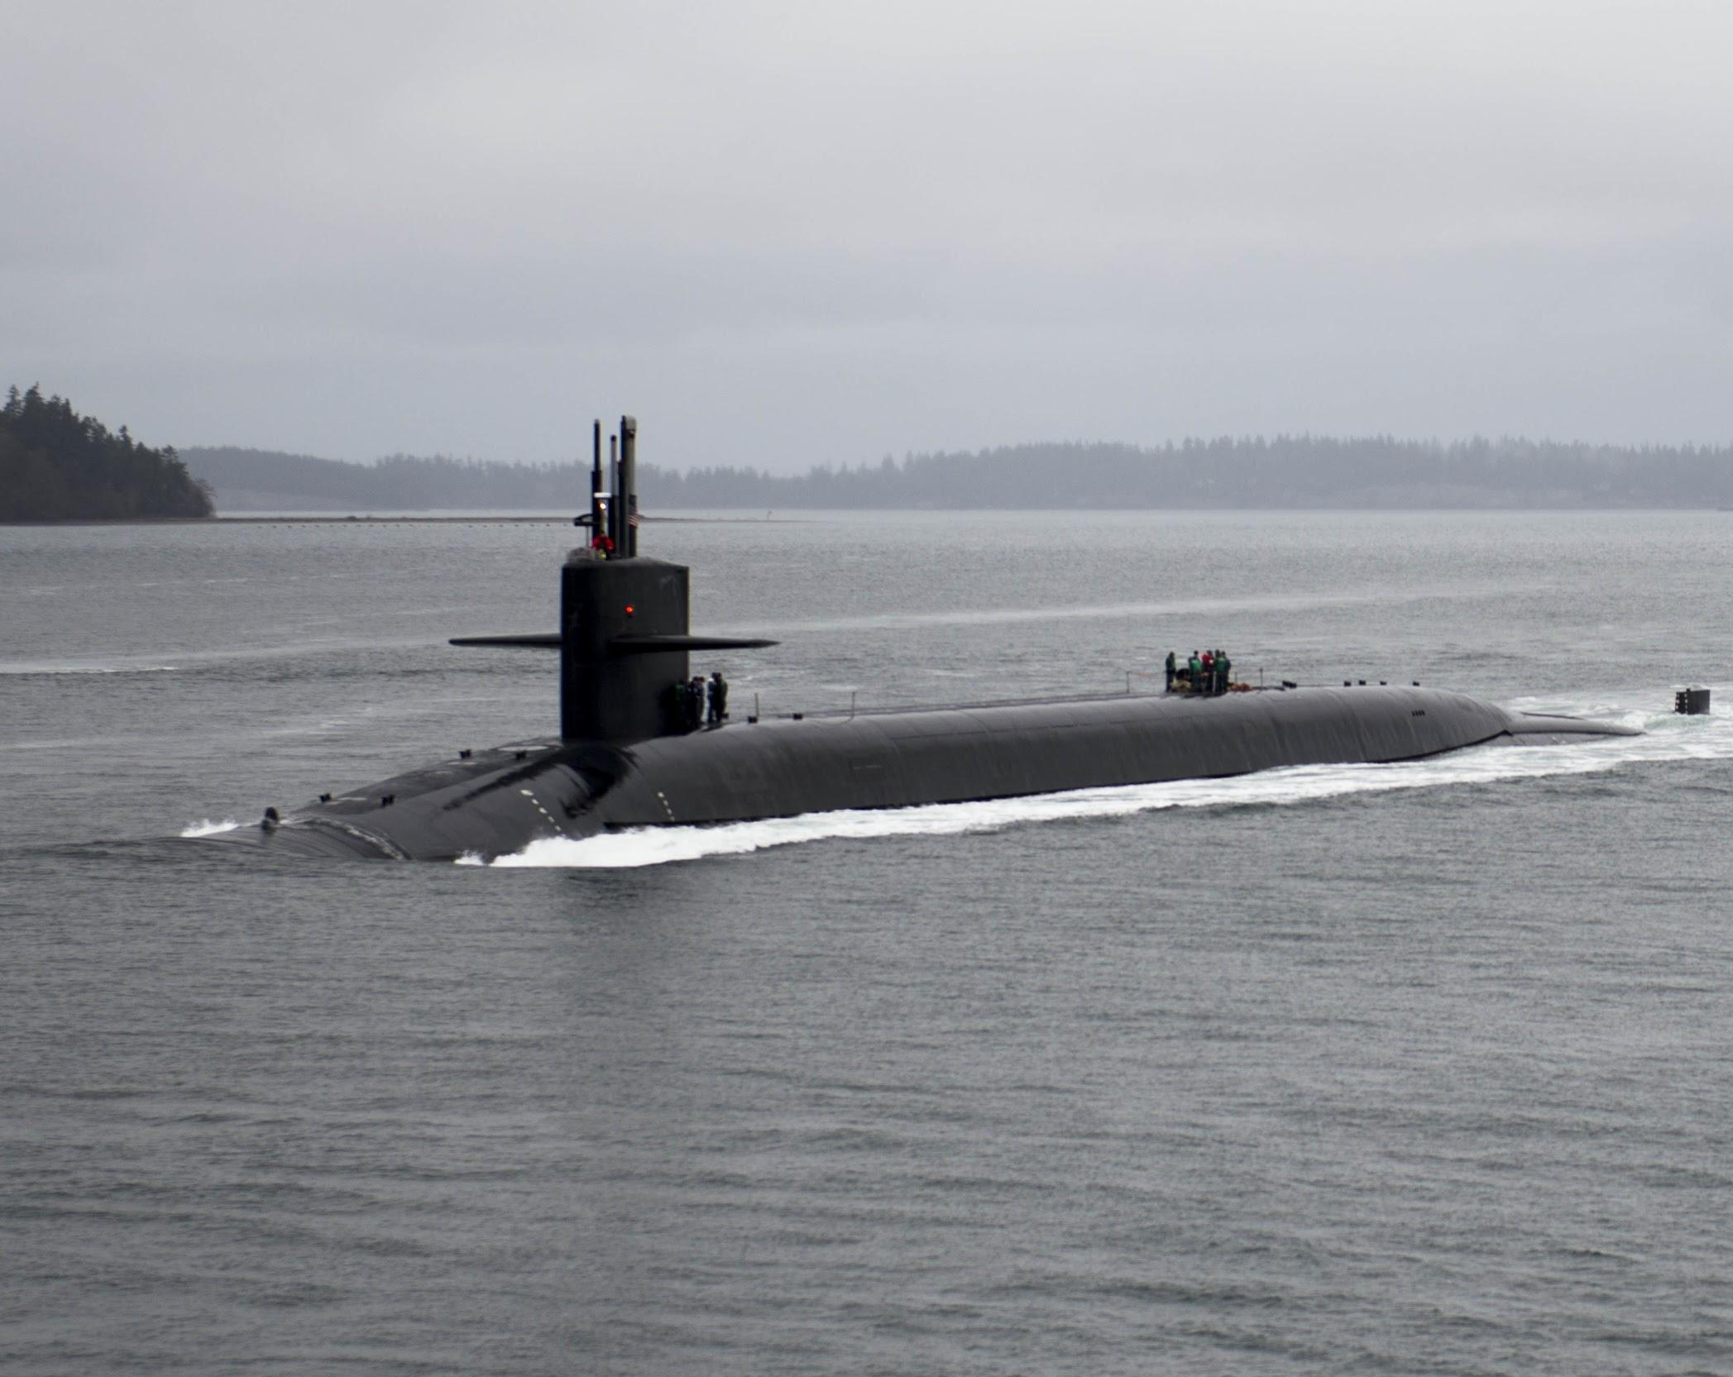
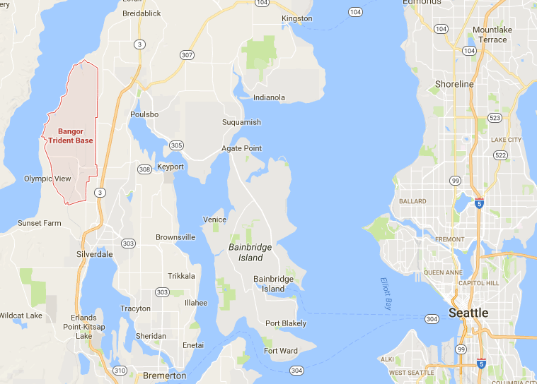
Notes:
Here in WA state, we have the largest concentration of nuclear weapons in the US
If WA were a country, we would be the third largest nuclear weapons country in the world
these weapons are just 20 miles from where we’re sitting today

Slide 5
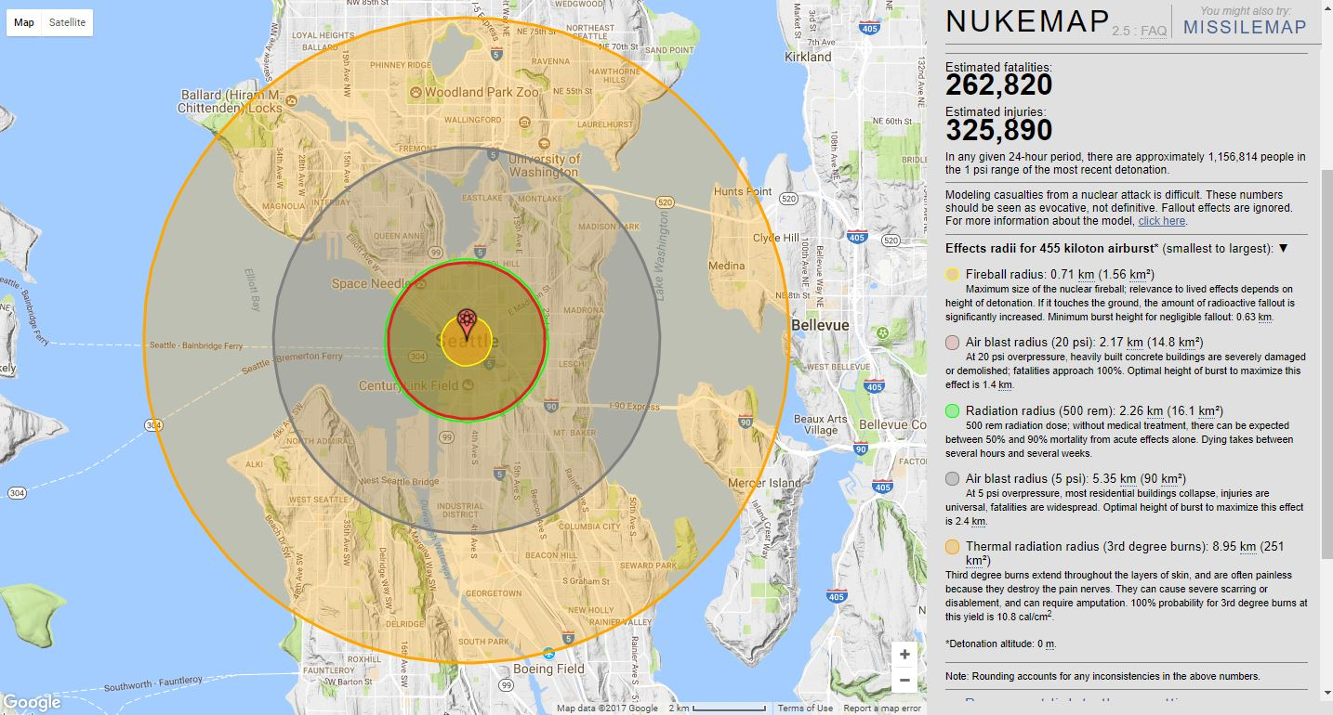
Notes:
This image shows the effect of a 455 Kiloton bomb aerial burst on Seattle - the same size as the warheads on the submarines in WA state
circles represent different effects from the bomb
1st (yellow) circle: fireball at center of explosion - hotter than surface of the sun, everything is vaporized
2nd (red) circle: no survivors, most structures are destroyed
gray/blue circle: injuries are universal, most residential buildings collapse. Because of blast, no medical system to address needs of survivors
orange circle - nearly universal 3rd degree burns
this is one image of what we will lose
Nukemap: https://bit.ly/2MgAIKG
Another simulator: https://bit.ly/2ltOGNC

Slide 6
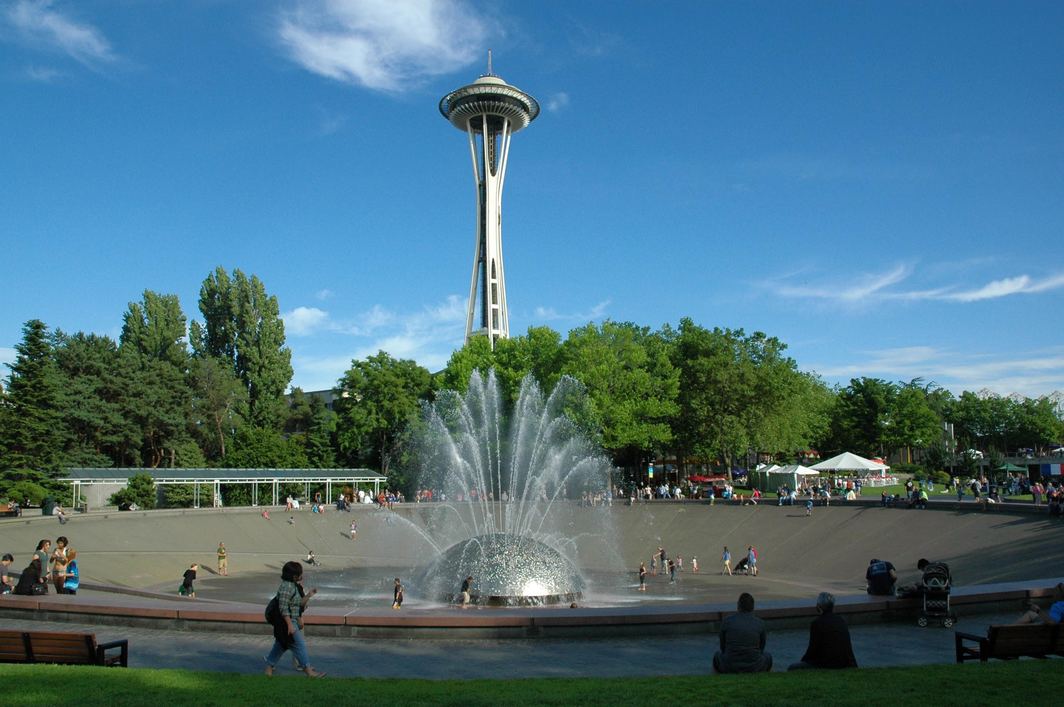
Notes:
This is an example of what we would lose

Slide 7
HUMANITARIAN CONCERN
AP Photo/Eugene Hoshiko
HIROSHIMA AND NAGASAKI, 1945
Notes:
This image shows a survivor, or hibakusha, from Nagasaki, holding a picture of himself taken in 1945
Most of us are familiar with images from Hiroshima and Nagasaki after the bombing, in which over 200,000 people died.
But it is important that we understand that the destruction of these two cities, as horrible as it was, does not begin to approximate what is likely to happen the next time nuclear weapons are used.
Nuclear war today will not involve just one or two bombs, and today, our nuclear weapons are up to hundreds of times more powerful than those used in Hiroshima.
There are also now 9 countries with nuclear weapons, not 2, and more than one or two cities would be targeted
Even in a “limited” nuclear conflict, we could face extinction
For personal stories of hibakusha living in Seattle, see these interviews from the Seattle Hiroshima Club: http://seahiro.org/culture/interviews/

Slide 8
Notes:
In the event of a nuclear war, we risk extinction as a species
Report: Nuclear Famine: 2 Billion People At Risk?

Slide 9
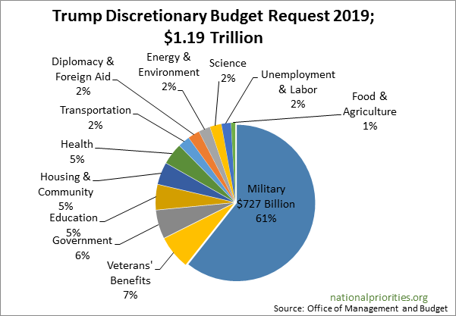
TRUMP’S 2019 BUDGET REQUEST
Notes:
Here’s a graph of how the government prioritizes our spending. This is Trump’s budget proposal for 2019.
only discretionary spending, does not include mandatory spending like social security, medicare and Medicaid, spending on the national debt, etc. It’s the money that our government can choose how to spend.
Over 60% of spending is set to go to military, nearly everything else is getting cut
If people ask: Nuclear weapons are roughly 4% of military budget, but that is now set to increase to 7%

Slide 10
SPENDING ON NUCLEAR WEAPONS
$400 billion over the next 10 years,
$1.7 trillion over 30 years
$4.6 million every hour, for the next 30 years
WHAT COULD WE SPEND THAT MONEY ON INSTEAD?
Notes:
So what do we specifically spend on nuclear weapons?
The Congressional Budget Office estimates that we’re going to spend $400 billion over the next 10 years on nuclear weapons
That’s roughly $1.7 trillion over 30 years, with inflation
That’s a huge number, and it’s hard to visualize a trillion dollars, so I like to break it down
If you calculate it out, $400 billion comes to $4.6 million, every single hour, for 10 years
What else could we do with that money? How many of the issues that people talked about before could be solved with that kind of funding?
It’s important to know that this is not just money for maintaining our current nuclear weapons; it’s going towards rebuilding every part of nuclear weapons “triad” – the submarines, air bombers, and ground launched missiles. We are making new nuclear weapons.
This is provoking a new arms race, because it’s forcing other nuclear weapons states to keep up.

Slide 11
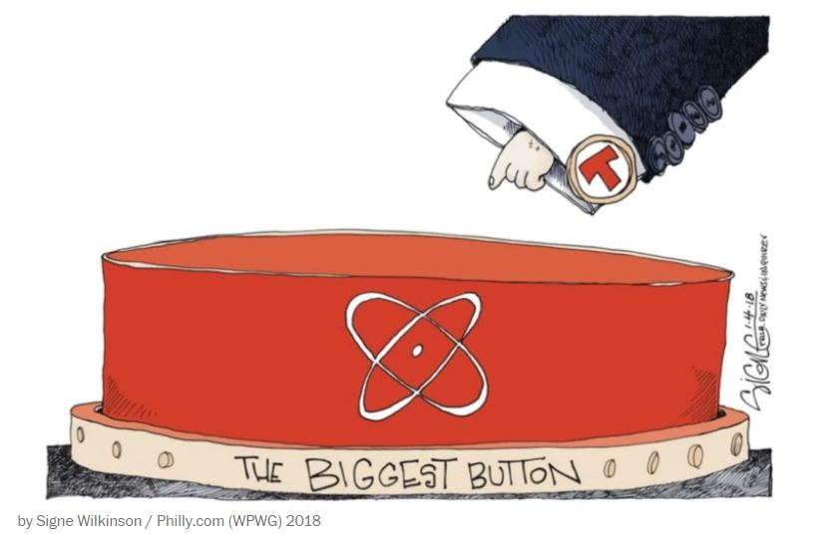
NUCLEAR POLICY AND OPPORTUNITIES
Treaty on the Prohibition of Nuclear Weapons
Nuclear Posture Review
First use legislation
Restricting first use of nuclear weapons
No first use
Restricting military violence
in North Korea
Notes:
In 2017, the UN passed the Treaty on the Prohibition of Nuclear Weapons, which makes it illegal for signatory countries to possess, make, or use nuclear weapons. This is a huge step towards a world without nuclear weapons. The US did not vote to support the treaty and is unlikely to ratify it.
Instead, the US is moving in the opposite direction. This Administration released a new “nuclear posture review” - a statement of the role of nuclear weapons in our military. It calls for not just the “modernization” program we talked about earlier, but also new, more dangerous nuclear weapons, expanding the situations in which we might use nuclear weapons, and drastically reducing the role of diplomacy and disarmament. This is a dangerous direction that we’re now moving in.
There has been legislation introduced to reduce the risks of nuclear weapons, and we strongly support these bills:
The Restricting First Use of Nuclear Weapons Act, which would require Congress to authorize any “first-use” of nuclear weapons
Going even further, a bill introduced by our own Rep. Adam Smith to enact a “no first use” policy, so that we would never be the first country to use nuclear weapons
And in response to the crisis in North Korea, legislation in the House + Senate to restrict military violence in North Korea without Congressional approval

