Slide 1
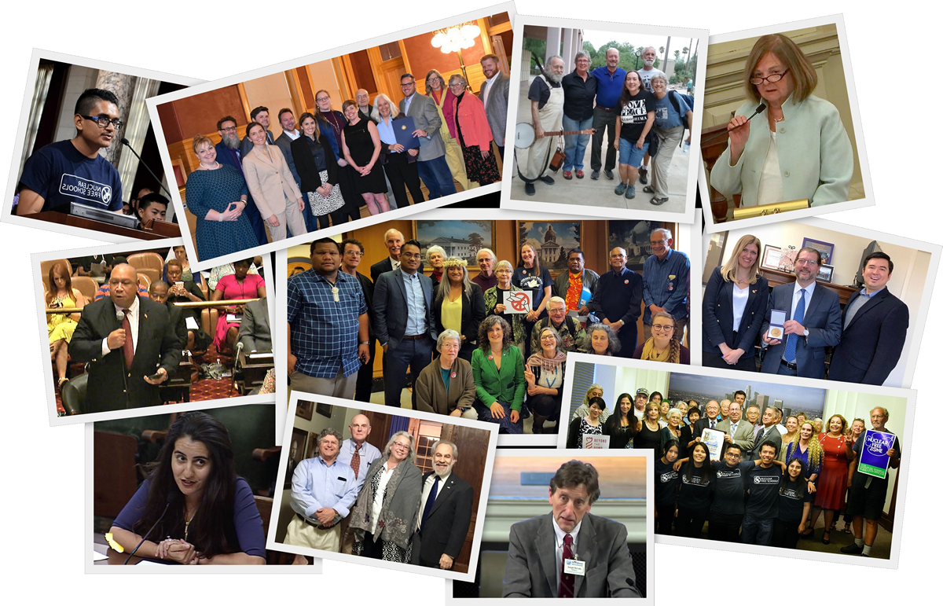
BACK FROM THE BRINK:
Organizing Locally to
Prevent Nuclear War
A PRESENTATION
FOR COMMUNITIES
Notes:
Thank you all for joining us and making time to learn about this important campaign, called “Back From the Brink: Organizing Locally to Prevent Nuclear War.”

Slide 2
PULLING BACK FROM THE BRINK
Notes:
It’s so important that you are with us today, given recent events that have heightened our concerns, such as:
US withdrawal from the Iranian nuclear deal resulting in increasingly confrontational actions by both the US and Iran;
the US and Russia walking away from the 1987 Intermediate Nuclear Forces Treaty;
no real progress in dealing with North Korea’s nuclear program;
an increasingly tense stand-off between nuclear armed India and Pakistan over the status of Kashmir;
and U.S. plans to develop provocative new low-yield warheads and nuclear-armed, sea-launched cruise missiles.
In 2018, the Bulletin of Atomic Scientists changed the time on its allegorical Doomsday Clock to two minutes before midnight, the closest it has ever been since 1953 during the Cold War. We need to act now.

Slide 3
WHAT IS “BACK FROM THE BRINK”?
BACK FROM THE BRINK: The Call to Prevent Nuclear War
is a national grassroots initiative seeking
to fundamentally change U.S. nuclear weapons policy.
Notes:
BACK FROM THE BRINK: The Call to Prevent Nuclear War is a national grassroots initiative seeking to fundamentally change U.S. nuclear weapons policy.

Slide 4
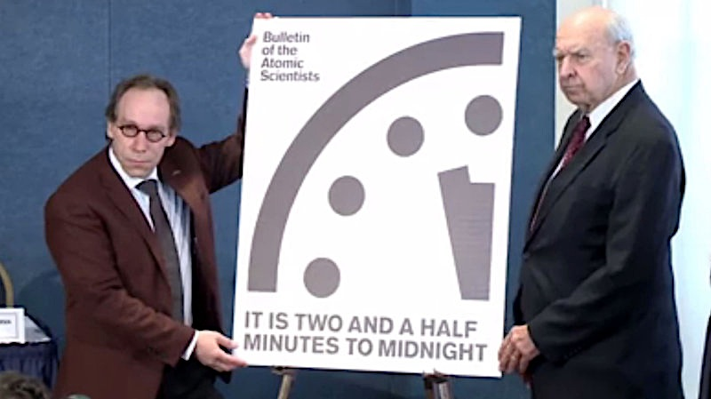
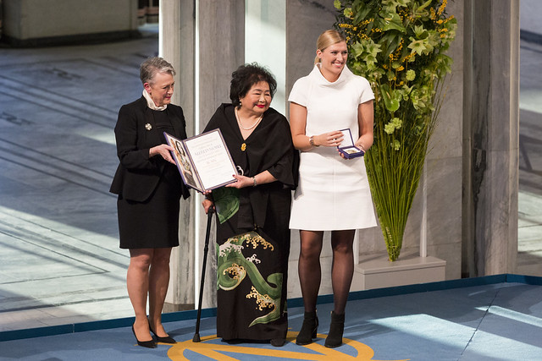
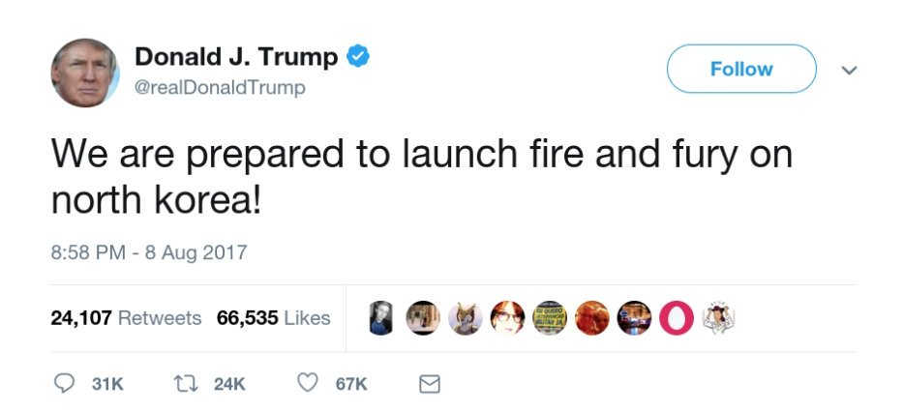
HOW DID BACK FROM THE BRINK BEGIN?
2017
Notes:
Back from the Brink began in 2017 out of conversations between Physicians for Social Responsibility and the Union of Concerned Scientists, who were looking for a vehicle to mobilize people locally that would also have national impact. An important factor was to create something that could be owned by everyone, not by one particular group or individual.
The final text of the five point policy platform that is the core of “Back from the Brink: The Call to Prevent Nuclear War” was agreed upon in late 2017, after the Nobel Peace Prize was awarded to the International Campaign to Abolish Nuclear weapons (ICAN) for its role in advocating for adoption of the Treaty on Prohibition of Nuclear Weapons.
In early 2018, Back from the Brink strategy was developed by representatives from UCS and PSR, along with Soka Gakkai International-USA, the United Church of Christ, and the Nuclear Age Peace Foundation.

Slide 5
1f4a7f
RENOUNCE FIRST USE
WE CALL ON THE UNITED STATES TO LEAD A GLOBAL EFFORT TO PREVENT NUCLEAR WAR.
END SOLE PRESIDENTIAL AUTHORITY
END HAIR-TRIGGER ALERT
CANCEL ENHANCED WEAPONS
PURSUE GLOBAL ELIMINATION
Notes:
The first 4 policy points are interim steps to lower nuclear danger that most anti-nuclear advocates agree are essential. We are calling on the United States to:
renounce the option of using nuclear weapons first;
end the sole, unchecked authority of any president to launch a nuclear attack;
take U.S. nuclear weapons off hair-trigger alert;
cancel the plan to replace its entire arsenal with enhanced weapons; and
The language of the 5th policy point was crafted carefully to make our ultimate goal clear, while creating room for legislators and policy makers to embrace language they felt comfortable with. It says: “actively pursue a verifiable agreement among nuclear-armed states to eliminate their nuclear arsenals”.

Slide 6
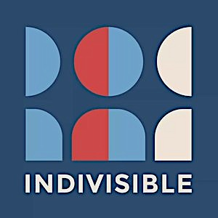
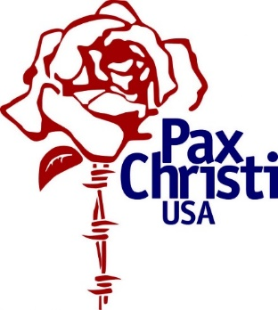
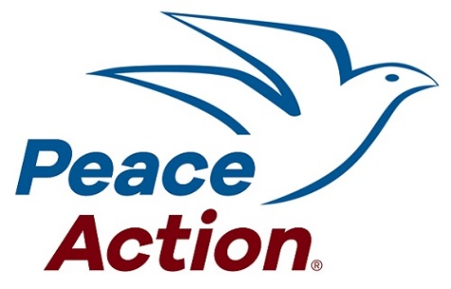
SOME ENDORSING ORGANIZATIONS
Health
Policy
Faith
Enviro
Peace
Notes:
Since then, Back from the Brink has been successfully engaging health professionals, the faith community, environmentalists, academics, policy makers, and peace and social justice advocates across the country.
To date, Back from the Brink has secured over 280 organizational endorsements. Here are logos for some of those groups. Organizations and individuals can endorse Back from the Brink through its website - www.preventnuclearwar.org. There will be a slide with more information about the website and other ways to keep in touch with Back from the Brink at the end of the presentation.

Slide 7
BACK FROM THE BRINK IN ACTION
Notes:
Back from the Brink’s strategy is to secure a growing number of national and local endorsements of Back from the Brink’s five point policy platform. With those local endorsements in hand, Back from the Brink advocates are going to city councils and state legislatures, getting Back from the Brink resolutions introduced and adopted. Through this process, we’re able to provide much-needed education to the public and elected officials about the danger posed by nuclear weapons and engage them in advocacy for effective policy solutions.
All of this local public support is intended to powerfully demonstrate to Representatives and Senators, and Presidential candidates, that we need fundamental changes in US nuclear policy. Members of Congress are more likely to take action when they realize that an issue is important to a large number of their constituents. Most Back from the Brink resolutions contain language indicating that the municipality that adopted it will send a copy of their resolution to their congressional delegation and the President. Communities are also able to use Back from the Brink endorsements and resolutions to demonstrate to their representatives in Congress that organizations, towns and cities in their district want to see action on our five-point policy platform.
To date 35 Back from the Brink resolutions have been adopted, in large cities and small towns across the country. Six legislative state bodies have also adopted Back from the Brink resolutions.

Slide 8
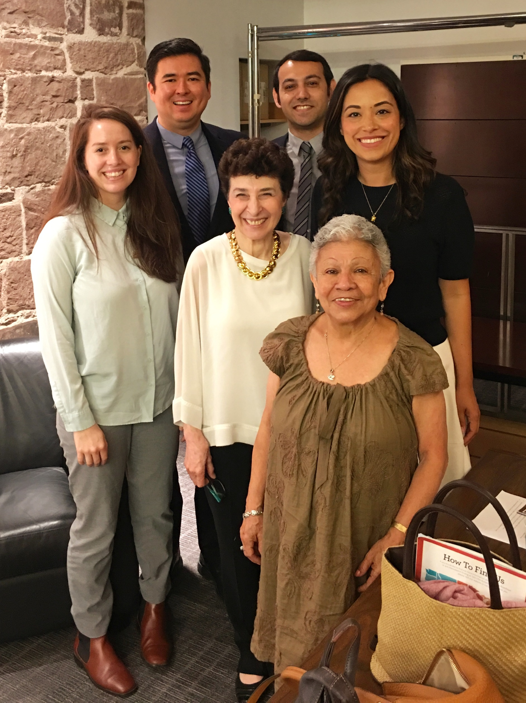
1f4a7f
GETTING
STARTED
IN YOUR HOMETOWN
Visit the Back from the Brink website at www.preventnuclearwar.org
Community members met with New York City Councilmember Carlina Rivera on July 15, 2019 to discuss Back from the Brink.
Notes:
First, make sure to visit the Back from the Brink website at www.preventnuclearwar.org and familiarize yourself with the information and materials there.

Slide 9
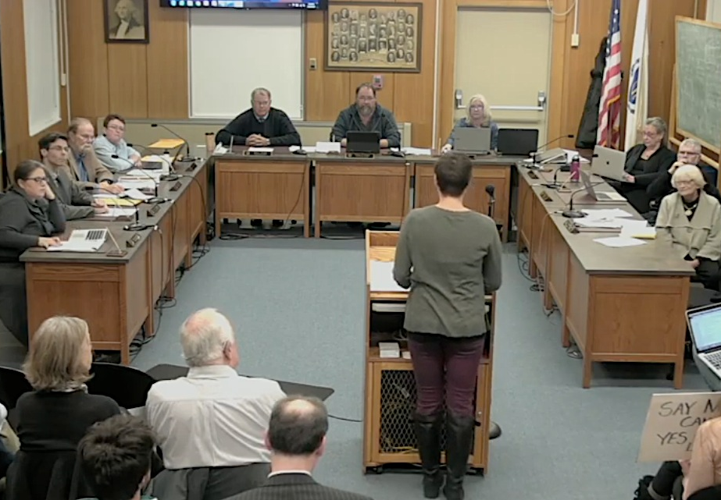
“RESOLUTION”
ESTABLISH
GOALS & DESIRED OUTCOMES
Who do you want to engage?
What terminology is used for statements of support?
Northampton, MA – Dec. 7, 2017
Notes:
First, you’ll need to determine which elected official or municipal legislative body (such as a town or city council or county board) that you want to engage. Familiarize yourself with the terminology and process for that municipality's statements of support. Many refer to such statements as resolutions. Here is a photo from the first Back from the Brink resolution passed in the U.S., which was in Northampton, MA in Dec. 2017.

Slide 10
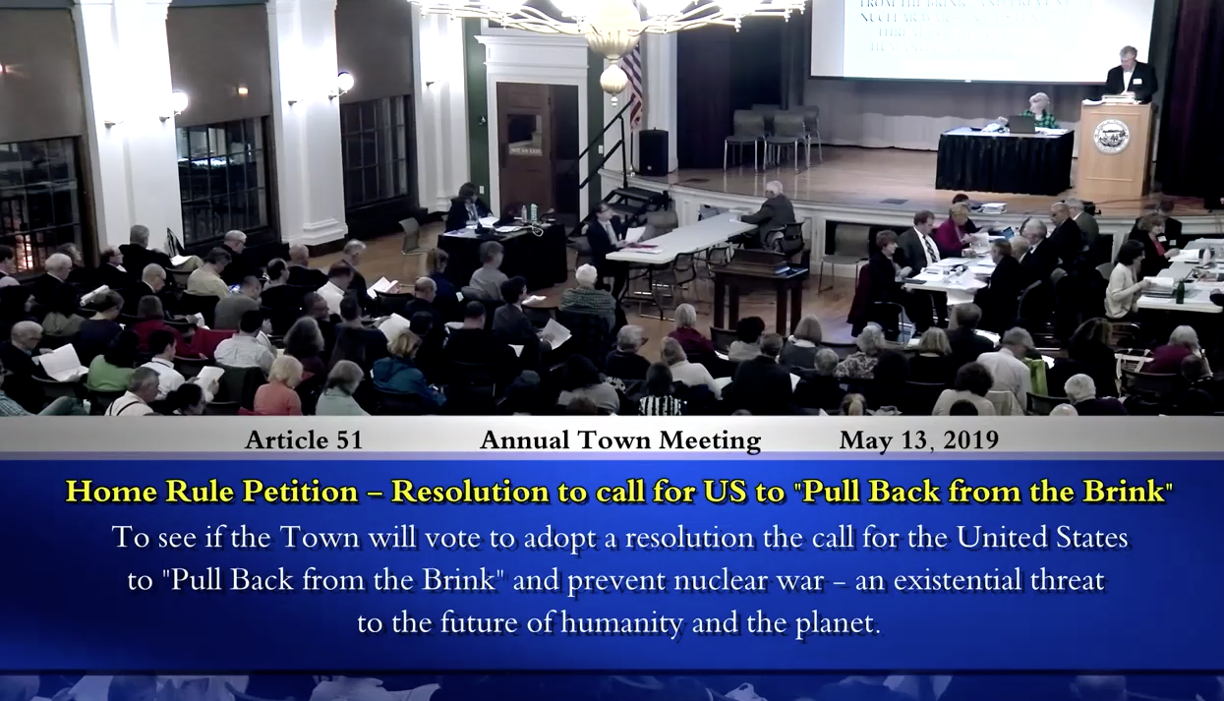
CITIZEN PETITION FOR TOWN MEETING
Notes:
In some areas, the entire town gets to vote, as you can see in this screenshot from a town meeting in Needham, MA. For this town, a resolution can be introduced by residents if they get enough other people in the town to first sign a petition in support of it.

Slide 11
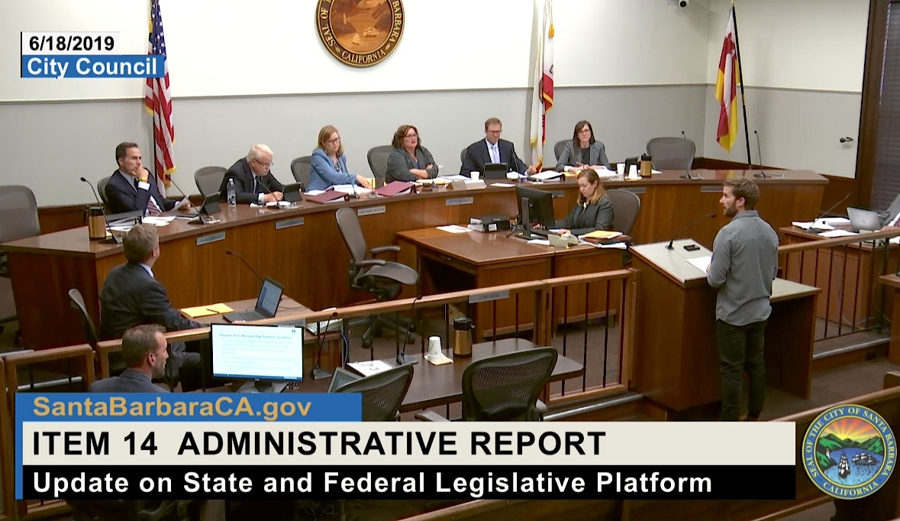
TOWN MEETING –PETITION FOR RESOLUTION
LEGISLATIVE PLATFORM
June 18, 2019
Notes:
Some cities might not do resolutions but would incorporate Back from the Brink’s policy points in their legislative platform, and that’s what happened in Santa Barbara, CA.

Slide 12
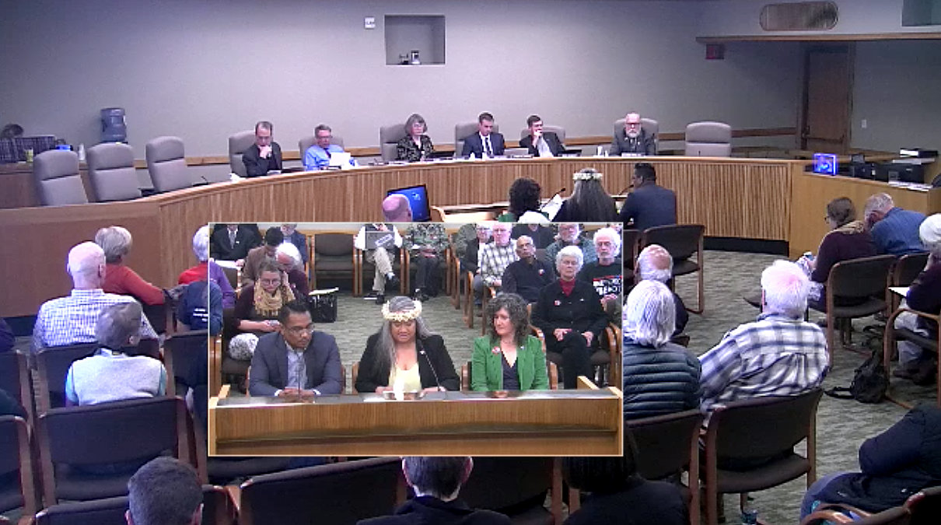
TOWN MEETING –PETITION FOR RESOLUTION
“MEMORIAL”
Oregon Senate Rules Committee hearing for Senate Joint Memorial 5 – April 3, 2019
Notes:
In Oregon, statements of support are referred to as memorials. Here you can see a committee hearing with testimony from a PSR representative and members of the Marshallese community whose homeland has been so grievously impacted by U.S. nuclear weapons tests.

Slide 13
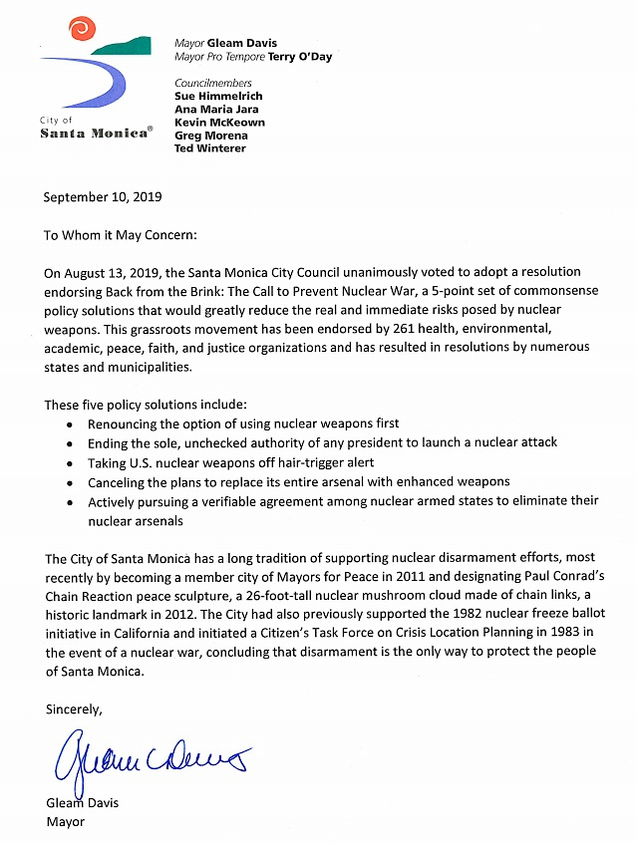
TOWN MEETING –PETITION FOR RESOLUTION
STATEMENT OF SUPPORT
Notes:
Some municipalities may simply want to provide a statement of support. In Santa Monica, the council voted unanimously to support Back from the Brink, but instead of a traditional resolution they provided a letter indicating their support.

Slide 14
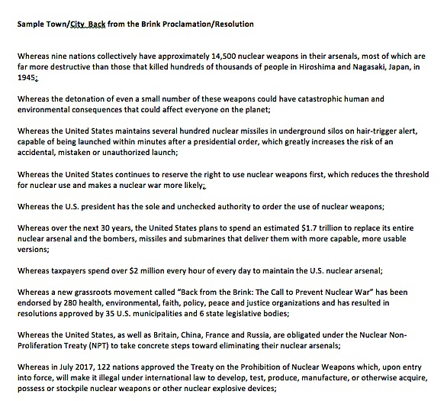
SAMPLE
RESOLUTION
Download from website
Include 5 policy points
Indicate resolution will be sent to Congress
Notes:
You can find a sample resolution on the Back from the Brink website that you can customize to make more relevant for your town or city. Of course you’ll want to be sure to include our five policy points and that the municipality will send the resolution to your area’s Congressional delegation.

Slide 15
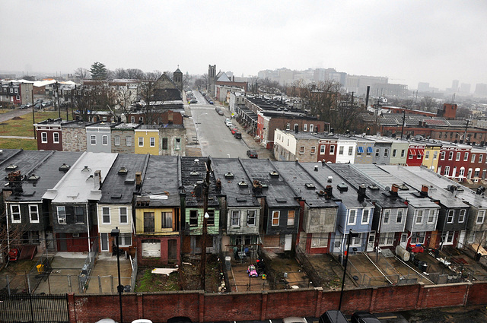
MAKE IT PERSONAL
Customize the “Whereas” statements to your city or town.
A statement related to nuclear weapons costs to taxpayers in your municipality may be especially powerful.
Photo: U.S. Forest Service
Despite struggling with serious problems including poverty and racism, the city of Baltimore, Maryland spent $105 million dollars in taxes for the nuclear weapons complex in 2018.
Notes:
Customize the “Whereas” statements to your city or town. An especially powerful statement may be related to nuclear weapons costs to taxpayers in your municipality. Including this information in Baltimore’s resolution helped it become the first major city in the U.S. to adopt a Back from the Brink resolution.

Slide 16
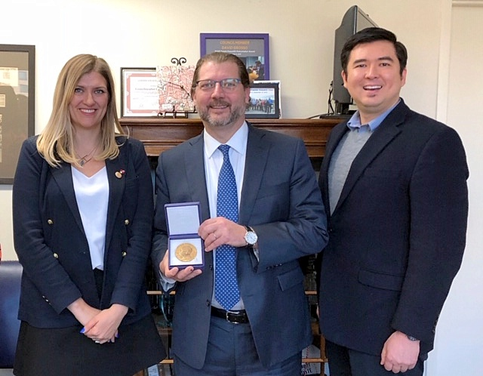
SAMPLE RESOLUTION - TPNW
Towns and cities that include a call for the U.S. to embrace the Treaty on the Prohibition of Nuclear Weapons in their resolution will be included in ICAN’s Cities Appeal.
Notes:
Towns and cities that include a call for the U.S. to embrace the Treaty on the Prohibition of Nuclear Weapons in their resolution will be included in ICAN’s Cities Appeal, which is a movement to gain support for the Treaty from cities throughout the world that was inspired by Back from the Brink. Washington DC is one city that did just that, and here you can see DC Councilmember David Gross with Danny Hall from Soka-Gakkai and ICAN’s Beatrice Fihn.

Slide 17
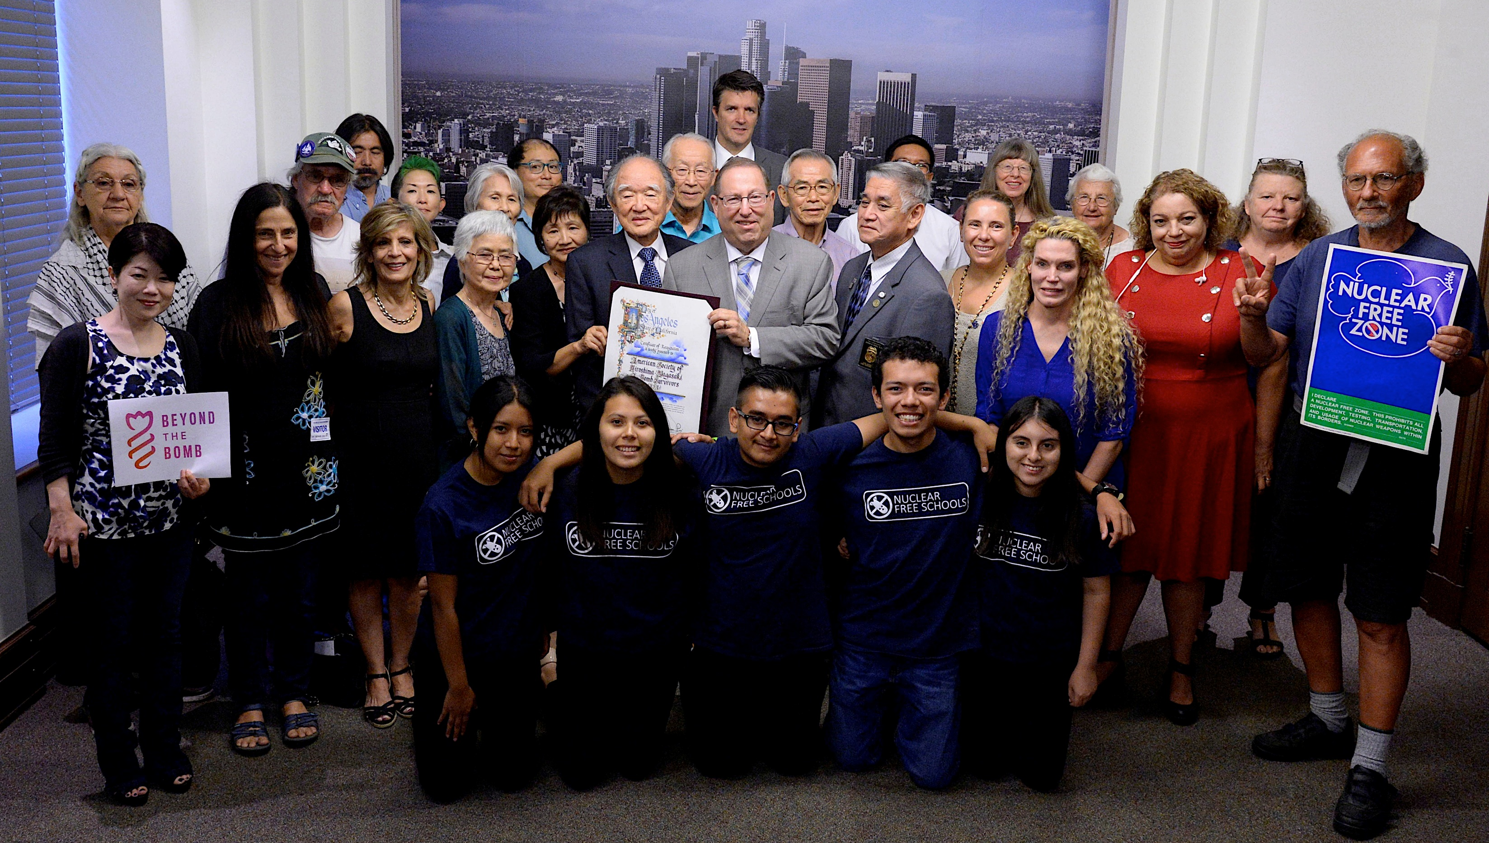
WORK WITH ALLIES – BUILD A COALITION
Notes:
Working with allies is critical to successful Back from the Brink efforts. Here’s a photo of a coalition in Los Angeles, which included hibakusha (atomic bomb survivors), doctors, students, veterans, members of the faith community, environmentalists and justice groups. Los Angeles adopted a Back from the Brink resolution in August 2018.

Slide 18
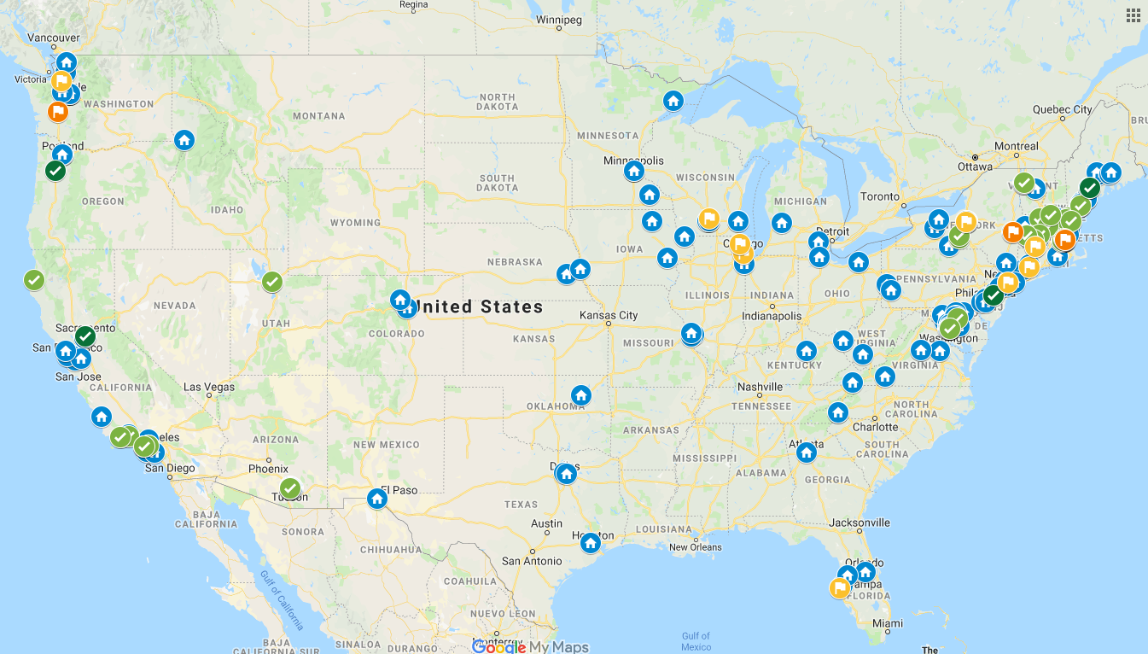
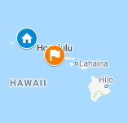
FINDING ALLIES
Reach out to allies before contacting elected officials
Review website for groups who’ve endorsed
Ask local groups to endorse
Ask us for help!
INFO@PREVENTNUCLEARWAR.ORG
Notes:
Identify and reach out to partners and seek their involvement and ideas BEFORE approaching any elected officials.
You can ask local organizations to endorse Back from the Brink. In addition to advocacy groups consider asking schools, churches, professional boards or societies, or civic groups.
You can also review the list of organizations who’ve endorsed Back from the Brink on our website. Some, like PSR, UCS, PeaceAction, Veterans for Peace may have a local chapter near you, and the faith community has expressed strong support for Back from the Brink from every denomination.
Contact Back from the Brink at info@preventnuclearwar.org and they can help connect you to others in your area. This map indicates all of the groups who’ve endorsed Back from the Brink, cities where resolutions have been adopted, and cities where resolutions are in process. It’s also on the website’s Advocacy Tools pages.

Slide 19
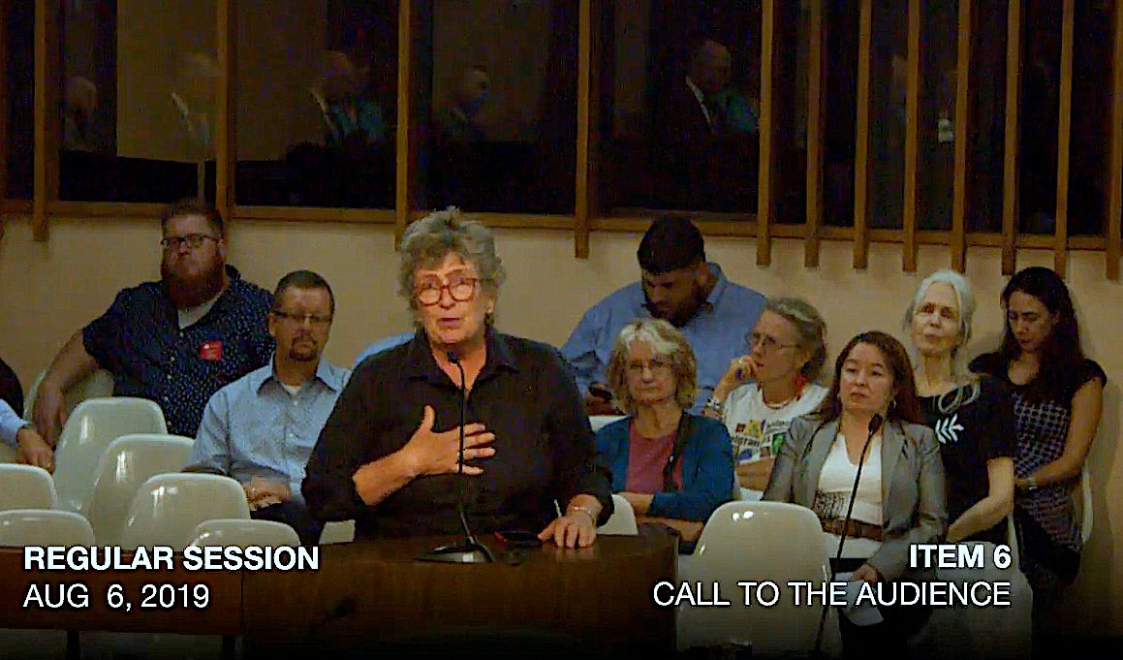
LEARN LOCAL PROCESS & RULES
Ask allies for help
Find a sponsor
Be persistent
Determine strategy with sponsor and allies
Tucson, AZ City Council
Notes:
Every legislative body has different rules for how they operate, which you can research online or call appropriate staff members, such as city clerks or staff for your representative.
In most cases you’ll need a representative to sponsor or introduce the resolution. If you have a relationship with someone on the legislative body, ask that person for advice. You can also ask local partners if they have helpful relationships or recommendations.
Be persistent. Don’t assume that a lack of response indicates an unwillingness to consider a resolution, it may simply be that the person to whom you’ve reached out is busy.

Slide 20
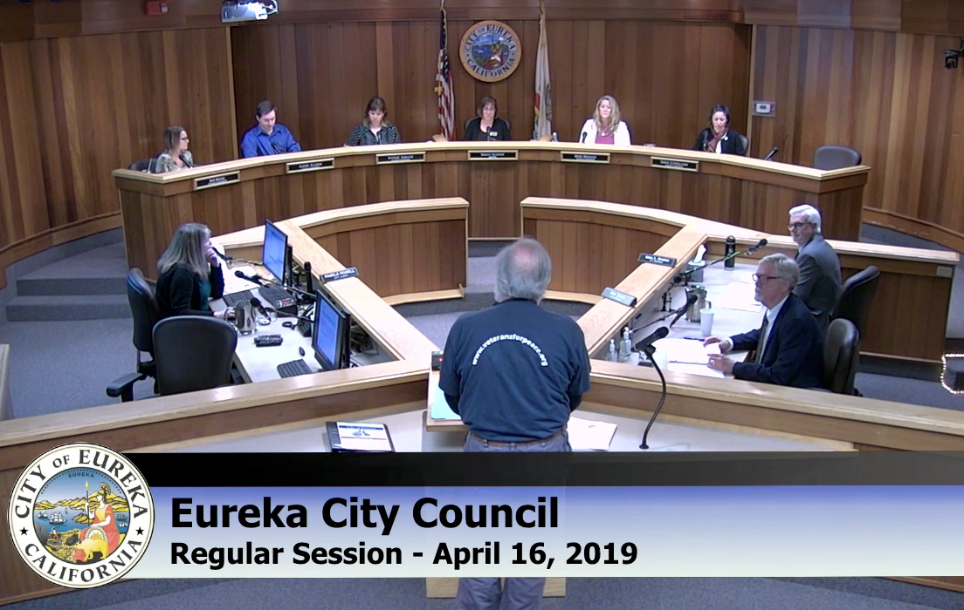
LEARN LOCAL PROCESS & RULES
Ask constituents to call, email, visit
Learn rules for public testimony
Notes:
When you do get a sponsor, that person will have invaluable advice on how to proceed. He or she may also have helpful advice on which elected officials need extra attention from you, such as calls or a visit, in order to gain a supportive vote.
When your resolution is introduced, you’ll want to marshal support by asking residents and partners to submit letters, make calls, and to testify at meetings where the resolution will be up for a vote.
Learn the rules for public testimony, such as when the testimony is heard how community members sign up to speak, and how much time each person is allotted for public testimony.

Slide 21
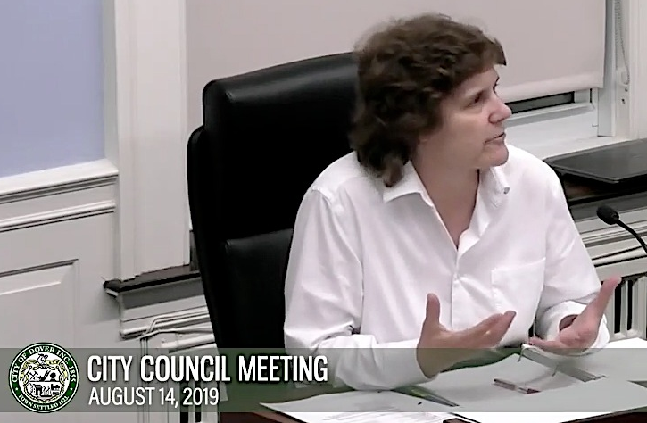
COMMON OBJECTIONS
“This isn’t city/town business.”
“It’s just a resolution.”
“We’re not experts.”
“I think we can walk and chew gum at the same time. I agree that we are a fiduciary body and that we’re supposed to be taking care of the city. But there won't be a city to take care of if we don’t find a way to make the state, the federal government listen to the citizens.”
Deborah Thibodeaux, Dover City Councilmember
Notes:
Some common objections that city councilmember have had to Back from the Brink resolutions focus on whether or not a municipality should weigh in on nuclear weapons, the value of a resolution, or that they’re not experts. It’s been really inspiring to see the strong responses by other councilmembers, who often point out that
the resolution will be sent to Congress,
that their job is to represent and amplify their constituents’ concerns,
that other cities are taking this on and there is power in numbers, and
that credible groups have provided them with more than enough information to make a decision.
Some have pointed out that cities often lead on issues before the state or federal government takes action. Here is one example.
“I think we can walk and chew gum at the same time. I agree that we are a fiduciary body and that we’re supposed to be taking care of the city. But there won't be a city to take care of if we don’t find a way to make the state, the federal government listen to the citizens.”

Slide 22
BACK FROM THE BRINK IN NEW HAMPSHIRE
“This resolution gives us the ability to deliver our message to our Congressionals, and I believe it also provides a tool and it gives us an ability to deliver a message to those people who are going to be marching through our state over the next four or five months as primary season kicks into high gear, that there’s an opinion that this board has and we share that opinion with a variety of cities and towns. Durham, Portsmouth, Exeter, Warner, it really is quite a wide variation in cities and towns that have taken this on.”
Dennis Shanahan, Dover City Councilmember
Notes:
Back from the Brink has additional importance in New Hampshire, the first state in the nation to hold its Presidential primary election, as noted by Dover City Councilmember Dennis Shanahan.
“This resolution gives us the ability to deliver our message to Congressionals and I believe it gives us an ability to deliver a message to these people who are going to be marching through our state over the next four to five months as primary season kicks in to high gear that there’s an opinion that this board has and we share that opinion with a variety of cities and towns: Durham, Portsmouth, Exeter, Warner, it is really a wide variation in cities and towns that have taken this on.”

Slide 23
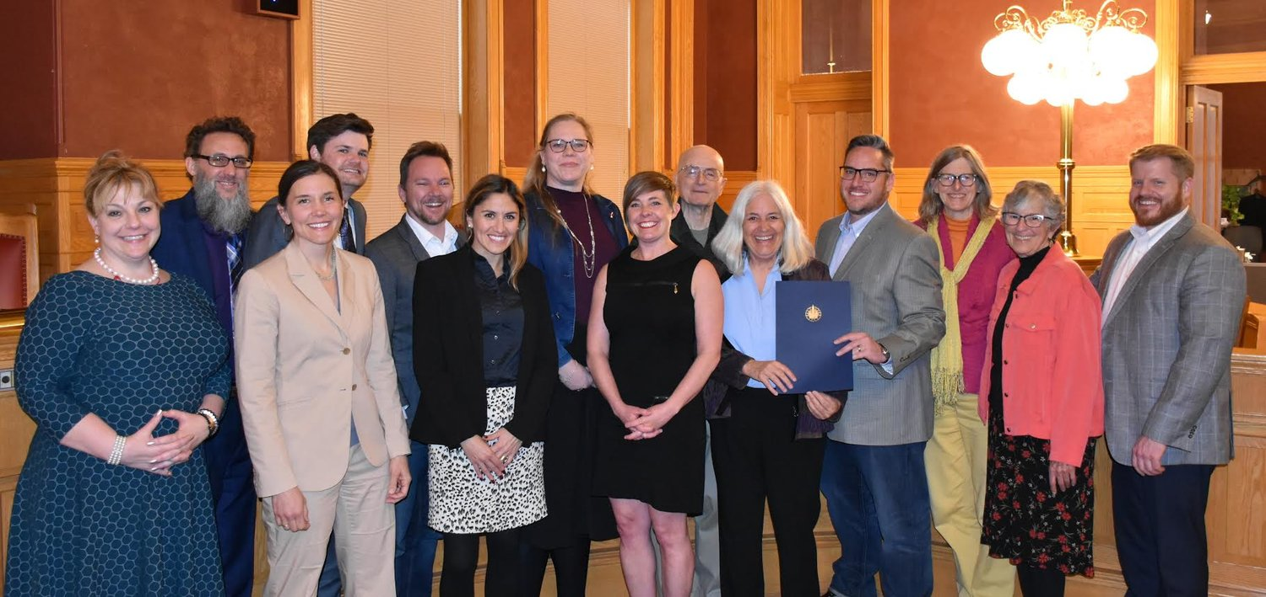
SHARE YOUR PROGRESS
Tell Back from the Brink about your resolution
Take photos and share them
Write press release or summary
Thank your elected officials
Salt Lake City, Utah – Community and City Councilmembers – April 2, 2019
Notes:
Let Back from the Brink organizers know when your resolution has been introduced and it’s progress along the way so they can help support you and amplify your success. Take photos during and after relevant meetings, post them on social media and send them to Back from the Brink to share them too. Write a press release or summary of your experience and sent that to local media and share that with the Back from the Brink as well. Finally, remember to thank the elected officials who championed your resolution and the legislative body that adopted it.

Slide 24
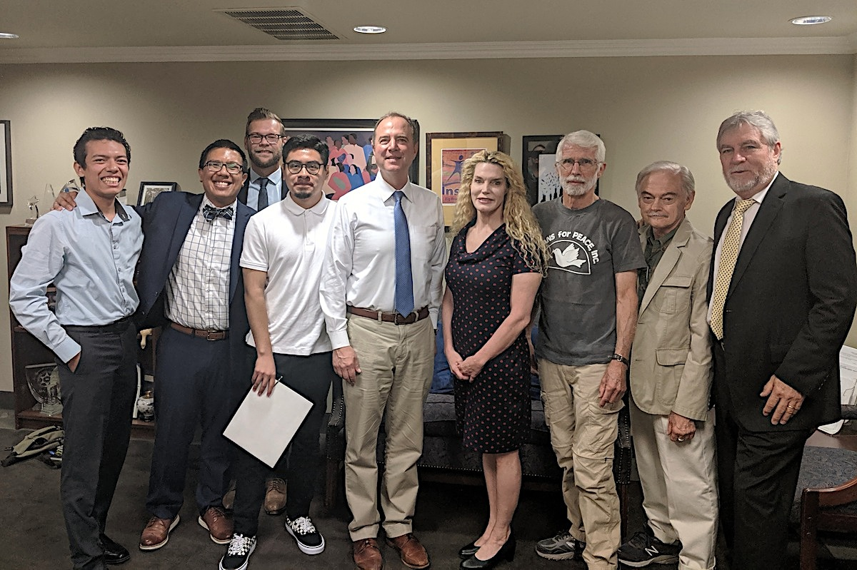
HELP BUILD THE MOVEMENT
Consider more resolutions
Visit your Congressional representatives
Renouncing First Use (H.R. 921 and S. 272)
Restricting Presidential Authority (H.R. 669 and S. 200)
All five Back from the Brink policy points are included in House Resolution 302
Notes:
Once you’ve had time to celebrate and rest, consider approaching another nearby town or city, or visiting with your Congressional representatives to let them know about the organizations and cities in their district that support Back from the Brink’s five-point policy platform. Two of those policies - Renouncing First Use (H.R. 921 and S. 272) and Restricting Presidential Authority (H.R. 669 and S. 200) are currently in legislation before Congress, and all five of our policy points are included in House Resolution 302.

Slide 25
QUESTIONS & ANSWERS
“We cannot afford to leave nuclear-weapons policy to the ‘experts’ in Washington or the few dedicated activists who have been keeping track of these fearsome developments over the years. We have entered a new era—one in which the use of nuclear weapons has become far more likely—and it is crucial that we all become more familiar with these matters and their deadly implications.”
-Michael T. Klare
Notes:
This slide is optional but can stay up during the Q & A of your presentation, if desired

Slide 26
STAY IN TOUCH WITH
BACK FROM THE BRINK!
WEBSITE
EMAIL
www.preventnuclearwar.org
info@preventnuclearwar.org
FACEBOOK
TWITTER
@preventnuclearwar
@backfrombrink
Notes:
Stay in touch with Back from the Brink via its website, email, or social media accounts.

